Slide 1

HathiTrust’s Past, Present and Future

Slide 2
Short- and Long-term Functional Objectives
Short-term
Page turner mechanism (and Mobile!)
Branding (overall initiative; individual libraries)
Format validation, migration and error-checking
Development of APIs that will allow partner libraries to access information and integrate it into local systems individually
Access mechanisms for persons with disabilities
Public ‘Discovery’ Interface for HathiTrust
Ability to publish virtual collections
Mechanism for direct ingest of non-Google content
Long-term
Compliance with required elements in the Trustworthy Repositories Audit and Certification (TRAC) criteria and checklist
Robust discovery mechanisms like full-text cross-repository searching
Development of an open service definition to make it possible for partner libraries to develop other secure access mechanisms and discovery tools
Support for formats beyond books and journals
Development of data mining tools for HathiTrust and use by HathiTrust of other analysis tools from other sources

Slide 3

mobile

Slide 4
Short- and Long-term Functional Objectives
Short-term
Page turner mechanism
Branding (overall initiative; individual libraries)
Format validation, migration and error-checking
Development of APIs that will allow partner libraries to access information and integrate it into local systems individually
Access mechanisms for persons with disabilities
Public ‘Discovery’ Interface for HathiTrust
Ability to publish virtual collections
Mechanism for direct ingest of non-Google content
Long-term
Compliance with required elements in the Trustworthy Repositories Audit and Certification (TRAC) criteria and checklist
Robust discovery mechanisms like full-text cross-repository searching
Development of an open service definition to make it possible for partner libraries to develop other secure access mechanisms and discovery tools
Support for formats beyond books and journals
Development of data mining tools for HathiTrust and use by HathiTrust of other analysis tools from other sources

Slide 5
Governance
Budget, Finances
Decision-making
Policy
Planning
Repository Administration
Web and application server configuration and maintenance
Security
Permissions
Logging
Repository Administration
Data management (content storage, backup, integrity checks, deletion)
Content and Metadata specifications
Disaster Recovery
Processes for ensuring content integrity
Rights Management
Copyright determination
Copyright review
Copyright information management (database)
Rightsholder permissions
Bibliographic Data Management
Entity description (record-level)
Object identification (item-level)
Collection Development
Digital
Expansion beyond books and journals (born-digital, images and maps, audio)
Selection of content (for non-Google volume ingest and pilots projects)
Print
Cloud Library (effect of digital on print)
Hardware selection and replacement
Enterprise Management
Communication and Coordination with partner institutions
Hardware configuration and maintenance
Project management
Data availability
e-Commerce
Content Access
PageTurner
Collection Builder
Large-scale Search
Bibliographic Catalog
Research Center
APIs
Quality Assurance
Quality Review
Content Certification
User Services
Usability
User support (helpdesk)
Outreach
Project website
Monthly newsletter
Papers and presentations
Communication with potential partners
Surveys, general inquiries
Repository evaluation and audit (e.g., DRAMBORA, TRAC)
Legal
Risk management (use of materials)
Partner agreements
Advocacy
Content Ingest
Transformation
Validation
Print on Demand
Financial contributions of partners
HathiTrust Functional Framework

Slide 7
A global change in the library environment
Academic print book collection already substantially duplicated in mass digitized book corpus
June 2010
Median duplication: 31%
June 2009
Median duplication: 19%
Notes:
How big is this shift likely to be and on what timeline? Over the last year we have studied the mass digitized book corpus in the context of systemwide print holdings and have found that a substantial part of the average academic library is already substantially duplicated.
This scatter chart provide a simple but effective visualization of an important pattern that this project has revealed: that is, that the risks and opportunities associated with moving collection management ‘into the cloud’ are uniformly distributed across the research library community as a whole.
[CLICK]
This is a picture of the ARL membership (a microcosm of the larger research library community) that shows the level of duplication between individual library collections and the mass digitized book collection in Hathi.
Over the course of this project, we have seen the rate of duplication between locally held print and mass digitized books increase steadily and significantly. In June of last year, an average of 20% of monographic titles in an academic library were duplicated in the Hathi repository; today that figure is about 30% (up to 40% for some institutions). [CLICK] In real terms, this means that rate of digital replication is exceeding the pace of growth in monographic acquisitions in most academic institutions. We estimate that the rate of duplication has increased by about 8% per library in the past year. Monographic acquisitions typically grow at about 2% per year in research libraries.
A very low standard deviation (variance of ~4%), and across the population very little movement outside this range: 2/3rds of ARL community falls within standard deviation.
[CLICK] We project that in a year’s time, many academic libraries are liable to find themselves “underwater,” holding a massive inventory of over-valued assets.
Library directors will be called to account and expected to respond to questions about how an increasingly redundant local print collection is serving the educational and research mission of the parent institution. We need to be preparing for a world in which just-in-time, print on demand delivery is an option for a large share of the retrospective book collection.
7

Slide 9
A global change in the library environment
Academic print book collection already substantially duplicated in mass digitized book corpus
June 2010
Median duplication: 31%
June 2009
Median duplication: 19%
Notes:
How big is this shift likely to be and on what timeline? Over the last year we have studied the mass digitized book corpus in the context of systemwide print holdings and have found that a substantial part of the average academic library is already substantially duplicated.
This scatter chart provide a simple but effective visualization of an important pattern that this project has revealed: that is, that the risks and opportunities associated with moving collection management ‘into the cloud’ are uniformly distributed across the research library community as a whole.
[CLICK]
This is a picture of the ARL membership (a microcosm of the larger research library community) that shows the level of duplication between individual library collections and the mass digitized book collection in Hathi.
Over the course of this project, we have seen the rate of duplication between locally held print and mass digitized books increase steadily and significantly. In June of last year, an average of 20% of monographic titles in an academic library were duplicated in the Hathi repository; today that figure is about 30% (up to 40% for some institutions). [CLICK] In real terms, this means that rate of digital replication is exceeding the pace of growth in monographic acquisitions in most academic institutions. We estimate that the rate of duplication has increased by about 8% per library in the past year. Monographic acquisitions typically grow at about 2% per year in research libraries.
A very low standard deviation (variance of ~4%), and across the population very little movement outside this range: 2/3rds of ARL community falls within standard deviation.
[CLICK] We project that in a year’s time, many academic libraries are liable to find themselves “underwater,” holding a massive inventory of over-valued assets.
Library directors will be called to account and expected to respond to questions about how an increasingly redundant local print collection is serving the educational and research mission of the parent institution. We need to be preparing for a world in which just-in-time, print on demand delivery is an option for a large share of the retrospective book collection.
9

Slide 10
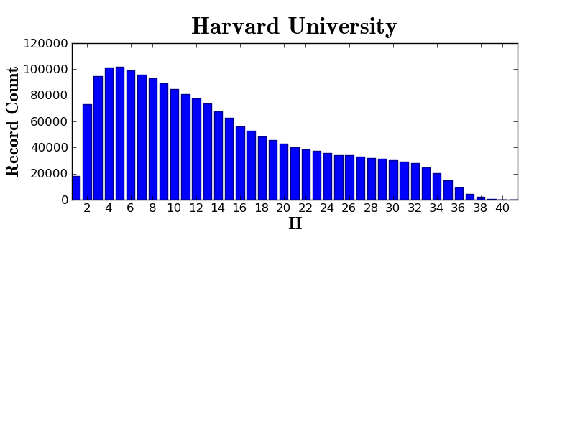
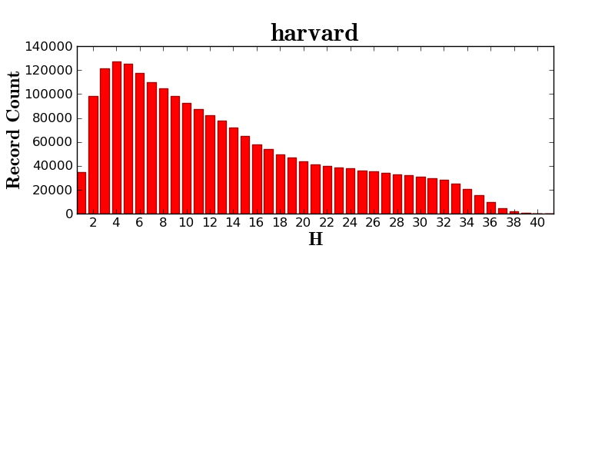

Slide 11
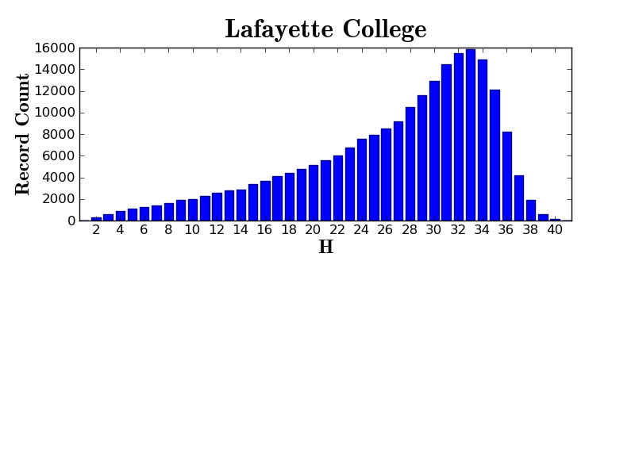

Slide 12
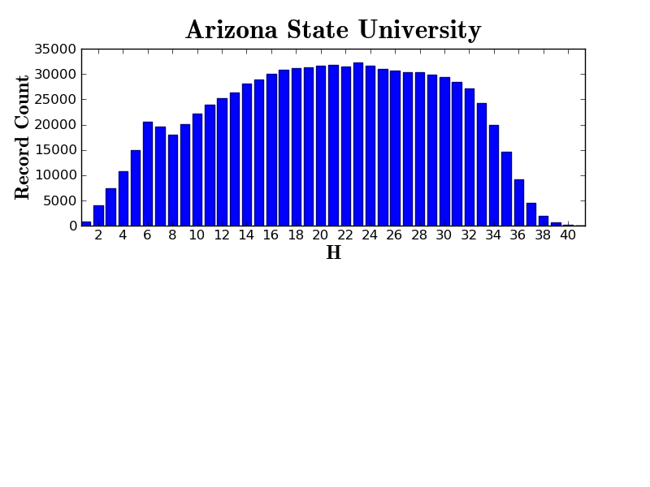

Slide 13
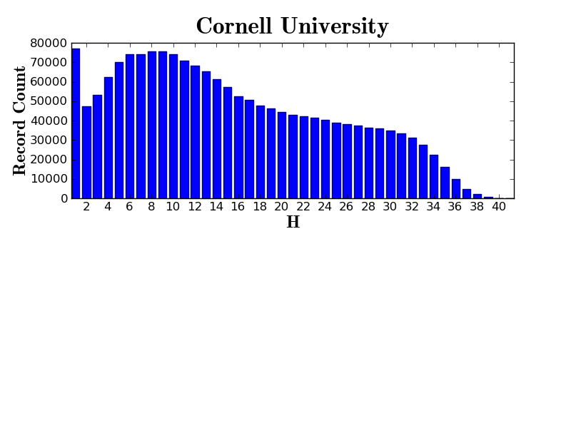

Slide 14
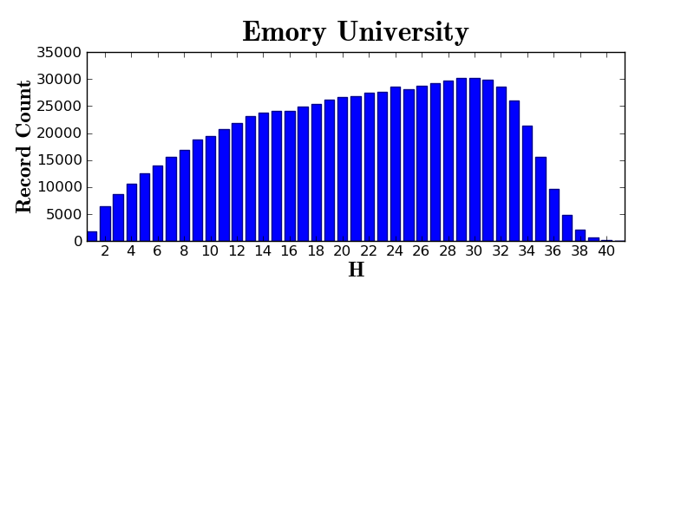

Slide 15
For public domain volumes:
(PD*X*C)/N
For a given in­copyright volume:
IC=(C*X)/H
Notes:
Most volumes, and particularly those in-copyright volumes for which we can make relatively limited uses, will be matched against the holdings of partner libraries. We will divide the cost of maintaining each volume by the number of holding libraries. Thus, if twenty-five libraries all hold or held a print version of a volume that costs $0.25/year to store, each library will pay $0.01 per year for the storage of that volume. Now, you’ll note that I say “holds or held,” and this is in recognition of our need to withdraw and the value we may derive from lawful uses of a digital copy. If I’ve withdrawn a print volume and I decide that I don’t want those lawful uses of the digital copy, I won’t declare that I hold or held that volume. There are no free-rider benefits without a corresponding record of ownership.
The other case is the small but growing body of public domain volumes and volumes that are open access. Each participating libraries enjoys the full benefits of these, whether held or not, and so the cost of these is divided by the total number of partner libraries.

Slide 16
Public Domain Cost

Slide 17
IC Single-part Monographs

Slide 18
IC Serials

Slide 19
All Costs

Slide 20
A “surprise” 1m volumes

Slide 21
Publisher Relations and Publishing
Making it possible for rights holders to open access to works
Making it possible for publishers to deposit digital masters for archiving (and open access)
Making it possible to publish directly into HathiTrust

Slide 22
Uses of in-copyright materials
Services for users with print disabilities
Section 108-related work
Orphan works
… and of course other cases with permission of the rights holder

Slide 23
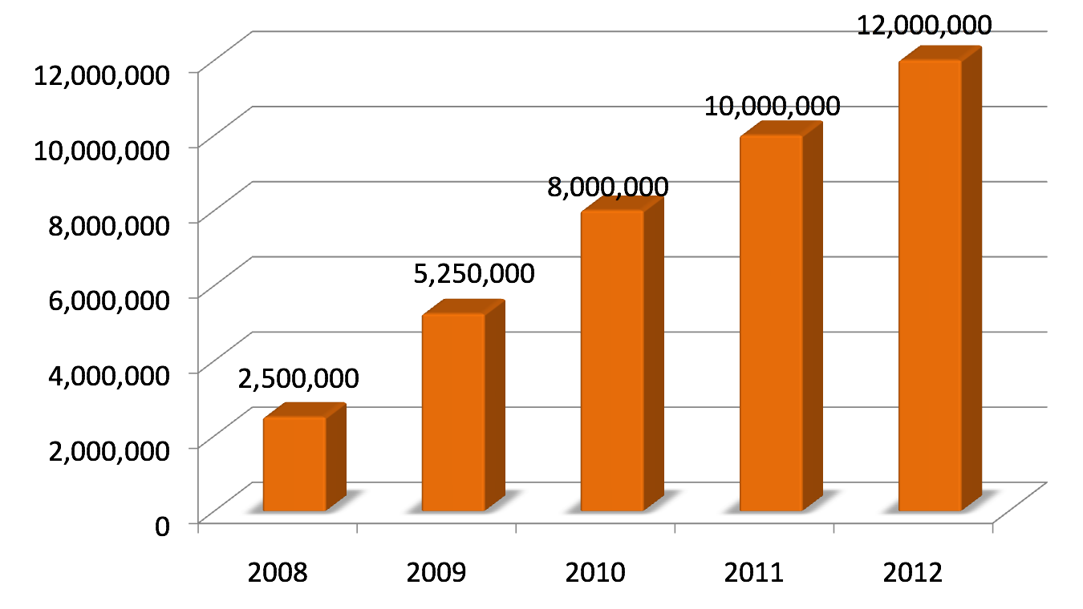
HathiTrust Content Growth
Notes:
23
Heather

Slide 24
Changing the way we work
Pooling resources to solve a common problem once
Applying resources from our individual institutions to collectively attack a common problem
Coordinated and collective action (e.g., best practices)

Slide 25
Thank you!

