Slide 1
The HathiTrust Research Center: Big Data Analytics in a Secure Data Framework
@hathitrust #SC14
Beth Plale | @bplale
Director Data to Insight Center | Indiana University
Robert H. McDonald | @mcdonald
Deputy Director Data to Insight Center | Indiana University

Slide 2
Outline
What is the HTRC?
Non-Consumptive Research Paradigm
Current Architecture
Future Architecture
Advanced Collaborative Support (RFP)
HTRC Science on a Sphere
HTRC @ Events

Slide 3
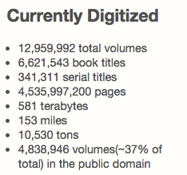
HathiTrust Digital Library
HathiTrust is a partnership of 90+ academic & research institutions, offering a collection of millions of digitized titles.
http://hathitrust.org
IU is a founding member of the HathiTrust along with University of Michigan, University of California, and the University of Virginia

Slide 4
HathiTrust Research Center
Mission
Public research arm of HathiTrust
Goal: enable researchers world-wide to accomplish tera-scale text data-mining and analysis
Develop cutting-edge software tools for processing, analyzing text
Develop cyberinfrastructure to enable HPC access to the HathiTrust Digital Library
Established: July, 2011
Collaborative center: Indiana University & University of Illinois

Slide 5
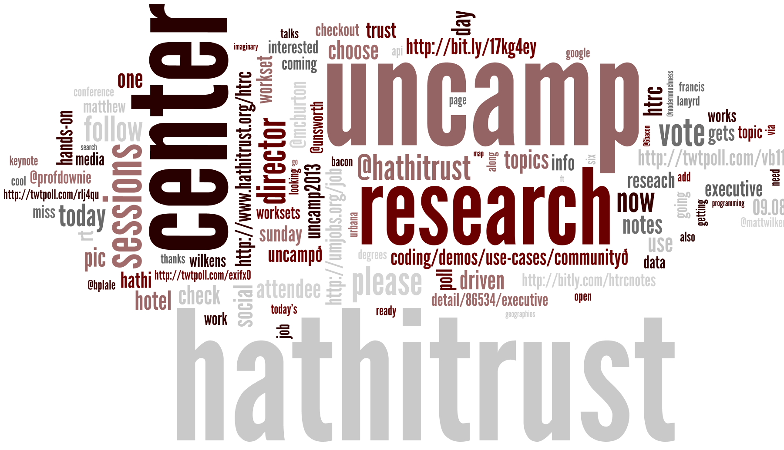
HTRC Timeline
Phase I: development 01 Jul 2011 – 31 Mar 2013
HTRC software and services release v1.0 https://github.com/htrc
Phase II: outreach, 01 Apr 2013 – 30 June 2014
2nd HTRC UnCamp Sep ’13
Phase III: operations, 01 July 2014 - present

Slide 6
HTRC Current Users
194 existing user accounts
Lots of user accounts; good starting point.
Improve :
Increase amount of real work being accomplished as measured by usage on HTRC’s compute resources Quarry and Big Red II at IU
Develop educational uses
Develop informatics uses
Decrease number of observers to 10%
➔ Project 200 users at any one time of which 90% are doing relevant education/scholarship
6

Slide 7
Non-Consumptive Research Paradigm
No action or set of actions on part of users, either acting alone or in cooperation with other users over duration of one or multiple sessions can result in sufficient information gathered from collection of copyrighted works to reassemble pages from collection.
Definition disallows collusion between users, or accumulation of material over time. Differentiates human researcher from proxy which is not a user. Users are human beings.

Slide 8
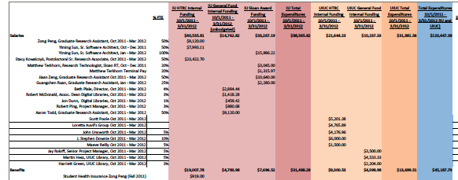
HTRC
Request
Spatial plots
All the complexity
Statistical plots
Tabular info
Complexity hiding interface
Notes:
HTRC hides complexity of analytics. In this sense, it is like Google search, which is a simple interface that hides complexity to search billions of pages. The kinds of things returned from HTRC interaction are spatial relationship of words (and their frequency obviously), statistical plots of information or tabular information.

Slide 9
HTRC Version 2.0
Notes:
Shifting the complexity hiding interface to the right, we open up the cloud to see what’s inside. HTRC at it simplest has 1) algorithms – these are drawn from SEASR and from other analysis tool suites including Mahout and mapreduce, the 2) HT corpus (and subsets of the corpus that users either have personally as part of a workset, or are publically available, and 3) other data sets that are used. HTRC brokers the bringing together of these pieces so that computation can take place on a resource like Big Red II (or XSEDE). Note that there is an arrow from the compute engine to the complexity hiding interface. This is because researcher interaction with the texts isn’t an automated workflow; it is one requiring levels of interaction with the computation as it is running.

Slide 10
HTRC Goals
Provide a persistent and sustainable structure to enable original and cutting edge research.
Leverage data storage and computational infrastructure at Indiana & Illinois
Stimulate community development of new functionality and tools
Use tools to enable discoveries that would not be possible without the HTRC
Enable scholars to fully utilize content of HathiTrust Library while preventing intellectual property misuse within U.S. copyright law.
Provision secure computational and data environment for scholars to perform research using HathiTrust Digital Library.

Slide 11
HTRC Organization 2014-18
HTRC Executive Mgmt
Administrative Support
Advanced Research
Advanced Collaborative Support
Scholarly Commons
Core Development

Slide 12
HTRC Data Capsule
@hathitrust #SC14
HTRC Data Capsule@IU Team
Beth Plale (PI)
Jiaan Zeng
Guangchen Ruan
HTRC Data Capsule@Michigan Team
Atul Prakash (PI)
Alexander Crowell
Jiaan Zeng, Guangchen Ruan, Alexander Crowell, Atul Prakash, and Beth Plale. 2014. Cloud computing data capsules for non-consumptiveuse of texts. In Proceedings of the 5th ACM workshop on Scientific cloud computing (ScienceCloud '14). ACM, New York, NY, USA, 9-16. DOI=10.1145/2608029.2608031 http://doi.acm.org/10.1145/2608029.2608031
Special Thanks to
Samitha Liyanage
Milinda Pathirage
Zong Peng
Earlence Fernandes
Ajit Aluri
Notes:
Jiaan Zeng, Guangchen Ruan, Alexander Crowell, Atul Prakash, and Beth Plale. 2014. Cloud computing data capsules for non-consumptiveuse of texts. In Proceedings of the 5th ACM workshop on Scientific cloud computing (ScienceCloud '14). ACM, New York, NY, USA, 9-16. DOI=10.1145/2608029.2608031 http://doi.acm.org/10.1145/2608029.2608031

Slide 13
HTRC Data Capsule
Web front end
Web UI
User Authentication
Firewall
Web service
Web Services
Audit
Hypervisor Scripts
Database
Image Store
Volume Store
Backend
VM-1
…
VM-k
VM-1
…
VM-k
Host-1
…
Host-N

Slide 14
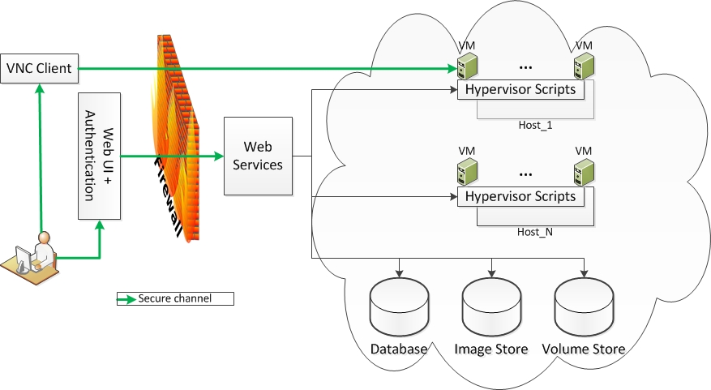
HTRC Data Capsule Workflow

Slide 15
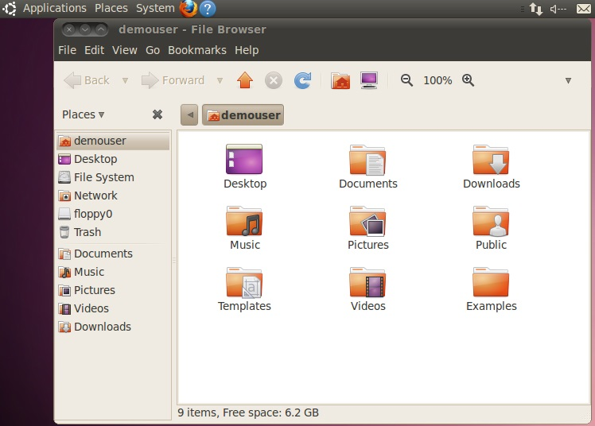
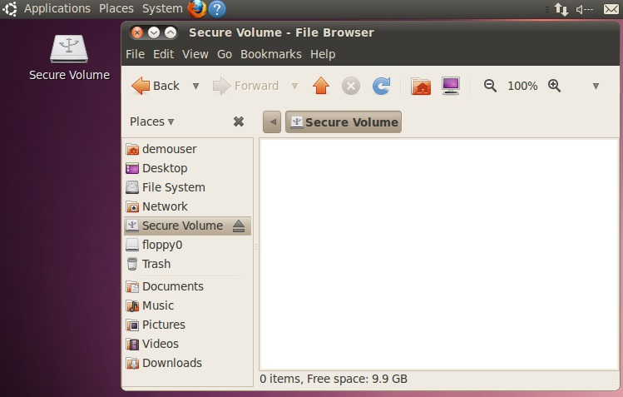
Data Capsule Screenshots
Secure Mode
Maintenance Mode

Slide 16
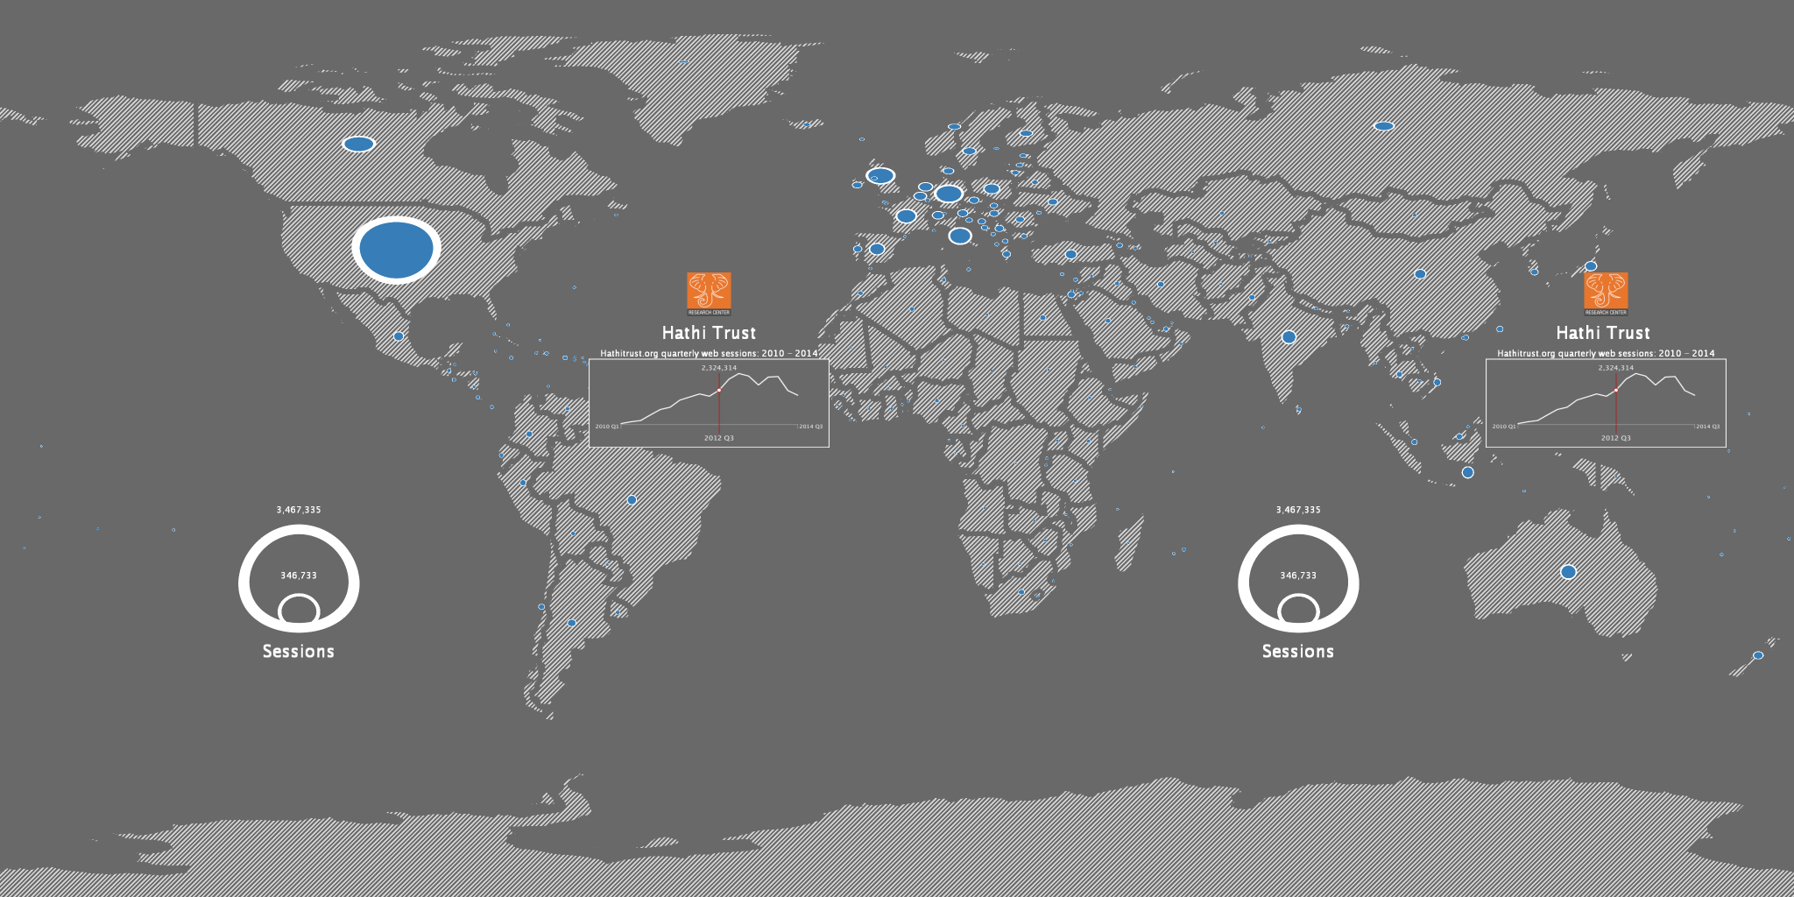
HTRC Science on a Sphere #SC14
Texts published per country
HathiTrust Member Institutions
HT Google analytics
Notes:
1.) Texts published per country
Data were from the Gender metadata work. It was used because it has volume authors and country of publication information. The total records have 60K volumes, with some country fields missing
2.) HathiTrust Member institutions
It maps geolocations of the UnCamp 2013 participants;
The text band shows UnCamp 15’ and 13M books available for non-consumptive use soon
3.) HT Google analytics
Shows HT webpage use over the time, by aggregating over the quarter
A drop around 2013 summer: could possibly be cause by summer break

Slide 17
HTRC Advanced Collaborative Support
ACS will be offered on a rolling basis over next four years 2014-18
1st RFP Call Deadline is Jan 8, 2015 5:00pm eastern
RFP - http://www.hathitrust.org/htrc/acs-rfp
For more info on the Advanced Collaborative Support please contact: htrc.acs.awards@gmail.com

Slide 18
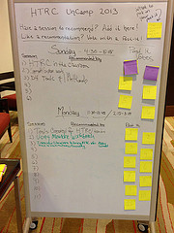
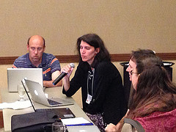
HTRC@Events
DHCS 2014, Oct 22, 2014 Evanston, IL
SC14 – IU Booth, Nov 17-19, 2014, New Orleans, LA
CLIR/CNI Workshop on Expanded Access to Collections, Dec. 7, 2014, Washington, DC
HTRC UnCamp 2015 – March 30-31, 2015 Ann Arbor, MI

Slide 19
Thank You
HTRC IU Team
Beth Plale (PI)
Robert H. McDonald
Miao Chen
Guangchen Ruan
Zong Peng
Milinda Pathirage
Samitha Liyanage
Leena Unnikrishnan
Nicholae Cline
HTRC UIUC Team
J. Stephen Downie (PI)
Beth Namachchivaya
Megan Senseney
Sayan Bhattacharyya
Colleen Fallaw
Loretta Auvil
Boris Capitanu
Harriet Green

Slide 20
More Information on HTRC
For details http://www.hathitrust.org/htrc/faq
General contact info
J. Stephen Downie, Co-Director HTRC, jdownie@Illinois.edu
Beth Plale, Co-Director HTRC, plale@indiana.edu
Requests for capability, interest
Miao Chen, Asst. Director for Outreach HTRC
miaochen@indiana.edu

Slide 21
The HathiTrust Research Center: Big Data Analytics in a Secure Data Framework
@hathitrust #SC14
For more on HTRC: http://www.hathitrust.org/htrc
For these slides go to:

