Slide 1
HathiTrust Research Center:
Your Analytic Gateway to the HathiTrust’s 4.5 Billion Pages

Slide 2
Some Useful URLs
HathiTrust
  http://hathitrust.org
HTRC Sandbox
  https://sandbox.htrc.illinois.edu/HTRC-UI-Portal2/HomeAction
Something To Keep You Amused
  http://www.websiteasteroids.com/
Notes:
In order to guide the partnership in its initial years the founding partners articulated a set of preliminary goals:
To build a reliable and increasingly comprehensive digital archive of library materials converted from print that is co-owned and managed by a number of academic institutions.
To improve access to them in ways that, first and foremost, meet the needs of the co-owning institutions.
To preserve these materials.
To stimulate redoubled efforts to coordinate shared storage strategies among libraries, thus reducing long-term capital and operating costs of libraries associated with the storage and care of print collections.
To create and sustain this “public good” in a way that ensures greatest possible availability of materials, while offering value to members, mitigating the problem of free-riders.
To create a technical framework that is simultaneously responsive to members through the centralized creation of functionality, such as preservation services and full-text search, and sufficiently open to the creation of tools and services not created by the central organization.
I’ll be talking more about these elements, and their relation to the development of a Research Center. First I would like to describe in more detail the HathiTrust collection and the services we offer.

Slide 3
HathiTrust Partnership
Allegheny College
Arizona State University
Baylor University
Boston College
Boston University
Brown University
California Digital Library
Colby College
Columbia University
Cornell University
Dartmouth College
Duke University
Emory University
Florida State University
Getty Research Institute
Harvard University Library
Indiana University
Johns Hopkins University
Lafayette College
Library of Congress
Massachusetts Institute of Technology
McGill University`
Michigan State University
New York Public Library
New York University
North Carolina Central
University
North Carolina State
University
Northwestern University
The Ohio State University
The Pennsylvania State
University
Princeton University
Purdue University
Stanford University
Temple University
Texas A&M University
Tufts University
Universidad Complutense
de Madrid
University of Alberta
University of British Columbia
University of Arizona
University of Calgary
University of California
Berkeley
Davis
Irvine
Los Angeles
Merced
Riverside
San Diego
San Francisco
Santa Barbara
Santa Cruz
The University of Chicago
University of Connecticut
University of Delaware
University of Florida
University of Houston
University of Illinois
University of Illinois at Chicago
The University of Iowa
University of Maryland
University of Massachusetts
University of Miami
University of Michigan
University of Minnesota
University of Missouri
University of Nebraska-Lincoln
The University of North
Carolina at Chapel Hill
University of Notre Dame
University of Oklahoma
University of Pennsylvania
University of Pittsburgh
University of Queensland
University of Tennessee,Knoxvile
University of Utah
University of Virginia
University of Washington
University of Wisconsin-Madison
Utah State University
Wake Forest University
Washington University
Yale University Library
Notes:
HathiTrust is a partnership of academic and research libraries that are seeking to work in collective ways to meet collective challenges faced by libraries: challenges in sustaining our collections (both digital and print); increasing their discovery and use; making them as accessible as possible to as broad a constituency as possible.
There are 70 partners currently (Virginia Tech, Kansas State not yet announced), including many of the largest research institutions in the United States, 2 institutions in Canada and one in Spain.

Slide 4
HathiTrust Partnership
Allegheny College
Arizona State University
Baylor University
Boston College
Boston University
Brown University
California Digital Library
Colby College
Columbia University
Cornell University
Dartmouth College
Duke University
Emory University
Florida State University
Getty Research Institute
Harvard University Library
Indiana University
Johns Hopkins University
Lafayette College
Library of Congress
Massachusetts Institute of Technology
McGill University`
Michigan State University
New York Public Library
New York University
North Carolina Central
University
North Carolina State
University
Northwestern University
The Ohio State University
The Pennsylvania State
University
Princeton University
Purdue University
Stanford University
Temple University
Texas A&M University
Tufts University
Universidad Complutense
de Madrid
University of Alberta
University of British Columbia
University of Arizona
University of Calgary
University of California
Berkeley
Davis
Irvine
Los Angeles
Merced
Riverside
San Diego
San Francisco
Santa Barbara
Santa Cruz
The University of Chicago
University of Connecticut
University of Delaware
University of Florida
University of Houston
University of Illinois
University of Illinois at Chicago
The University of Iowa
University of Maryland
University of Massachusetts
University of Miami
University of Michigan
University of Minnesota
University of Missouri
University of Nebraska-Lincoln
The University of North
Carolina at Chapel Hill
University of Notre Dame
University of Oklahoma
University of Pennsylvania
University of Pittsburgh
University of Queensland
University of Tennessee,Knoxvile
University of Utah
University of Virginia
University of Washington
University of Wisconsin-Madison
Utah State University
Wake Forest University
Washington University
Yale University Library
Notes:
HathiTrust is a partnership of academic and research libraries that are seeking to work in collective ways to meet collective challenges faced by libraries: challenges in sustaining our collections (both digital and print); increasing their discovery and use; making them as accessible as possible to as broad a constituency as possible.
There are 70 partners currently (Virginia Tech, Kansas State not yet announced), including many of the largest research institutions in the United States, 2 institutions in Canada and one in Spain.

Slide 5
HathiTrust Mission
To contribute to the common good by collecting, organizing, preserving, communicating, and sharing the record of human knowledge
Notes:
The mission of HathiTrust is to contribute to the common good by collecting, organizing, preserving, communicating, and sharing the record of human knowledge. The scope of the mission is extremely broad and you will notice that there is no mention in particular of print materials versus digital, or even born-digital materials. This is intentional; the vision of the founding partners was nothing less than to ensure the long-term preservation and accessibility of the cultural record writ large.

Slide 6
HathiTrust “Wow” Numbers
12,426,986 total volumes
6,387,108 book titles
325,984 serial titles
4,349,445,100 pages
557 terabytes
147 miles
10,097 tons
4,561,002 volumes (~37% of total) in the public domain

Slide 7
HathiTrust “Wow” Numbers
13,284,163 total volumes
6,742,394 book titles
352,534 serial titles
4,649,457,050 pages
595 terabytes
157 miles
10,793 tons
4,979,599 volumes (~37% of total) in the public domain

Slide 8
Call Number Distribution

Slide 9
Language Distribution (Sample)
Language | Count | Percent
English | 3,423,589 | 49.82
German | 647,432 | 9.42
French | 513,347 | 7.47
Spanish | 306,031 | 4.45
Russian | 249,189 | 3.63
Chinese | 248,825 | 3.62
Japanese | 219,961 | 3.20
Italian | 180,877 | 2.63
Arabic | 123,721 | 1.80
Latin | 95,223 | 1.39
Portuguese | 62,074 | 0.90
Polish | 59,729 | 0.87
Dutch | 50,607 | 0.74
Hebrew | 45,171 | 0.66
Hindi | 38,884 | 0.57
Indonesian | 34,651 | 0.50
Swedish | 31,521 | 0.46
Korean | 30,650 | 0.45

Slide 10
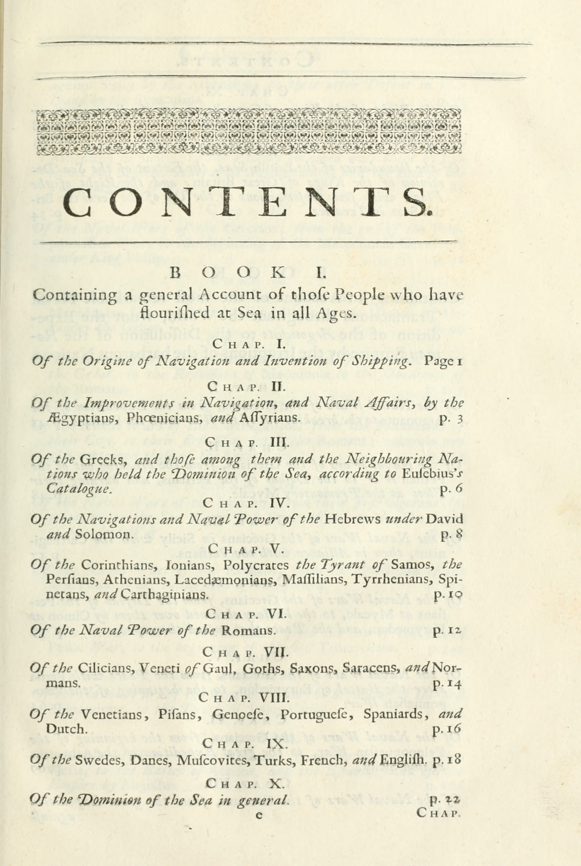
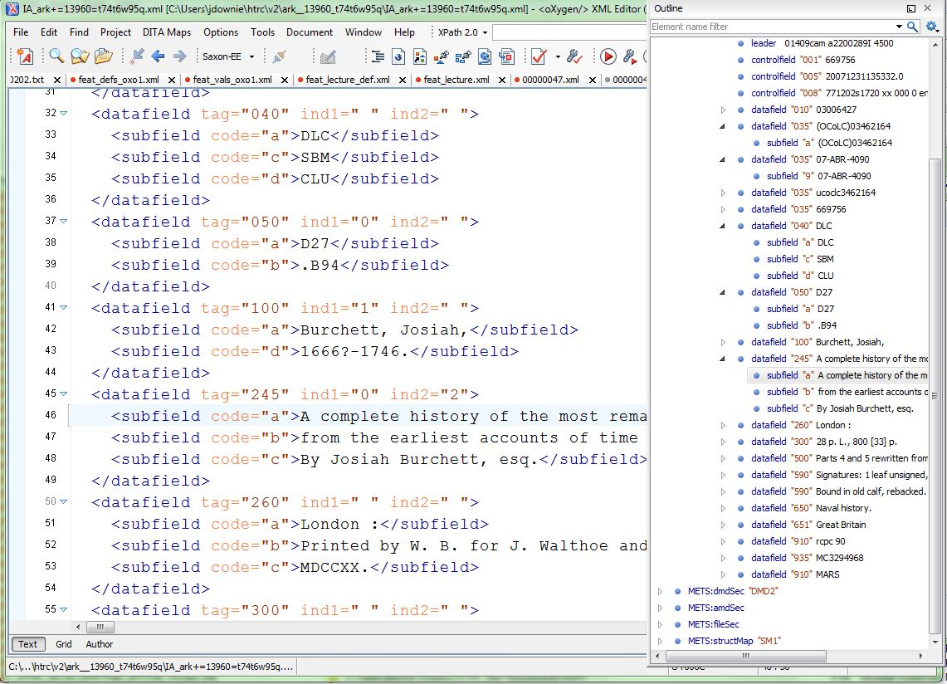
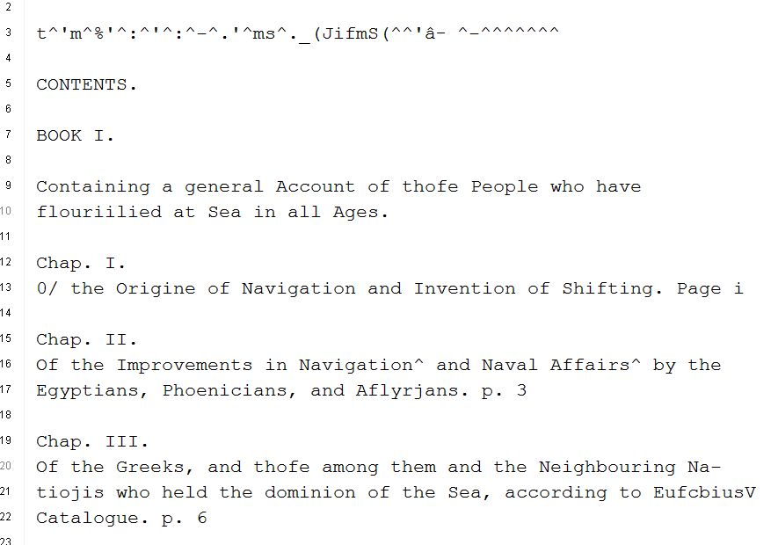
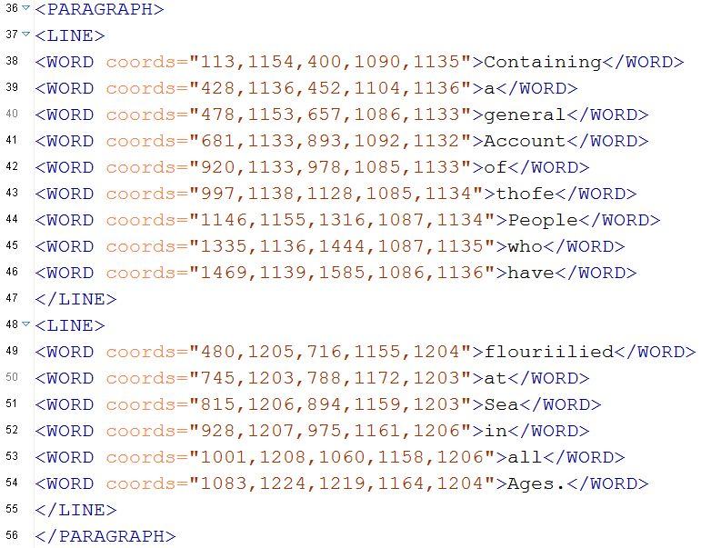

Slide 11

Mission of the HT Research Center
Research arm of HathiTrust
Established: July, 2011
Collaborative center: Indiana University & University of Illinois
Mission: Enable researchers world-wide to accomplish tera-scale text data-mining and analysis
  Develop cyberinfrastructure to enable HPC access to the HathiTrust Digital Library
  Develop cutting-edge software tools for processing, analyzing text
  Develop translational tools and data that can be used to enhance HathiTrust Digital Library services to users

Slide 12

HTRC Governance
Reports to the HathiTrust Board of Governors
HTRC Executive Committee
  J. Stephen Downie (Co-director), Professor and Associate Dean for Research, University of Illinois GSLIS
  Beth Plale (Co-director and Chair), Director Data To Insight Center and professor in the School of Informatics and Computing at Indiana University
  Robert H. McDonald, Associate Dean of Libraries/Deputy Director Data to Insight Center at Indiana University
  Beth Sandore Namachchivaya, Associate University Librarian for Information Technology Planning & Policy at the University of Illinois
  John Unsworth, Vice Provost for Library & Technology Services and Chief Information Officer at Brandeis University

Slide 13
Board of Governors
  Executive Committee
    Executive Director
HathiTrust
University of Michigan
HathiTrust
Research
Center
Data Copy #1
Data Copy #2
Indiana
University
University of
Illinois
Notes:
This last broadened HathiTrust governance to a 12-member Board of Governors, composed of 6 members elected from the partnership and 6 appointed by the founding members. The Board was charged with conducting financial oversight of the partnership, developing strategies, setting priorities, and creating working groups and committees to carry out the work of the partnering institutions.
The Constitutional Convention, the establishment of broader, shared governance, and the precedent of collective decision-making about future initiatives and ways of conducting business - were truly significant developments and events in the history of our partnership. We believe in the expertise of our colleagues and the power of what we can do collectively to achieve common goals. We believe that the deeper our collaborative ties – with libraries, with students, faculty – the more we can do to advance our knowledge and scholarship, and ensure that these are carried forward to future generations.

Slide 14
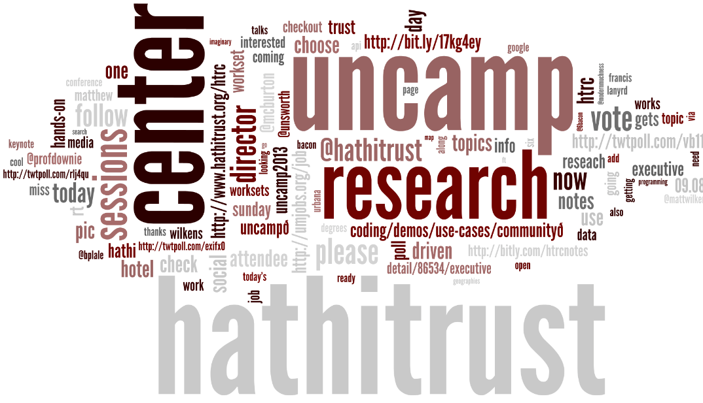
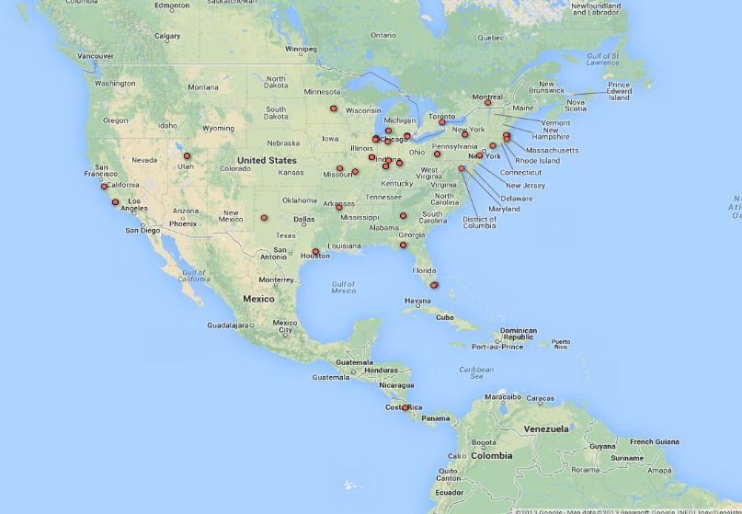
HTRC Timeline
Phase I: Development 01 Jul 2011 – 31 Mar 2013
  HTRC software and services release v1.0 https://github.com/htrc
Phase II: Outreach, 01 Apr 2013 – 30 June 2014
  2nd HTRC UnCamp Sep ’13
Phase III: Operations, 01 July 2014 – June 2018

Slide 15
Goals for HTRC
Provide a persistent and sustainable structure to enable original and cutting edge research.
      Leverage data storage and computational infrastructure at Indiana & Illinois
      Stimulate community development of new functionality and tools
      Use tools to enable discoveries that would not be possible without the HTRC
Enable scholars to fully utilize content of HathiTrust Library while preventing intellectual property misuse within U.S. copyright law.
      Provision secure computational and data environment for scholars to perform research using HathiTrust Digital Library.

Slide 16
HTRC 2014-2018 Org Chart
HTRC Executive Mgmt
Administrative Support
Advanced Research
Advanced Collaborative Support
Scholarly Commons
Core Development

Slide 17
Core Development
Controls releases
Implements new features
System auditing, incident response
Manages bug queue
Oversees translational research process
At 2 FTE + UI specialist + minor roles
HTRC System Managers belong to this group

Slide 18
Advanced Collaborative Support
Pairs HT institution researchers with expert staff for an extended period during which they work together to address a particularly vexing issue (e.g., efficient parallelization and optimization of a machine learning algorithm)
20 hours/week available: example: at any one time 4 active projects, each receiving 5 hours a week for up to 2 months.
Resourced at 1.25 FTE
Staffed by HTRC Staff who have signed the staff agreement

Slide 19
Advanced Research
Grant funded
May include people designated as HTRC Staff
Activity that is not immediately intended for production availability
Activity from this group has to pass translational evaluation to be incorporated as production service

Slide 20
Scholarly Commons
User Support Service
Develop training materials
Educational workshops
Tool and workset creation
Collaborate with librarians and DH centers at HT institutions
Assist researchers in HTRC text data mining research projects
Led out of University of Illinois Library; smaller group at IU
Resourced at 2.7 FTE.
Notes:
The Scholarly Commons User Support service gives HT institutions exclusive access to training and learning materials that help them establish programs that integrate HTRC tools and services into their scholarly commons programs in libraries and digital humanities centers.
The SC will be physically located on the University of Illinois Library’s Scholarly commons. Several Library staff and faculty will support this service. Key among these is the Digital Humanities Research Specialist who will assist with the development of training and outreach initiatives in support of researchers working with the Hathi Trust Research Center and HathiTrust digital library affiliates who seek to start their own HTRC research services. This will involve planning, implementation and continuous development of training materials, educational workshops, and potential tools, and outreach activities in support of the usage of HTRC tools and datasets. The HTRC Digital H. Specialist will focus on development of HTRC research services at HathiTrust member institutions, and will collaborate with public services and data services librarians at HathiTrust member institutions on developing support services for digital humanities research with HTRC corpus. The specialist will work closely with the English and Digital Humanities Librarian at the University of Illinois Library to develop research data services for the humanities, with particular emphasis on the HTRC corpus and tools.
Additional professionals are focused on related aspects of HTRC work, including a CLIR Postdoc researching user requirements for HTRC tools, a Technical Specialist and other technical support. These professionals contribute to the work of the Scholarly Commons and to the HT community in helping to articulate the relationship between new technologies and humanities scholarship to the community of humanists; and in advising teaching faculty on the usage of digitized textual corpora and providing technical support for use of analytical tools. The scope and responsibilities will evolve in accordance with priorities established by the Library and HathiTrust community.
The specialist will spend up to 20 percent of their time on the support of research work with the HTRC.
Examples of currently supported digital humanities projects involving the HTRC corpus include:
A text mining project of eighteenth-century novels for changes in dialect;
A textual analysis of nineteenth-century women's serial novels for thematic patterns;
A comparative literature textual analysis project;
Topic modeling of twentieth-century texts for depictions of African-American women.

Slide 21
Data Overview
Notes:
I’d like to spend some time now putting or locating HathiTrust and the HathiTrust Research Center in the broader context of textual analysis in general over the years to get a sort of thousand-foot view of what it is that we are now accomplishing.
Numerous projects were begun in the 1990s and early 2000s, including digitization of printed volumes on a larger scale (for instance in the Making of American project at the University of Michigan and Cornell). These projects and the resources they made available were the beginnings of, or gave rise to Digital Humanities – humanities study that leveraged or were influenced by the digitization of materials.
The early days of digitization, in the 1990s in particular, were about developing standards for digitization, experimenting with work at scale, but nothing comprehensive was undertaken except with respect to digitizing perhaps an entire collection of papers or a small set of resources.
As digitization and digital humanities projects have progressed, there have been efforts to link initiatives together to provide a research corpus that is more comprehensive. The NINES project, which offers federated search of digital resources including targeted websites such as the Willa Cather Archive and British Women Romantic Poets, is an example, and there are others.
Enter large-scale digitization and HathiTrust
New possibilities for computational research were introduced with initiatives to engage in digitization on a large-scale. From the beginning, these possibilities were seen by HathiTrust-participating institutions and one of earliest multi-institution HathiTrust working groups formed was to consider the development of a HathiTrust Research Center.
At the time, discussions centered largely around the Google Settlement and included discussions of the infrastructure and policies that would need to be in place to enable “non-consumptive” research. The effort to establish a research center was always larger than Google, however, as there were more materials in HathiTrust than were digitized by Google alone, and an awareness that there would be more over time. The vision for a research center indeed was as broad as the vision for HathiTrust – to enable new kinds of discovery, new kinds of research across an increasingly comprehensive body of materials, with our progress in these areas determined by our needs for research, and our ability to put forward the resources to meet those needs.
The HathiTrust Research Center is a fantastic example of the collective action that HathiTrust was formed to catalyze. Experts from across the partnership assembled over a period of several months in the initial working group to discuss types of research, infrastructure, and legal dimensions of a research center.
The University of Illinois and Indiana University jointly submitted and RFP to develop the HathiTrust Research Center. The Research Center initiative was seen to be so valuable by these institutions that Indiana and Illinois directed their own institutional resources to create the infrastructure and leadership that were needed to launch it. It added that much more to the effort that the leadership was formed from faculty of these institutions, as opposed to the libraries in support of faculty. In its first phase of development the HTRC has already attracted funding from Sloan to investigate issues of computation across in-copyright materials, and we can expect the Research Center to be a magnet for other funding in the future.
The HTRC is a terrific example of what we can accomplish by working together to address common needs and challenges. In HathiTrust in general we have seen an initiative to aggregate the results of past and ongoing digitization and digital production into a collective collection. The Research Center represents a venture similarly to bring together research initiatives of our institutions; solving common problems in research by bringing researchers to the corpus - to the data - facilitating not only more comprehensive research, but addressing at the same time challenges of formats, standards, and curation, and reuse in a unified environment.

Slide 22
Datasets
Non-Google-digitized Dataset (300,000+)
  PD, PDUS, Open Access
  Signed researcher statement
Google-digitized (2.2 million+)
  PD, PDUS, Open Access
  Agreement between institution and Google
  Brief proposal
    Characterize texts
    Provide ids (custom sets possible)
    Research, results, use of results
  Signed researcher statement

Slide 23
How is it available?
Web interfaces
APIs
  Data API
  Bib API
Data feeds and distribution
  Hathifiles
  OAI
  Datasets

Slide 24
Hathifiles
Tab-delimited inventory files
Aggregated monthly
Daily incremental files
Contain
  Identifiers
  Limited bibliographic information
  Rights, language, gov docs status information

Slide 25
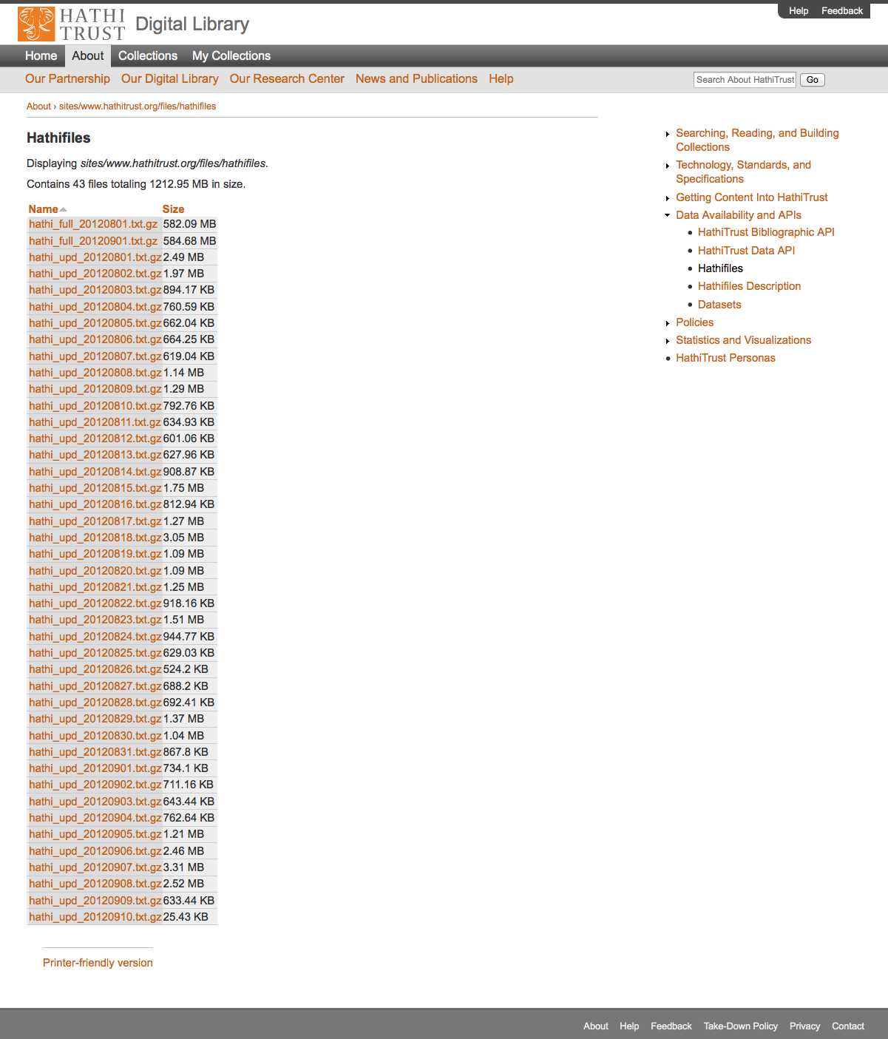

Slide 26
Data Element | Example
Volume identifier | coo.31924003924275
Access | deny
Rights | ic
University of Michigan Record # | 002052896
Enumeration/Chronology | Band I
Source | COO
Source Institution Record # | 17132
OCLC numbers | 62370740
ISBNs
ISSNs | gs 12000204
LCCNs
Example HathiFile
Excel

Slide 27
Data Element | Example
Title | Anleitung zur bestimmung der karbonpflanzen…
Imprint | Kommissionsverlag von Craz & Gerlach (J. Stettner) 1911-
Rights determination reason code | bib
Date of last update | 2011-04-11 20:32:41
Government document | 0
Publication date | 1911
Publication place | gw
Language | ger
Bibliographic format | BK

Slide 28
Copyright
Strongly bound to US copyright issues with constant vigilance of the international scene
Status determinations via:
  Bibliographic metadata
  Automatic and manual rights determination

Slide 29
Automatic Rights Determination
Conducted on all works at time of ingest and when records are modified
  Public domain worldwide
    US works published before 1923, US federal government publications, non-US works published prior to 1872
  Public domain in the United States
    Non-US works published prior to 1923

Slide 30
Manual Rights Determination
IMLS-funded CRMS project
  US-published works 1923-1963
  Conformance with formalities
  Expanding to non-US works
  Double-blind review with expert review for conflicts
  Staff at 4 HathiTrust partner institutions (15 will take part in non-US)
  As of February 2012 ~190,000 reviewed, more than 100,000 opened
Rights Holder Permissions

Slide 31
Rights Attributes
id | name | type | dscr
1 | pd | copyright | public domain
2 | ic | copyright | in-copyright
3 | opb | copyright | out-of-print and brittle (implies in-copyright)
4 | orph | copyright | copyright-orphaned (implies in-copyright)
5 | und | copyright | undetermined copyright status
6 | umall | access | available to UM affiliates and walk-in patrons (all campuses)
7 | world | access | available to everyone in the world
8 | nobody | access | available to nobody; blocked for all users
9 | pdus | copyright | public domain only when viewed in the US
10 | cc-by | copyright | Creative Commons Attribution
11 | cc-by-nd | copyright | Creative Commons Attribution-NoDerivatives
12 | cc-by-nc-nd | copyright | Creative Commons Attribution-NonCommercial-NoDerivatives
13 | cc-by-nc | copyright | Creative Commons Attribution-NonCommercial
14 | cc-by-nc-sa | copyright | Creative Commons Attribution-NonCommercial-ShareAlike
15 | cc-by-sa | copyright | Creative Commons Attribution-ShareAlike
16 | orphcand | copyright | orphan candidate - in 90-day holding period (implies in-copyright)
17 | cc-zero | copyright | Creative Commons Zero license (implies pd)
18 | und-world | copyright | Undetermined copyright status and permitted as world-viewable by the depositor
19 | Ic-us | copyright | In copyright in the US

Slide 32
Rights Determination Reason Codes
id | name | dscr
1 | bib | bibliographically-derived by automatic processes
2 | ncn | no printed copyright notice
3 | con | contractual agreement with copyright holder on file
4 | ddd | due diligence documentation on file
5 | man | manual access control override; see note for details
6 | pvt | private personal information visible
7 | ren | copyright renewal research was conducted
8 | nfi | needs further investigation (copyright research partially complete; an ambiguous, unclear, or other time-consuming situation was encountered)
9 | cdpp | title page or verso contain copyright date and/or place of publication information not in bib record
10 | cip | condition review and in-print status research was conducted
11 | unp | unpublished work
12 | gfv | Google viewability set at VIEW_FULL
13 | crms | derived from multiple reviews in the Copyright Review Management System (CRMS) via an internal resolution policy; consult CRMS records for details
14 | add | author death date research was conducted or notification was received from authoritative source
15 | exp | expiration of copyright term for non-US work with corporate author
16 | Del | Deleted from repository; see note for details
17 | Gatt | Non-US public domain work restored to in-copyright in the US by GATT

Slide 33
Terms of Access
Available to students, faculty, staff of partnering institutions
  On library premises or authenticated into HathiTrust
Partner libraries own a print copy
  One simultaneous user per print copy owned
Users must be on U.S. soil
One page at a time download

Slide 34
Type of work | Searchable (bibliographic and full-text) | Viewable* | Full-PDF download (Data API) | Print on Demand | Print disabilities* | Preservation uses (Section 108)*
Public domain worldwide | Worldwide | Worldwide | Partners only if scanned by Google, if not, worldwide. | Worldwide | Partners worldwide | N/A
Public domain (US) – Non-US works published between 1872 and 1923. | Worldwide | When accessed from with the United States | Partners in the US if scanned by Google, if not, anyone US | Available within the United States | Partners in the US; partners worldwide where similar laws in effect | N/A
Works that rights holders have opened access to in HathiTrust | Worldwide | Worldwide | Worldwide (if digitized by Google, full-PDF only available if opened with CC license) | Worldwide with permission | Partners worldwide | N/A
Works that are in-copyright or of undetermined status | Worldwide | Not available | Not available | Not available | Partners in the US; partners worldwide where similar laws in effect | Partners in the US; partner worldwide where similar laws in effect
Orphan works | Worldwide | To participating partners | Not available | Not available | Partners in the US | Partners in the US; partners worldwide where similar laws in effect
* Note: Access to in-copyright works is subject to conditions on Terms of Access slide. See here also.

Slide 35
Content Distribution
Notes:
35

Slide 36
Non-Consumptive Research Model

Slide 37
Non-Consumptive Research Paradigm
No action or set of actions on part of users, either acting alone or in cooperation with other users over duration of one or multiple sessions can result in sufficient information gathered from collection of copyrighted works to reassemble pages from collection.
Definition disallows collusion between users, or accumulation of material over time. Differentiates human researcher from proxy which is not a user. Users are human beings.

Slide 38
Non-Consumptive Research Paradigm
Bring the
COMPUTATION
to the
DATA!

Slide 39
Amicus Brief …
Jockers, M.L., Sag, M. and Schultz, J. (2012) Brief of Digital Humanities and Law Scholars as Amici Curiae in Authors Guild v. Google, Social Science Research Network (SSRC). http://dx.doi.org/10.2139/ssrn.2102542

Slide 40
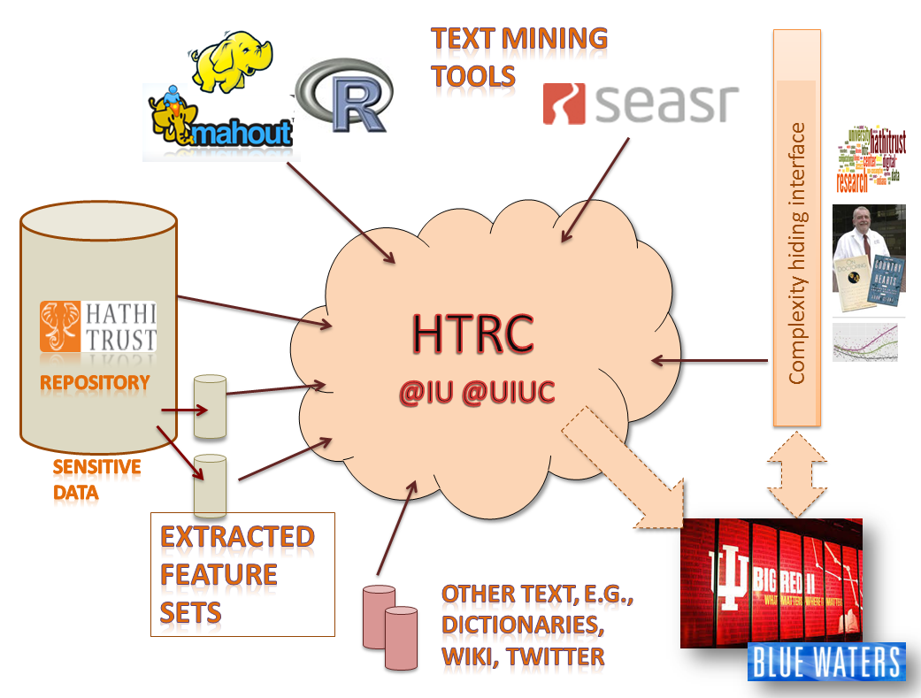
HTRC Overview

Slide 41
Three Approaches
Secure Portal Access
Data Capsule Access
Feature Extraction Services

Slide 42

HTRC Architecture
Portal Access
Blacklight
Direct programmatic access (by programs running on HTRC machines)
Agent
Job Submission
Collection building
Security (OAuth2)
Data API access interface
Solr Proxy
Registry (WSO2)
Audit
Algorithms
Meandre Workflows
Cassandra cluster volume store
Result Sets
Collections
Solr index
Compute resources
Storage resources
Notes:
Registry – agent can deploy any service listed in this digram and can run with the computational resources –
Original Plan iis to use XSEDE – not using this on IIS machine but are using ODIN (128 node cluster each core has 4Gb memory and 4 computation cores)– smoketree (D2I server)(24 cores physical 48 loical cores 128 GB memory) – these are not long term just using for now -

Slide 43
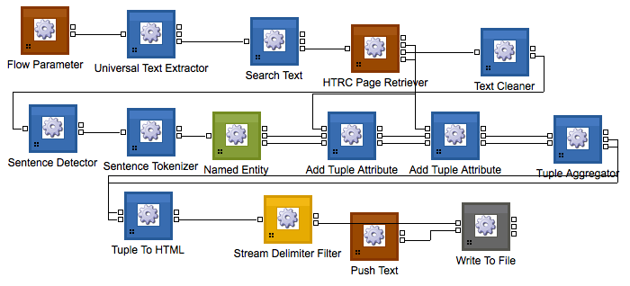

HTRC Architecture
Portal Access
Portal Access
HTRC Portal
Blacklight
Direct programmatic access (by programs running on HTRC machines)
Agent
Blacklight
Job Submission
Collection building
Security (OAuth2)
App SEAR
App Blacklight
Data API access interface
Solr Proxy
Registry (WSO2)
Audit
Algorithms
Meandre Workflows
Cassandra cluster volume store
Result Sets
Collections
Solr index
Compute resources
Storage resources
Notes:
Registry – agent can deploy any service listed in this digram and can run with the computational resources –
Original Plan iis to use XSEDE – not using this on IIS machine but are using ODIN (128 node cluster each core has 4Gb memory and 4 computation cores)– smoketree (D2I server)(24 cores physical 48 loical cores 128 GB memory) – these are not long term just using for now -

Slide 44
HTRC Architecture
Agent
Portal Access
HTRC Agent
Blacklight
Direct programmatic access (by programs running on HTRC machines)
Job
Submission
Collection building
Agent
Job Submission
Collection building
Security (OAuth2)
Data API access interface
Solr Proxy
Registry (WSO2)
Audit
Algorithms
Meandre Workflows
Cassandra cluster volume store
Result Sets
Collections
Solr index
Compute resources
Storage resources
Notes:
Registry – agent can deploy any service listed in this diagram and can run with the computational resources –
Original Plan iis to use XSEDE – not using this on IIS machine but are using ODIN (128 node cluster each core has 4Gb memory and 4 computation cores)– smoketree (D2I server)(24 cores physical 48 loical cores 128 GB memory) – these are not long term just using for now -

Slide 45

HTRC Architecture
1
HTRC Registry
Portal Access
Registry (WSO2)
Blacklight
Algorithms
Meandre Workflows
Direct programmatic access (by programs running on HTRC machines)
Agent
Job Submission
Collection building
Result Sets
Collections
Security (OAuth2)
Data API access interface
Solr Proxy
Registry (WSO2)
Audit
Algorithms
Meandre Workflows
Cassandra cluster volume store
Result Sets
Collections
Solr index
Compute resources
Storage resources
Notes:
Registry – agent can deploy any service listed in this diagram and can run with the computational resources –
Original Plan iis to use XSEDE – not using this on IIS machine but are using ODIN (128 node cluster each core has 4Gb memory and 4 computation cores)– smoketree (D2I server)(24 cores physical 48 loical cores 128 GB memory) – these are not long term just using for now -

Slide 46

HTRC Architecture
Secure Data API
Portal Access
Blacklight
RESTful Web Service
  Language agnostic
  Clients don’t have to deal with Cassandra
Simple OAuth2 authentication
HTTP over SSL
Audits client access
Protected behind firewall, accessible only to authorized IPs
Direct programmatic access (by programs running on HTRC machines)
Agent
Job Submission
Collection building
Security (OAuth2)
Data API access interface
Solr Proxy
Registry (WSO2)
Audit
Algorithms
Meandre Workflows
Cassandra cluster volume store
Result Sets
Collections
Solr index
HTRC
Compute resources
Storage resources
Notes:
Registry – agent can deploy any service listed in this digram and can run with the computational resources –
Original Plan iis to use XSEDE – not using this on IIS machine but are using ODIN (128 node cluster each core has 4Gb memory and 4 computation cores)– smoketree (D2I server)(24 cores physical 48 loical cores 128 GB memory) – these are not long term just using for now -

Slide 47
HTRC Architecture
Solr Proxy
Portal Access
Blacklight
Direct programmatic access (by programs running on HTRC machines)
Agent
Solr proxy
Job Submission
Collection building
Security (OAuth2)
Solr service
Data API access interface
Solr Proxy
Registry (WSO2)
Audit
Algorithms
Meandre Workflows
Cassandra cluster volume store
Result Sets
Collections
Solr index
RFS distributed file system
Compute resources
Storage resources
Notes:
Registry – agent can deploy any service listed in this digram and can run with the computational resources –
Original Plan iis to use XSEDE – not using this on IIS machine but are using ODIN (128 node cluster each core has 4Gb memory and 4 computation cores)– smoketree (D2I server)(24 cores physical 48 loical cores 128 GB memory) – these are not long term just using for now -

Slide 48
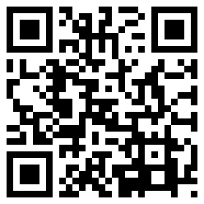




Data Capsule Team
HTRC Data Capsule@IU Team
Beth Plale (PI)
Jiaan Zeng
Guangchen Ruan
HTRC Data Capsule@Michigan Team
Atul Prakash (PI)
Alexander Crowell
Jiaan Zeng, Guangchen Ruan, Alexander Crowell, Atul Prakash, and Beth Plale. 2014. Cloud computing data capsules for non-consumptiveuse of texts. In Proceedings of the 5th ACM workshop on Scientific cloud computing (ScienceCloud '14). ACM, New York, NY, USA, 9-16. DOI=10.1145/2608029.2608031 http://doi.acm.org/10.1145/2608029.2608031
Special Thanks to
Samitha Liyanage
Milinda Pathirage
Zong Peng
Earlence Fernandes
Ajit Aluri

Slide 49
HTRC Data Capsule
HTRC Data Capsule@IU Team
Beth Plale (PI)
Jiaan Zeng
Guangchen Ruan
HTRC Data Capsule@Michigan Team
Atul Prakash (PI)
Alexander Crowell
Jiaan Zeng, Guangchen Ruan, Alexander Crowell, Atul Prakash, and Beth Plale. 2014. Cloud computing data capsules for non-consumptiveuse of texts. In Proceedings of the 5th ACM workshop on Scientific cloud computing (ScienceCloud '14). ACM, New York, NY, USA, 9-16. DOI=10.1145/2608029.2608031 http://doi.acm.org/10.1145/2608029.2608031
Special Thanks to
Samitha Liyanage
Milinda Pathirage
Zong Peng
Earlence Fernandes
Ajit Aluri
Notes:
Jiaan Zeng, Guangchen Ruan, Alexander Crowell, Atul Prakash, and Beth Plale. 2014. Cloud computing data capsules for non-consumptiveuse of texts. In Proceedings of the 5th ACM workshop on Scientific cloud computing (ScienceCloud '14). ACM, New York, NY, USA, 9-16. DOI=10.1145/2608029.2608031 http://doi.acm.org/10.1145/2608029.2608031

Slide 50
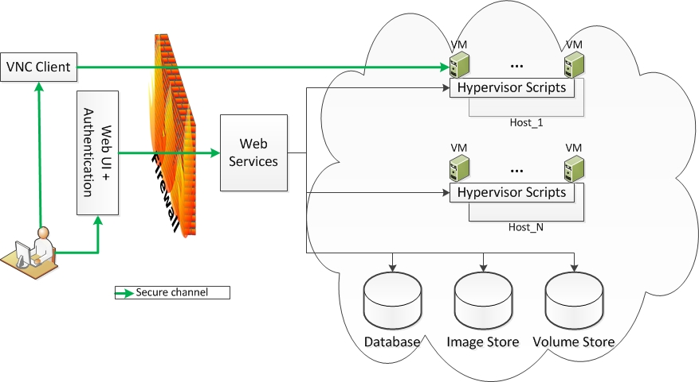
Data Capsule Workflow

Slide 51
HTRC Data Capsule
Web front end
Web UI
User Authentication
Firewall
Web service
Web Services
Audit
Hypervisor Scripts
Database
Image Store
Volume Store
Backend
VM-1
…
VM-k
VM-1
…
VM-k
Host-1
…
Host-N

Slide 52
HT Data Capsule
Web front end
Web UI
User Authentication
Firewall
Web service
Web Services
Audit
Hypervisor Scripts
Database
Image Store
Volume Store
Backend
VM-1
…
VM-k
VM-1
…
VM-k
Host-1
…
Host-N

Slide 53
HTRC Data Capsule Workflow

Slide 54
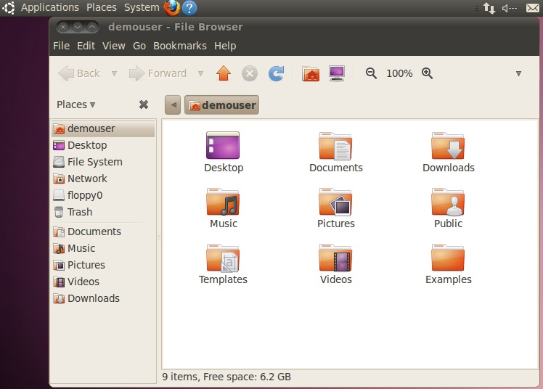
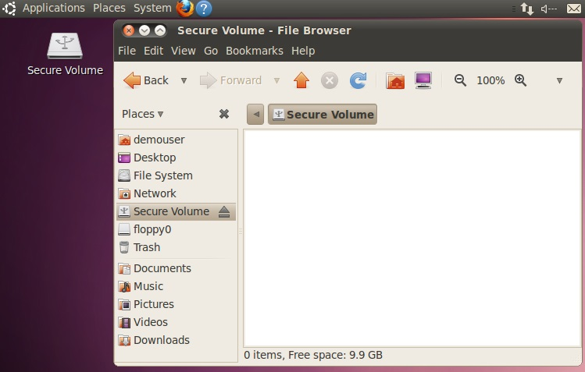
Data Capsule Screenshots
Secure Mode
Maintenance Mode

Slide 55
HT Data Capsule Screenshots
Secure Mode
Maintenance Mode

Slide 56
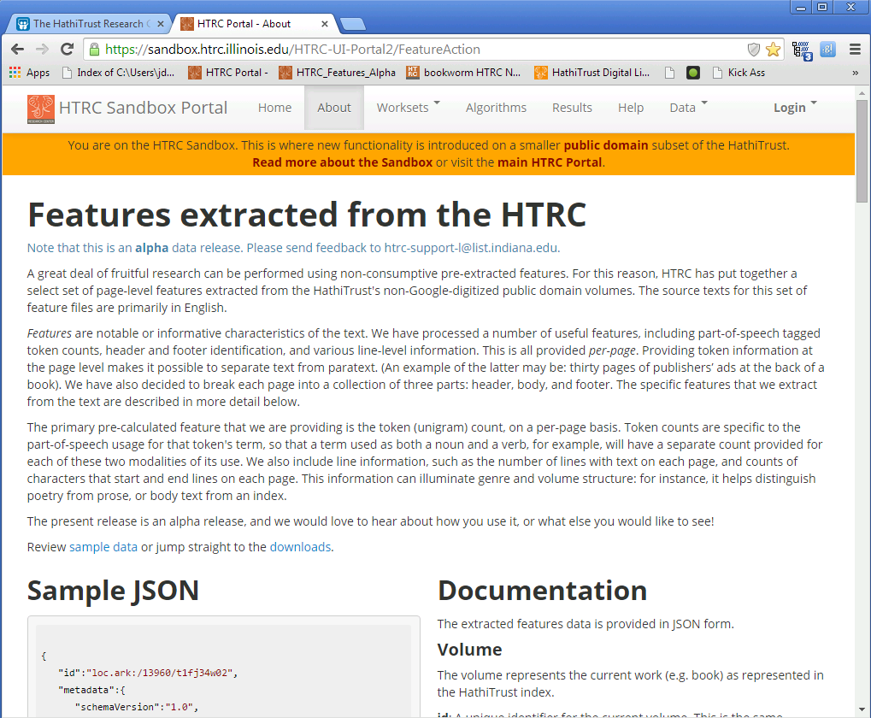
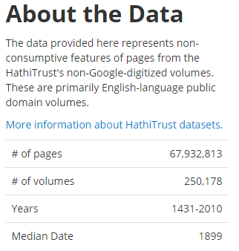
Extracted Features

Slide 57
HT Members Engaged
Allegheny College
American University of Beirut
Arizona State University
Baylor University
Boston College
Boston University
Brandeis University
Brown University
California Digital Library
Carnegie Mellon University
Colby College
Columbia University
Committee on Institutional Cooperation
Cornell University
Dartmouth College
Duke University
Emory University
Florida State University
Harvard University
Indiana University
Iowa State University
Johns Hopkins University
Kansas State University
Lafayette College
Library of Congress
Massachusetts Institute of Technology
McGill University
Montana State University
Mount Holyoke College
Michigan State University
New York University
New York Public Library
North Carolina Central University
North Carolina State University
Northeastern University
Northwestern University
The Ohio State University
The Pennsylvania State University
Princeton University
Purdue University
Rutgers University
Stanford University
Syracuse University
Temple University
Texas A&M University
Tufts University
Universidad Complutense de Madrid
University of Alabama
University of Arizona
University of California
University of California Berkeley
University of California Davis
University of California Irvine
University of California Los Angeles
University of California Merced
University of California Riverside
University of California San Diego
University of California San Francisco
University of California Santa Barbara
University of California Santa Cruz
The University of Chicago
University of Connecticut
University of Delaware
University of Florida
University of Houston
University of Illinois at Urbana-Champaign
University of Illinois at Chicago
The University of Iowa
University of Kansas
University of Maine
University of Maryland
University of Massachusetts Amherst
University of Michigan
University of Minnesota
University of Missouri
University of Nebraska-Lincoln
University of New Mexico
The University of North Carolina at Chapel Hill
University of Notre Dame
University of Oklahoma
University of Pennsylvania
University of Pittsburgh
University of Tennessee, Knoxville
University of Utah
Vanderbilt University
University of Virginia
University of Washington
University of Wisconsin-Madison
Utah State University
Virginia Tech
Wake Forest University
Washington University
Yale University Library
Notes:
In black on this slide are the HathiTrust member institutions where one or more people have a) attended an uncamp, or b) subscribe to the HTRC usergroup email list, or c) have contacted us about collaborating on a grant proposal.

Slide 58
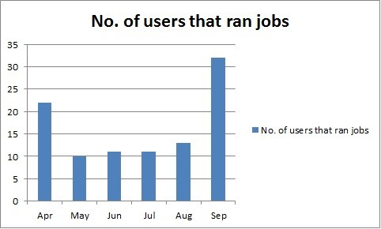
Growing Use

Slide 59
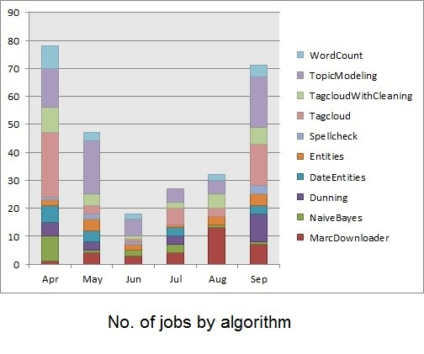
User-Generated Analytics

Slide 60
Current U.S. Grants
Data Capsule
  Alfred P. Sloan Foundation
Workset Creation for Scholarly Analysis
  Andrew W. Mellon Foundation
Exploring the Billions and Billions of Words in the HathiTrust Corpus with Bookworm
  National Endowment for the Humanities

Slide 61
Workset Creation for Scholarly Analysis:
Prototyping Project
Collection analysis and prototype tools & services to facilitate workset creation
  J. Stephen Downie, Tim Cole, Beth Plale
  Andrew W. Mellon Foundation
  1 July 2013 - 30 June 2015
Proposal Narrative:
  http://bit.ly/htrrcworksetgrant

Slide 62
Grand Motivation
The ability to slice through a massive corpus constructed from many different library collections, and out of that to construct the precise workset required for a particular scholarly investigation, is an example of the “game changing” potential of the HathiTrust...

Slide 63
Dimensions of Workset Creation (Illustrative)
My workset should contain (inspired by 2012 UnCamp):
Volumes pertaining to Japan / in Japanese
All volumes relevant to the study of Francis Bacon
Music scores or notation extracted from HT volumes
Images of Victorian England extracted from HT vols.
Volumes in HT similar to TCP-ECCO novels
19th c. English-language novels by female authors
Representative sample (by pub date & genre) of French language items in HT

Slide 64
Two Project Streams
Workset formal structures and semantics
  Work in conjunction with Center for Informatics Research in Science and Scholarship at the Graduate School of Library and Information Science
WCSA Prototyping Projects
  Four projects funded by the grant but conducted by community teams

Slide 65
What is a Workset?
A workset is an aggregation of materials brought together for the purpose of analysis.
Worksets are conceptual and must be expressible in a variety of ways
Need to allow creation outside of HathiTrust
Need to facilitate inclusion of resources beyond HathiTrust
Need to facilitate the inclusion of resources at many different levels of granularity beyond the book
Worksets encapsulate the specific materials that underwent analysis.
Need to capture provenance information
Possible recording of parameters
Worksets should be able to spawn descendants but otherwise immutable

Slide 66
What is Workset? #1
A workset is an aggregation of materials brought together for the purpose of analysis.

Slide 67
What is a Workset? #2
Worksets are conceptual and must be expressible in a variety of ways
Need to allow creation outside of HathiTrust
Need to facilitate inclusion of resources beyond HathiTrust
Need to facilitate the inclusion of resources at many different levels of granularity beyond the book

Slide 68
What is Workset #3
Worksets encapsulate the specific materials that underwent analysis.
Need to capture provenance information
Possible recording of parameters

Slide 69
What is a Workset? #4
Worksets should be able to spawn descendants but otherwise immutable

Slide 70
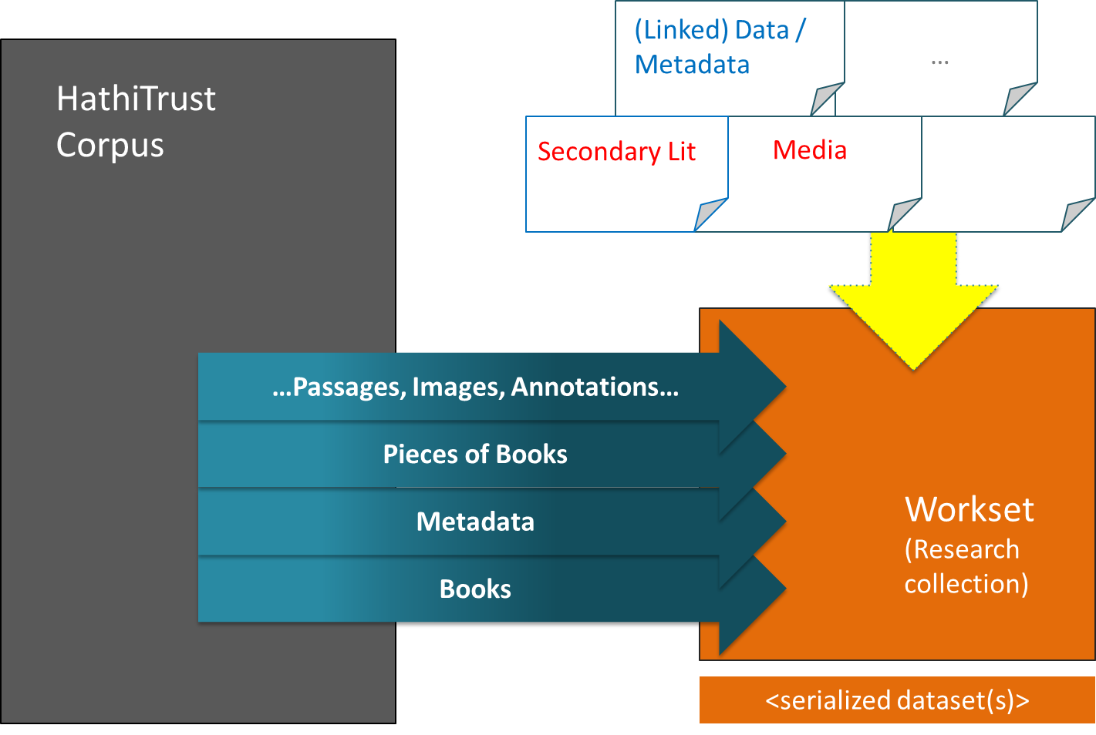
Scope

Slide 71
MARC Metadata Shortcomings I
MARC Field | Percent of records in OCLC having instance of this field
245 Title Statement | > 99%
260 Publication Distribution, etc. | 92%
500 General Note | 41%
650 Topical Term / 653 Index Term – Uncontrolled | 39% / 13%
050 LC Classification No / 082 Dewey Classification No | 17% / 13%
655 Index Term -- Genre Form | 12%
Table 2. Frequency of MARC fields in OCLC Records

Slide 72
MARC Metadata Shortcomings II
MARC Field | Percent of British Novel MARC records having instance of this field
650 Topical Term | 6%
050 LC Classification No / 082 Dewey Classification No | 27% / 4%
655 Index Term -- Genre Form | 5%
Table 3. Frequency of MARC fields used in 2,386 descriptions
of 19th century British novels digitized from UIUC collections

Slide 73
Why Worksets?
The result of a first-level, rough filter
Better scale for intensive analytics
Provides essential scope for certain analytics
  Word frequency scope over Bacon’s essays
Some tools (are trained to) work best on a narrow, homogeneous work-set
Eliminate noise that would otherwise arise by asking questions across whole of HT

Slide 74
Research Questions (Illustrative only)
Can we enrich the HathiTrust corpus metadata by distilling analytics over full text?
Can we augment string-based metadata with URIs for recognized entities – e.g., names, subjects, publication location, etc. -- and by doing so can we leverage external services to facilitate discovery and clustering of resources?
Can we leverage existing, well-defined external corpora to identify complementary subsets of HT volumes, and having done so can we demonstrate the ability to create and perform analytics over an integrated workset that includes resources external to HT?

Slide 75
WCSA Project #1
Workset Creation through Image Analysis of Document Pages
PI: Keith Biggers
Texas A & M University
Maps visual features of pages to determine content types and locations

Slide 76
WCSA Project #2
Semantic Analysis of Documents from the HathiTrust Corpus
PI: Annike Hinze
University of Waikato
Concept knowledge base and semantics generated from external sources used to map concepts onto HT collection

Slide 77
WCSA Project #3
Distributed Metadata Correction and Annotation
PI: Trevor Muñoz
Maryland Institute for Technology in the Humanities
Distributed approach using OpenRefine and Open Annotation to discover and correct metadata omissions and errors

Slide 78
WCSA Project #4
ElEPHãT: Early English Print in HathiTrust, a Linked Semantic Workset Prototype
PI: Kevin Page
University of Oxford
Linked data approaches to map documents in EEBO with related works and items in HT collection

Slide 79
Workset Formal Model

Slide 80

Workset Formal Model V.2
“Agrippa”^^xsd:string
htrc:Collection
rdf:type
“Agrippa and Mexia”^^xsd:string
dc:title
dcterms:extent
9^^xsd:integer
cnt:content
:_workset1
:_desc1
dcterms:abstract
dcterms:created
dc:creator
“2013-11-11T15:55:48-5:00Z”^^xsd:dateTime
rdf:type
dul1.ark:/13960/t77s8cw40
:_curator1
rdf:type
cnt:ContentAsText
htrc:BibliographicResource
rdf:type
rdf:about
foaf:accountName
foaf:Agent
http://catalog.hathitrust.org/Record/010944168
rdf:type
“rkfritz”^^xsd:string
htrc:BibliographicRecord

Slide 81
Draft Workset Data Model V. 0.2
htrc:Collection
“Agrippa”^^xsd:string
rdf:type
“Agrippa and Mexia”^^xsd:string
dc:title
dcterms:extent
9^^xsd:integer
cnt:content
:_workset1
dcterms:abstract
:_desc1
dcterms:created
dc:creator
htrc:isGatheredInto
“2013-11-11T15:55:48-5:00Z”^^xsd:dateTime
rdf:type
dul1.ark:/13960/t77s8cw40
cnt:ContentAsText
:_curator1
htrc:BibliographicResource
rdf:type
rdf:type
rdf:about
foaf:accountName
foaf:Agent
http://catalog.hathitrust.org/Record/010944168
rdf:type
“rkfritz”^^xsd:string
htrc:BibliographicRecord

Slide 82
In the Grant Pipeline
Secure Data Capsules for Computational Linguistics
  Unsworth (Brandeis)
Repository Services for Accessible Course Content
  Wood (Tufts)
Digging Deeper, Reaching Further: Libraries Empowering Users to Mine the HathiTrust Digital Library Resources
  Green (Illinois)

Slide 83
Exploring the Billions and Billions of Words in the HathiTrust Corpus with Bookworm
National Endowment for the Humanities Implemenation Grant
Team
  J. Stephen Downie, University of Illinois at Urbana-Champaign
  Erez Lieberman Aiden, Baylor College of Medicine
  Benjamin Schmidt, Northeastern University
  Robert McDonald, Indiana University
  Loretta Auvil, University of Illinois at Urbana-Champaign
  Sayan Bhattacharyya, University of Illinois at Urbana-Champaign
  Colleen Fallaw, University of Illinois at Urbana-Champaign
  Muhammad Shamim, Baylor College of Medicine
  Peter Organisciak, University of Illinois at Urbana-Champaign

Slide 84
HT+BW Project
HT
  Textual data
  Metadata
Bookworm
  Tool that visualizes language usage trends in repositories of digitized texts in a simple and powerful way

Slide 85
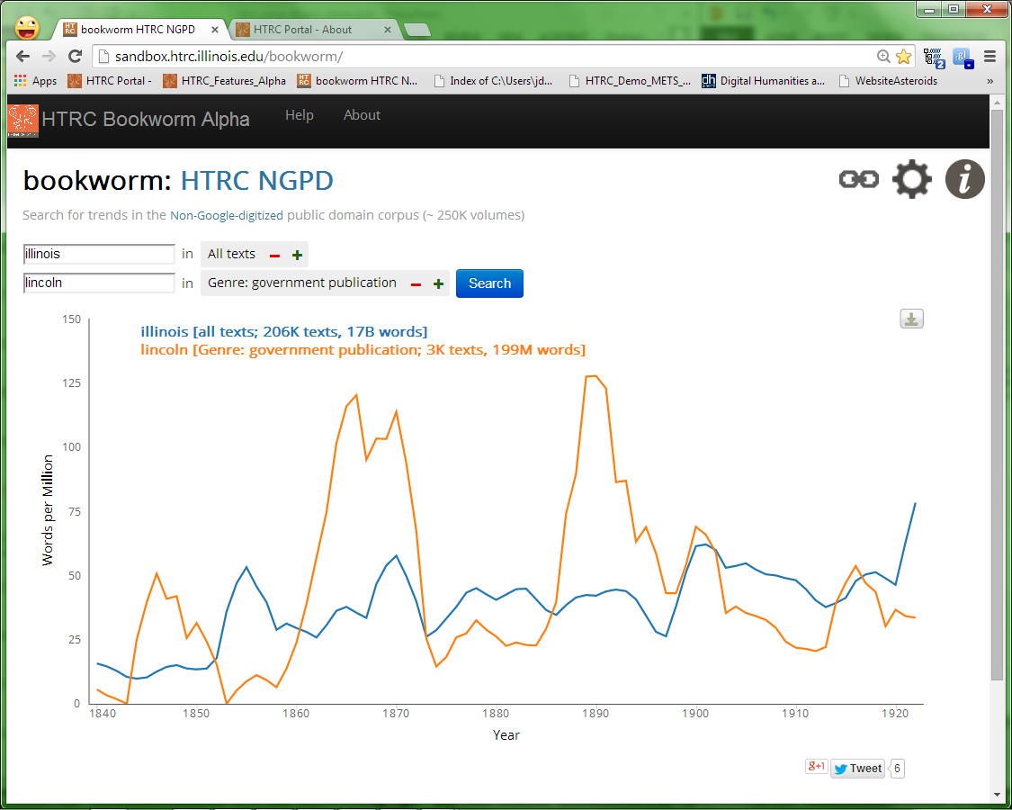
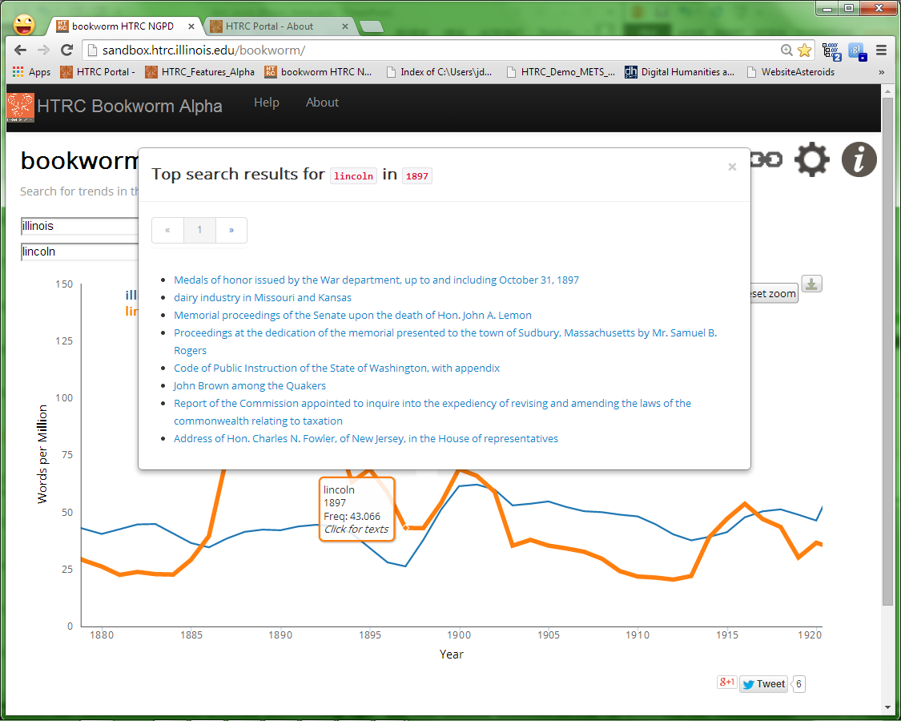

Slide 86
Principal goals for the HT+BW Project
To integrate Bookworm into HTRC in ways that are beneficial to our core demographic of humanities researchers, and
To develop our improvements to Bookworm in ways that can be contributed back to the open source project and benefit other large-scale textual repositories.

Slide 87
Tasks
Implement analytics at scale
  Development of API for data access
  Enable SOLR backend in addition to current MySQL
Identify valuable metadata formats for humanities scholars
  Development of API for data access
  Expand metadata available
Allow creation of custom research collections (HTRC Worksets)
  Display of trends of only HTRC Workset
  Create an HTRC workset from trend viewing
Generalize beyond HTRC back to Bookworm for usage by others
  Improvements to GUI
  API Improvements
Conduct outreach, training and workshops

Slide 88
Current Metadata
Class
Subclass
Fiction
Genre
Language
Issuance
Author Gender
Page Count
Word Count
Publication Country
Publication State
What additional metadata should we add?
Need hierarchy abilities
to make searching more meaningful

Slide 89
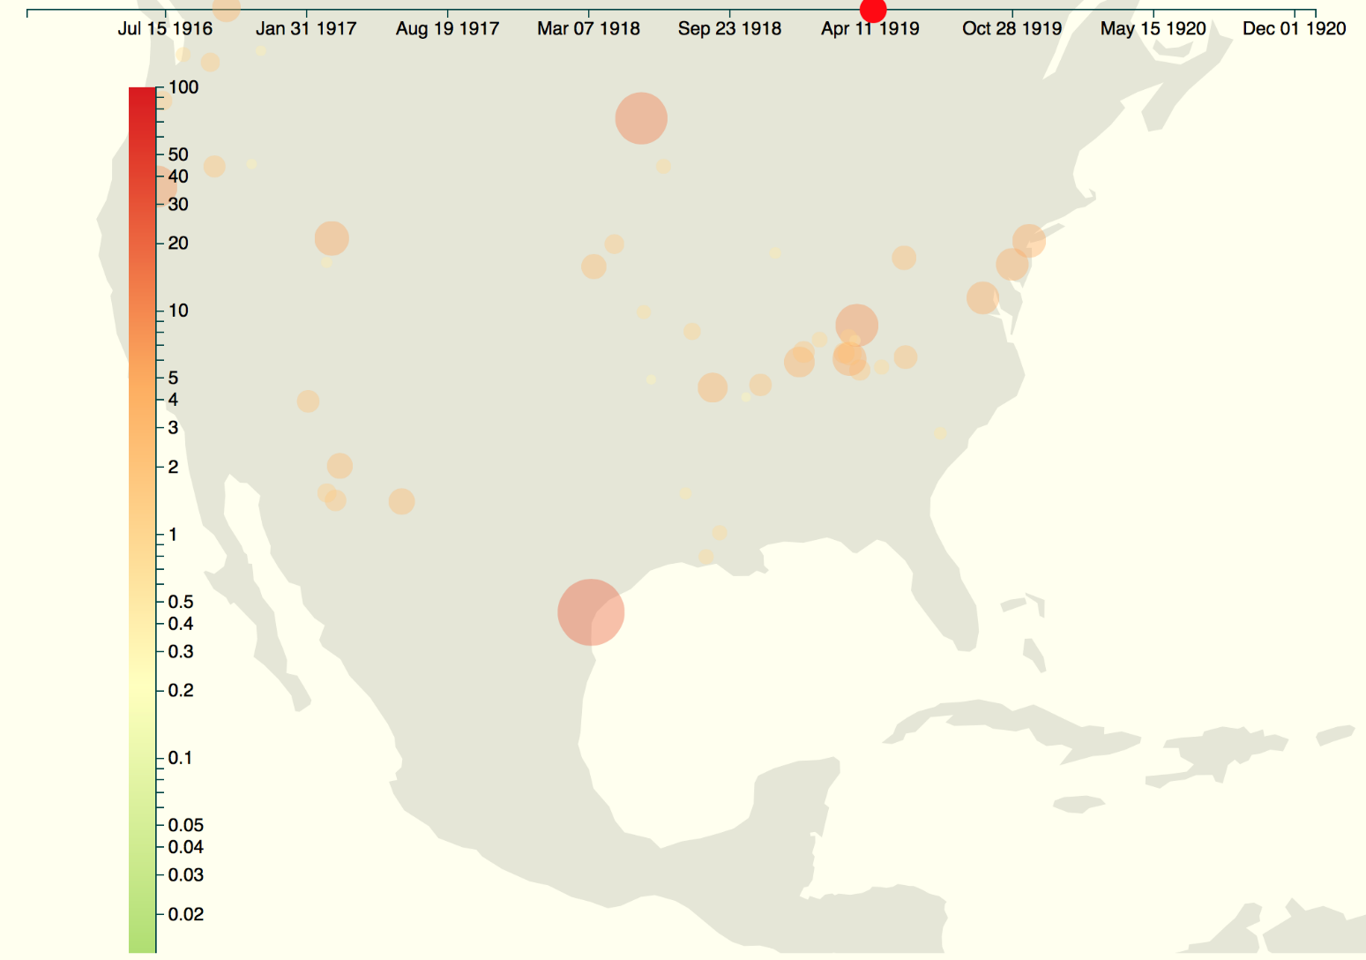
Using Maps
Leveraging metadata viz tools

Slide 90
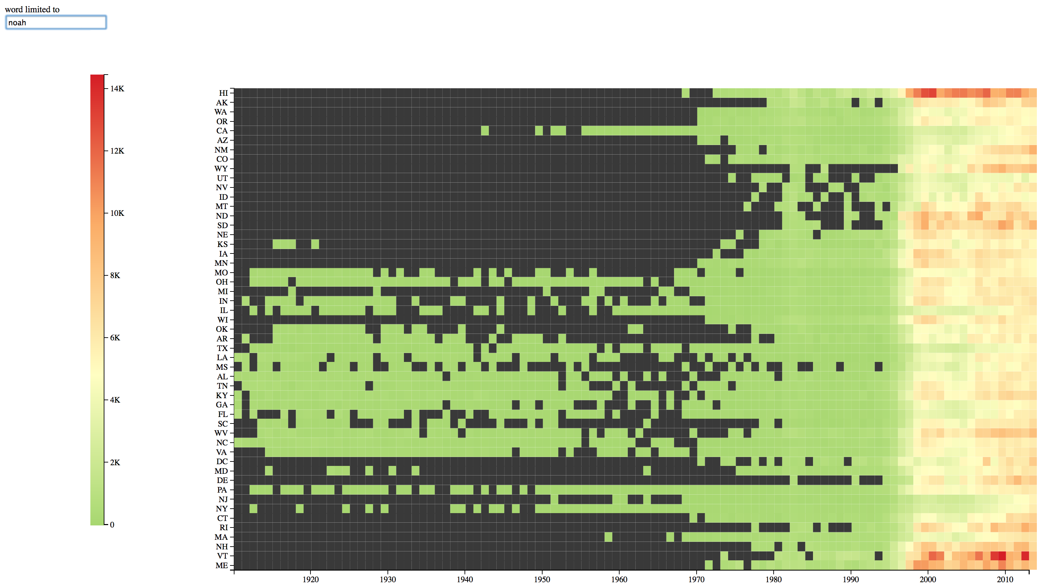
Using Heatmaps
Metadata serves as attributes for heatmaps
2013 top boy name,“noah”, displayed over time by US State

Slide 91
Canadian Collaborations
Novel TM
PI: Andrew Piper, McGill University
  http://novel-tm.ca/
The Single Interface for Music Score Searching and Analysis Project (SIMSSA)
PI: Ichiro Fujinaga, McGill University
  http://simssa.ca/

Slide 92
HTRC Future Work
Copyrighted content in progress
Advanced Collaborative Support
  The award model
  Award content is HTRC ACS staff time
  Collaborate with scholars on addressing their research needs related to HTRC
  E.g. prototyping, running text analysis
  Advocate open source; encourage extending the work to a grant submission
  Call for proposals went out Mid-October 2014
Scholars Commons
  Interaction with scholars to help using HTRC tools and services
  An interface to interact with HTRC users via the channel of scholars commons
  Series of workshops at IU and UIUC

Slide 93
Personal Goals for HTRC
Keep up momentum on workset research
Engage in more collaborative projects
Expand to have truly international partnerships
Make sure to move beyond text
Make sure to move beyond humanities!
Explore accessibility issues for visually impaired

Slide 94
Future Events
HTRC UnCamp 2015
  March 30-31, 2015 at Ann Arbor, MI
DH 2015
  June 29-3 July, 2015 at Sydney, Australia

Slide 95
Thank You!

