Slide 1
HathiTrust Update
2015 Midwinter CCDO
January 30, 2015
Mike Furlough, Executive Director
Sharon Farb, HathiTrust Collections Committee
Tom Teper, Print Monographs Archive Planning Task Force
Mark Sandler, Government Documents Initiative Planning and Advisory Group
Beth Sandore Namachchivaya, HathiTrust Research Center

Slide 2
This Morning’s Updates
Organizational
Collections Committee
Shared Print
Government Documents
HathiTrust Research Center
Your questions

Slide 3
HathiTrust in January 2015 (1)
13.1 million total items
6.7 million book titles
345,000 serial titles
604,000 government documents
4.9 million items open (public domain & CC-licenses)
A handful of images and thimbleful of audio files
103 members
96 in the US, 4 in Canada, 1 each in Spain, Australia, and Lebanon

Slide 4
HathiTrust in January 2015 (2)
Our mission, collection, and the repository operations are all strong.
Our work is solidly based in the law.
We have expanded access in unprecedented ways.
We have very important programs underway.
The partnership provides a solid base for action.

Slide 5
Program Steering Committee
Serves at the direction of the Board of Governors to…
Review HathiTrust’s development agenda, shaping initiatives and strategies.
Develops position papers to encourage debate or mobilize activity
Works with the Board of Governors to develop policies for HathiTrust and its members.

Slide 6
Program Steering Committee Membership
Ivy Anderson (CDL)
John Butler (Minnesota)
Chris Freeland (Washington University)
Todd Grappone (UCLA)
Martha Hruska (UC San Diego)
Martin Kurth (New York University)
Erika Linke (Carnegie Mellon University)
Robert McDonald (Indiana)
Elaine Westbrooks (Michigan)
Bob Wolven, Chair (Columbia)

Slide 7
PSC Actions
To date:
Initial focus on Constitutional Convention Ballot Initiatives (Government Documents, Shared Print)
Re-established Collections Committee
Created Rights & Access Working Group
Developed charge for Zephir Advisory Group
Pending:
Reviewing working group recommentations
Quality metrics and assessment
Metadata policy and strategy
Additional content-types (non-text)?

Slide 8
HathiTrust in 2015: Issues
Strategy, mission, and role in the future
Membership growth
Collections program
Public policy
(Inter)National infrastructure
Services for members and the public
Organizational
Engagement with researchers and libraries
Enabling more participation in plans and action
Standing up on our own

Slide 9
Assumptions
Our actions must align with the mission, goals, and purpose across our partnership.
A few additional assumptions
We should pursue complementarity and cooperation, not competition and duplication.
Scale will continue to drive our strategies
Potential partners are not just other libraries and library organizations, but also readers, authors, publishers.

Slide 10
HathiTrust Collections Committee

Slide 11
Collections Committee Members
Ivy Anderson, Chair and PSC Liaison (CDL), 2014 - 2015
Sharon Farb (UCLA), 2014
Dan Hazen (Harvard University), 2014
Carmelita Pickett (Texas A&M University), 2014
Bryan Skib (University of Michigan), 2014
Claire Stewart (Northwestern), 2014
Tom Teper (University of Illinois), 2014 – 2015
Ann Thornton (NYPL), 2014

Slide 12
Shared Print Working Group

Slide 13
The Print Monographs Archive Planning Task Force
Ballot Initiative passed at the 2011 HT Constitutional Convention (Con-Con)
“To develop a print monographs archive corresponding to volumes represented within the HathiTrust”
HathiTrust Board of Governors approved appointment of a PSC-designed task force to begin planning in June 2014
Calls every other week with two face-to-face meetings in October 2014 and one in January 2015

Slide 14
Ballot Initiative Called For….
A print archive founded on formal agreements with print repositories of member institutions or their affiliated agents
Agreements that would establish retention commitments to ensure continuing availability of the archived holdings to the HT members
Provision of financial support to the designated repositories sufficient to secure and maintain these agreements
The initiation of a formal planning process by which necessary policies, operational plans, and business models required would be established to sustain a distributed archive

Slide 15
Among the issues to examine…
Exploration of the model needed to identify and preserve print resources
Qualifications of participating repositories
Analysis and identification of appropriate content for inclusion in the archive
Additional criteria for participation, such as geography, repository type, breadth of contribution, institutional commitment…
Retention periods
Discovery, access policies, and service models
Business and financial models
Roles and relationships among HT and other libraries and organizations engaged in collaborative management of print collections.

Slide 16
Task Force proposal…
Defines the character of the repository as…
A collection that mirrors HT’s monographic holdings, is distributed and “light”
A repository that is governed, managed, and supported by the HT as a whole, not a subset of members
A repository that is relatively lightweight and focused on lowering barriers for early participation

Slide 17
Task Force proposal…
Defines the development of the repository as…
A phased process that seeks, in phases one and two, to launch the repository and match commitments for 50% of the titles
A process that, in phase three, will build out the infrastructure, including more advanced access services
A process that, in phase four, will seek to operationalize services to support continued growth.

Slide 18
Task Force proposal…
Defines the national role of the repository as…
Providing leadership in the area of monographic, print retention.
Supporting the development of the technical infrastructure necessary to disclose commitments and discover content.
Providing services to members that support their efforts to make local collection management decisions

Slide 19
Building a Foundation to Accrue Advantages
The repository will convey our collective intent to preserve our published monographic heritage.
The repository will serve as the foundation for making local retention/withdrawal decisions.
The program will provide members with tools to support collection management/development decisions.
The program will provide transformative services to users.
The program will provide the means to establish prospective retention and digitization commitments for newly published literature.

Slide 20
Conclusion
Our proposal is grounded in a set of assumptions:
We believe that collaborative management of print is important
We believe that libraries need to preserve ongoing access to the print record
We believe in sharing and providing enhanced access.
By working together, our members believes that Hathi’s nation-wide organization can reshape the collections landscape, redefine how libraries manage collections, and support member institutions as they seek to meet the changing needs of the readers and scholars they serve.

Slide 21
Expanding Access to Government Information

Slide 22
Current Activity
Approximately 600,000 documents in HT
About 500,000 of these sourced from CIC universities and digitized by Google
CIC libraries and UC system libraries will continue to supply content
Hathi building a comprehensive registry of government publications
Hathi and Google carrying out an analysis of HT member holdings

Slide 23
Working Group Appointed
Group Charge:
Develop an overall strategy for building a comprehensive public domain corpus of U.S. federal documents in HathiTrust
Recommend investments as needed to pursue the initiative
Advise the Board on relevant policy issues
Provide oversight and guidance as the project develops

Slide 24
Working Group
Group Members:
Prue Adler (ARL) Mark Phillips (UNT)
Ivy Anderson (CDL) Jon Rothman (UMICH)
Joni Blake (GWLA) Judy Russell (UFL)
Kirsten Clark (UMN) Mark Sandler (CIC)
Rick Clement (UNM) Barbie Selby (UVA)
Elizabeth Cowell (UCSC) Jeremy York (HT)

Slide 25
Deliverable
20 page report with 16 recommendations for future action
Near, intermediate and long-term recommendations
Reviewed by PSC
To be passed on to the Board
Expect response in the next month or so

Slide 26
All Done
Thank You and Questions
msandler@staff.cic.net

Slide 27
HathiTrust Research Center

Slide 28
Mission of HT Research Center
Research arm of HathiTrust
Goal: enable researchers world-wide to carry out computational investigation of HT repository through
Develop model for access: the ‘workset’
Develop tools that facilitate research by digital humanities and informatics communities
Develop secure cyberinfrastructure that allows computational investigation of entire copyrighted and public domain HathiTrust repository
Established: July, 2011
Collaborative effort of Indiana University and University of Illinois

Slide 29
Try it!
https://htrc2.pti.indiana.edu/

Slide 30
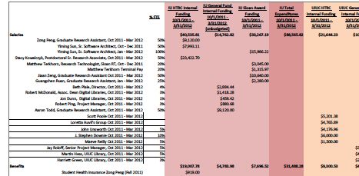
HTRC system
Request
Spatial plots
The complexity
Statistical plots
Tabular info
Complexity hiding interface

Slide 31
Text mining tools
Complexity hiding interface
HTRC
Repository
@IU @UIUC
Extracted feature sets
Other text, e.g., dictionaries, wiki, twitter

Slide 32
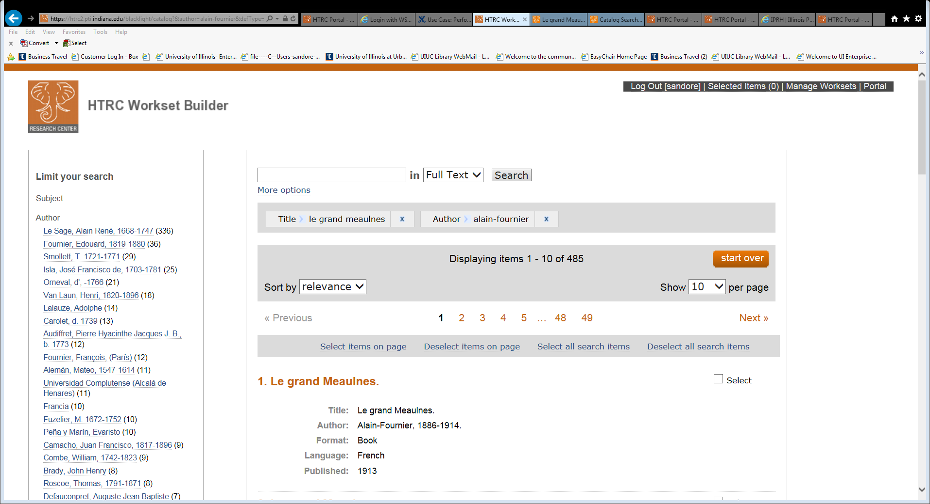
Workset builder

Slide 33
HTRC Data Capsule: Secure access to copyrighted materials
Secure computing framework that:
Trusts that researcher will not deliberately leak repository data, but
Prevents malware acting on user's behalf from leaking data.
Secure support for:
Non-consumptive use: framework for safe handling of large volumes of protected data
Openness: supports user-contributed analysis tools
Efficiency: supports user-contributed analysis tools without lengthy prior review
Large-scale and low cost: protections extend to large-scale national (public) supercomputers

Slide 34
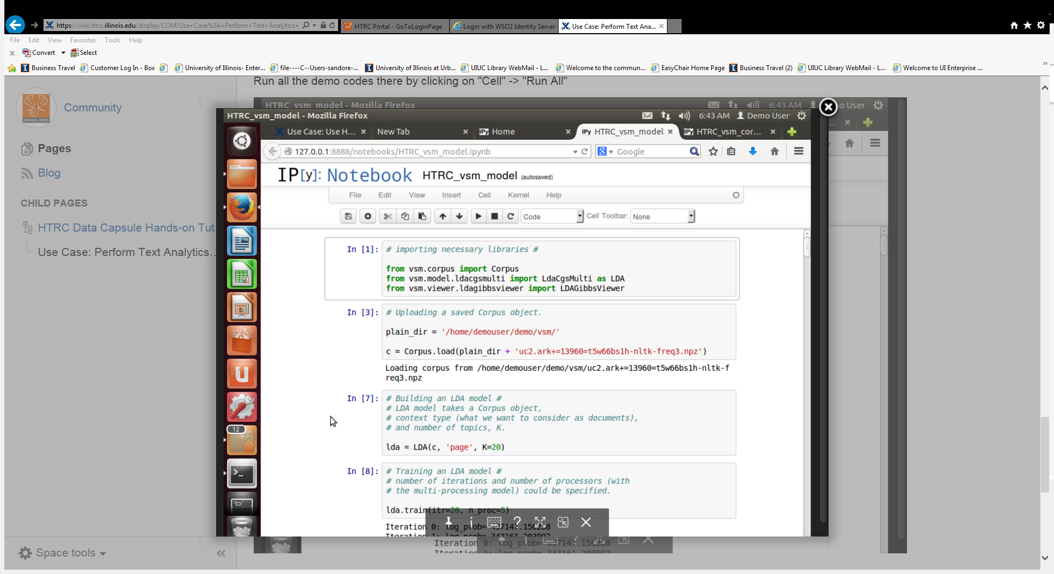
HTRC secure data capsule: view from researcher desktop

Slide 35
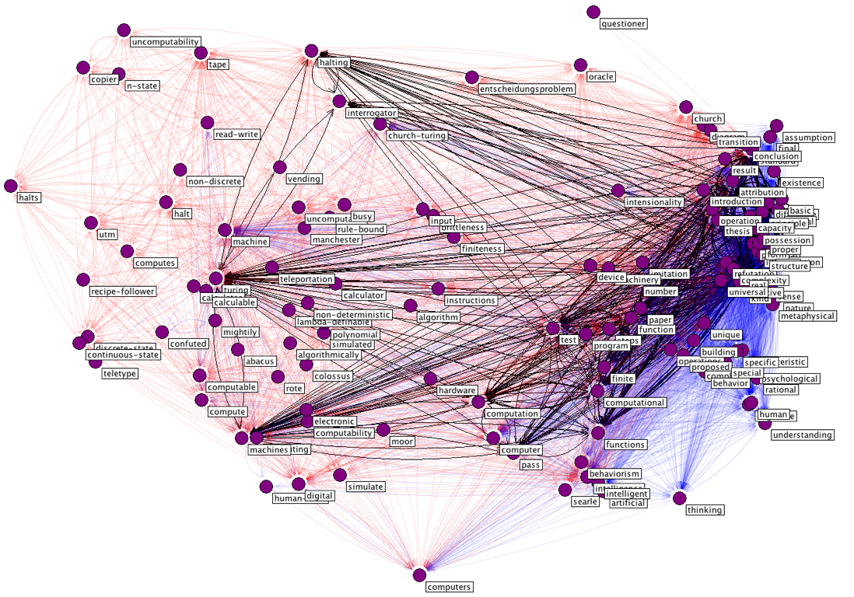
Scholarly Commons User Support Service
Develop training materials
Educational workshops
Tool and workset support
Collaborate with librarians and DH centers at HT institutions
Assist researchers in HTRC text data mining research projects
Collaboration: University Libraries, Illinois and Indiana

Slide 36
http://www.hathitrust.org
http://www.hathitrust.org/htrc
Sponsors:

Slide 37
Discussion

