Slide 1
HathiTrust: the Collection and its Uses
John Wilkin
Sigrid Cordell
May 6, 2013

Slide 2
Introduction

Slide 3
Partnership
Arizona State University
Baylor University
Boston College
Boston University
Brandeis University
Brown University
California Digital Library
Carnegie Mellon University
Columbia University
Cornell University
Dartmouth College
Duke University
Emory University
Florida State University
Getty Research Institute
Harvard University Library
Indiana University
Iowa State University
Johns Hopkins University
Kansas State University
Lafayette College
Library of Congress
Massachusetts Institute of Technology
McGill University`
Michigan State University
New York Public Library
New York University
North Carolina Central
University
North Carolina State
University
Northwestern University
The Ohio State University
The Pennsylvania State
University
Princeton University
Purdue University
Stanford University
Syracuse University
Texas A&M University
Tufts University
Universidad Complutense
de Madrid
University of Arizona
University of Calgary
University of California
Berkeley
Davis
Irvine
Los Angeles
Merced
Riverside
San Diego
San Francisco
Santa Barbara
Santa Cruz
The University of Chicago
University of Connecticut
University of Delaware
University of Florida
University of Houston
University of Illinois
University of Illinois at Chicago
The University of Iowa
University of Kansas
University of Maryland
University of Miami
University of Michigan
University of Minnesota
University of Missouri
University of Nebraska-Lincoln
The University of North
Carolina at Chapel Hill
University of Notre Dame
University of Pennsylvania
University of Pittsburgh
University of Utah
University of Vermont
University of Virginia
University of Washington
University of Wisconsin- Madison
Utah State University
Vanderbilt University
Virginia Tech
Wake Forest University
Washington University
Yale University Library

Slide 4
Digital Repository
Launched 2008
Initial focus on digitized book and journal content
10.6 million total volumes
5.6 million book titles
277,000 serial titles
3.3 million public domain (~31%)

Slide 5
Mission
To contribute to the common good by collecting, organizing, preserving, communicating, and sharing the record of human knowledge

Slide 6
Goals
Reliable and comprehensive archive of materials converted from print…co-owned
Improve access …to meet the needs of the co-owning institutions
Ensure the long-term preservation of content
Coordinate shared storage strategies
“public good” …sustaining the historical record
Simultaneously …centralized …open

Slide 7
Copyright Distribution
Notes:
7

Slide 8
Language Distribution (1)
The top 10 languages make up ~86% of all content
Notes:
8

Slide 9
Services
Long-term preservation
Bit-level and migration
Bibliographic search
Full-text search
Reading and download capabilities
Print on demand
Collections
Datasets, Research Center

Slide 10
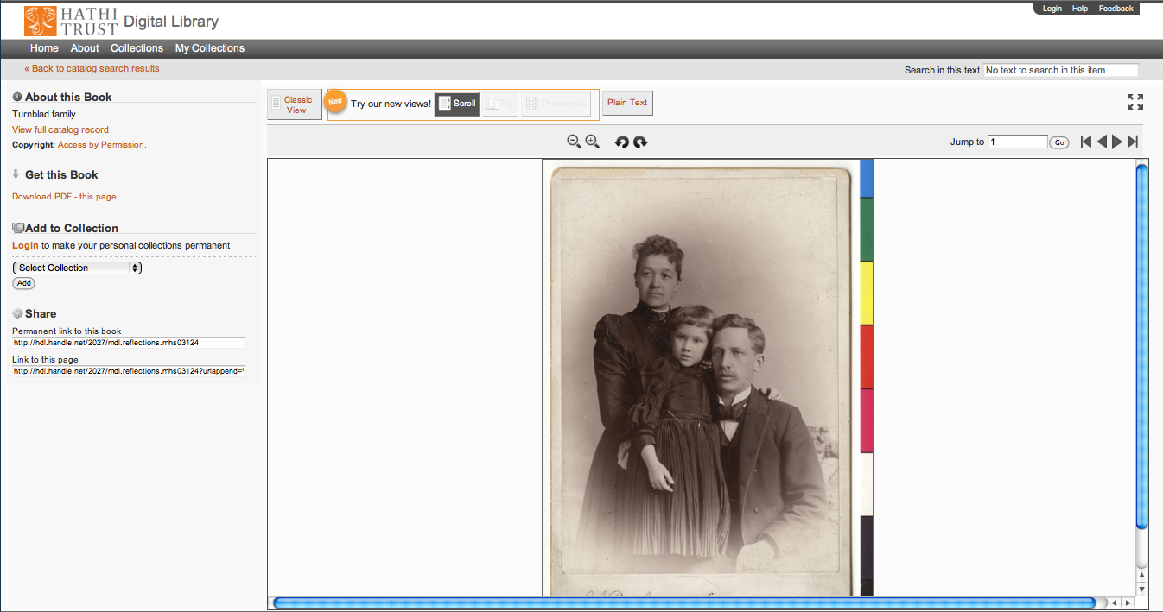
Support Beyond Books and Journals

Slide 11
Impact

Slide 12
Rights Determination
CRMS US (since 2008)
Published in US, 1923-1963
239,296 determinations
129,026 opened (~53%)
CRMS-World (since 2012)
Published non-US (UK, Canada, Australia, Spain)
41,162 determinations
22,288 opened (~54%)
Permissions
Open access - 6,566
Additional Creative Commons – 5,460

Slide 13
Collection Management, Development
Overlap
More than 50% median overlap with ARL institutions; higher for small liberal arts colleges
Pricing model based on Print holdings
Requires print holdings database
Also support expansion of legal uses, efforts in de-duplication
Facilitate individual and collaborative collection development and management operations
Print monographs archiving

Slide 14
Discovery and Use
Search, collections, online access
APIs and data feeds
Data API
Bibliographic API
“Hathifiles” inventory files
OAI
Computational Research
Distribution of datasets
Protocol-based access
Research Center

Slide 15
How to find out more
About: http://www.hathitrust.org/about
Twitter: http://twitter.com/hathitrust
Facebook: http://www.facebook.com/hathitrust
Monthly newsletter:
http:www.hathitrust.org/updates
RSS http://www.hathitrust.org/updates_rss
Contact us: feedback@issues.hathitrust.org
Blogs: http://www.hathitrust.org/blogs
Large-scale Search
Perspectives from HathiTrust

Slide 16
Thank You.
John Wilkin (jpwilkin@umich.edu
Sigrid Cordell (scordell@umich.edu)

