Slide 1
HathiTrust on the Move
A Growing Partnership Taking Stock and Looking Ahead
National Library of Medecine
October 11, 2011
Jeremy York
Project Librarian, HathiTrust

Slide 2
Outline
Overview
  Mission and Goals
  Partnership and benefits
Accomplishments
Current work
Partnership
The road ahead

Slide 3
Partnership
Arizona State University
Baylor University
Boston University
California Digital Library
Columbia University
Cornell University
Dartmouth College
Duke University
Emory University
Getty Research Institute
Harvard University Library
Indiana University
Johns Hopkins University
Lafayette College
Library of Congress
Massachusetts Institute of Technology
McGill University
Michigan State University
New York Public Library
New York University
North Carolina Central
University
North Carolina State
University
Northwestern University
The Ohio State University
The Pennsylvania State
University
Princeton University
Purdue University
Stanford University
Texas A&M University
Universidad Complutense
de Madrid
University of Arizona
University of Calgary
University of California
Berkeley
Davis
Irvine
Los Angeles
Merced
Riverside
San Diego
San Francisco
Santa Barbara
Santa Cruz
The University of Chicago
University of Connecticut
University of Florida
University of Illinois
University of Illinois at Chicago
The University of Iowa
University of Maryland
University of Miami
University of Michigan
University of Minnesota
University of Missouri
University of Nebraska-Lincoln
The University of North Carolina at Chapel Hill
University of Notre Dame
University of Pennsylvania
University of Pittsburgh
University of Utah
University of Virginia
University of Washington
University of Wisconsin- Madison
Utah State University
Yale University Library

Slide 4

The Name
The meaning behind the name
  Hathi (hah-tee)--Hindi for elephant
  Big, strong
  Never forgets, wise
  Secure
  Trustworthy

Slide 5
Mission
To contribute to the common good by collecting, organizing, preserving, communicating, and sharing the record of human knowledge

Slide 6
HathiTrust
Universal Library
Common Goal
Single Entity, Many Partners

Slide 7
Collections and Collaboration
Comprehensive collection
  Preservation…with Access
Shared strategies
  Collection management, development
  Copyright
  Preservation (digital and print)
  Bibliographic Indeterminacy
  Discovery / Use
  Efficient user services
Public Good

Slide 8
Partnership
Who can become a partner?
  Institutions worldwide
  Libraries with print holdings

Slide 9
What are the benefits? (1)
Cost-effective long-term preservation and access services for digitized content
  Commitments on digital content facilitate decisions about digitization efforts and print collection management
For those with content, immediately offering long-term preservation, bibliographic and full-text search, collection-building
With content or not, full viewing and downloading capabilities for public domain materials and materials for which we have received permissions

Slide 10
What are the benefits? (2)
Specialized access to public domain and in-copyright materials for users with print disabilities
Other lawful uses of in copyright materials such as Section 108 uses (print replacement copies, digital access to applicable works), orphan works
HathiTrust encourages participation in initiatives and resources geared toward
  Shared collection development and management (e.g., copyright review work, print holdings database, de-duplication, collaboration with other organizations and initiatives)
  Participation in governance and collaborative initiatives
  Defining directions for the shared library.

Slide 11
What’s involved?
Contract
  Sustaining
  Content-Contributing
Yearly fees
Commitment
  5-year periods
Shibboleth
Print Holdings

Slide 12
Print Collections
Discovery
SERIALS SOLUTIONS
OCLC
EBSCO
APIs
HathiTrust
Bibliographic
Full-text
Access and Use
Research Center
Rights
Page-Turner
Collections
Repository
Partnership

Slide 13
Print Collections
Discovery
SERIALS SOLUTIONS
OCLC
EBSCO
APIs
HathiTrust
Bibliographic
Full-text
Access and Use
Research Center
Rights
Page-Turner
Collections
Repository
Partnership

Slide 14
Print Collections
Discovery
SERIALS SOLUTIONS
OCLC
EBSCO
APIs
HathiTrust
Bibliographic
Full-text
Access and Use
Research Center
Rights
Page-Turner
Collections
Repository
Partnership

Slide 15
Print Collections
Discovery
SERIALS SOLUTIONS
OCLC
EBSCO
APIs
HathiTrust
Bibliographic
Full-text
Access and Use
Research Center
Rights
Page-Turner
Collections
Repository
Partnership

Slide 16
Print Collections
Discovery
SERIALS SOLUTIONS
OCLC
EBSCO
APIs
HathiTrust
Bibliographic
Full-text
Access and Use
Research Center
Rights
Page-Turner
Collections
Repository
Partnership

Slide 17
Print Collections
Discovery
SERIALS SOLUTIONS
OCLC
EBSCO
APIs
HathiTrust
Bibliographic
Full-text
Access and Use
Research Center
Rights
Page-Turner
Collections
Repository
Partnership

Slide 18
Repository / Preservation
9,710,975 Volumes
2,641,985 Public Domain
5,154,739 Book titles
256,156 Serial titles
Repository
bib
data
bib
data

Slide 19
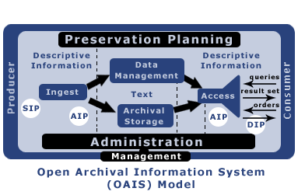
Repository – OAIS
Page Turner
HathiTrust API
OAI
GeoIP DB
CNRI Handles
[Solr]
MARC record extensions
(Aleph)
Rights DB
GROOVE
(JHOVE)
Google
Internet Archive
In-house
;
GRIN
Internal Data Loading
METS object
PNG
OCR
PDF
METS/PREMIS object
TIFF G4/JPEG2000
OCR
MD5 checksums
Isilon
Site Replication
TSM
MD5 checksum validation

Slide 20

Object Package
images
text
Source METS
Zip
HT
METS
Repository
bib
data
bib
data

Slide 21

Object Package
images
text
Source METS
Zip
TRAC
HT
METS
Repository
bib
data
bib
data

Slide 22
Print Collections
Discovery
SERIALS SOLUTIONS
OCLC
EBSCO
APIs
HathiTrust
Bibliographic
Full-text
Access and Use
Research Center
Rights
Page-Turner
Collections
Repository
Partnership

Slide 23
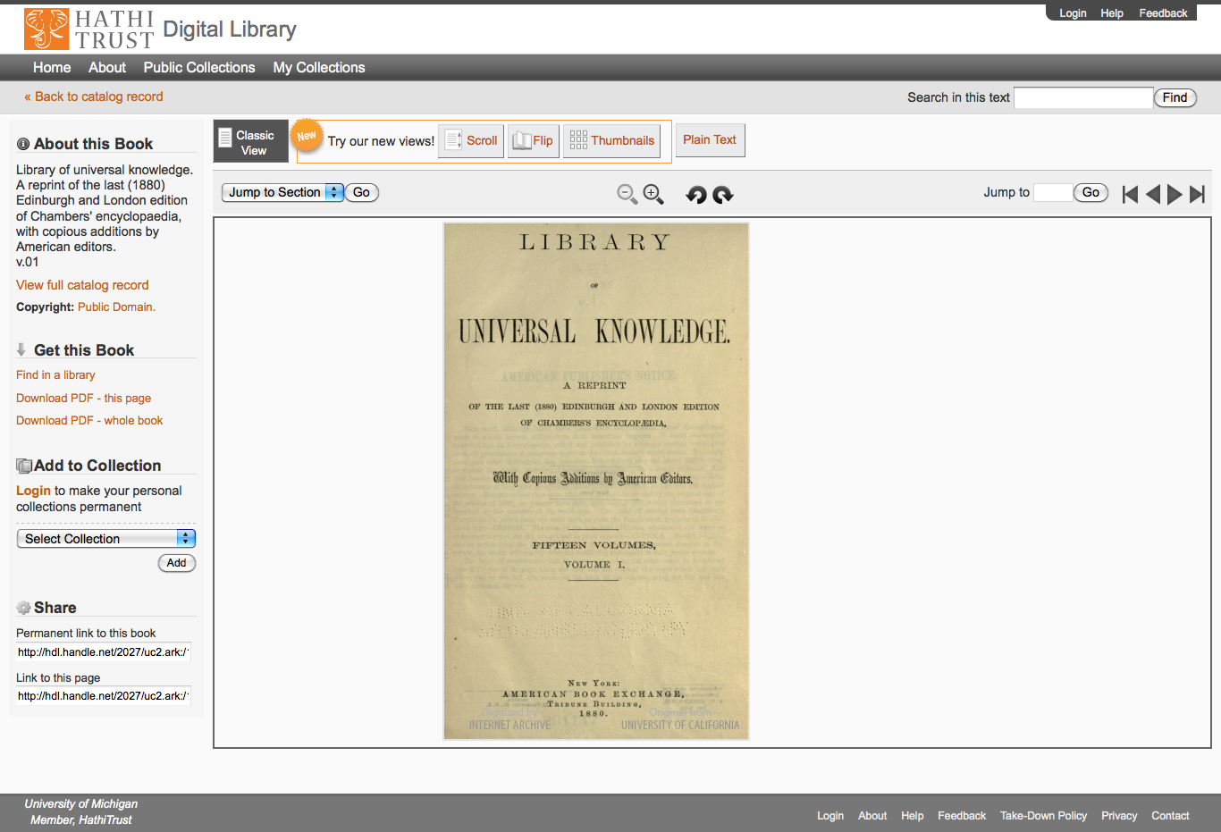

Slide 24
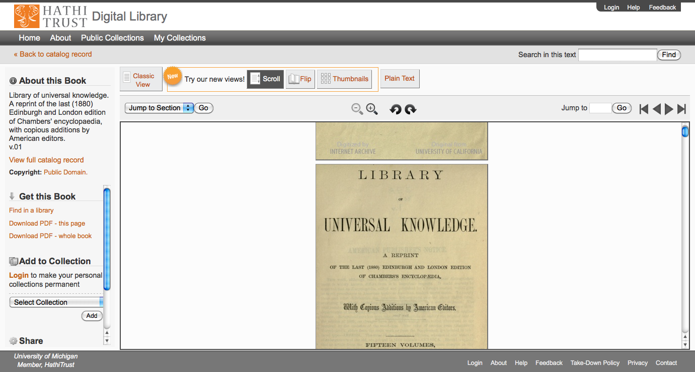

Slide 25
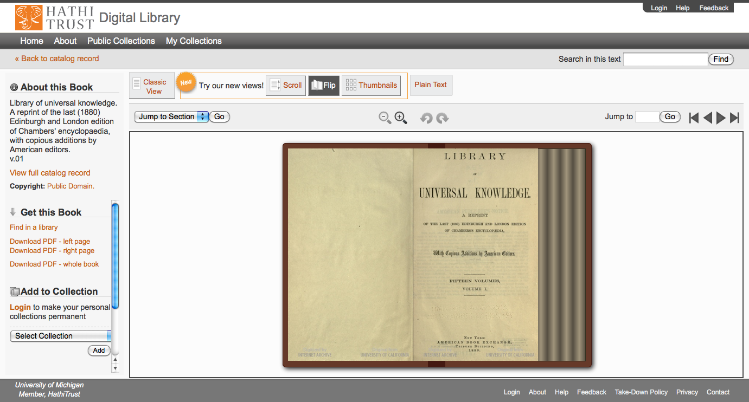

Slide 26
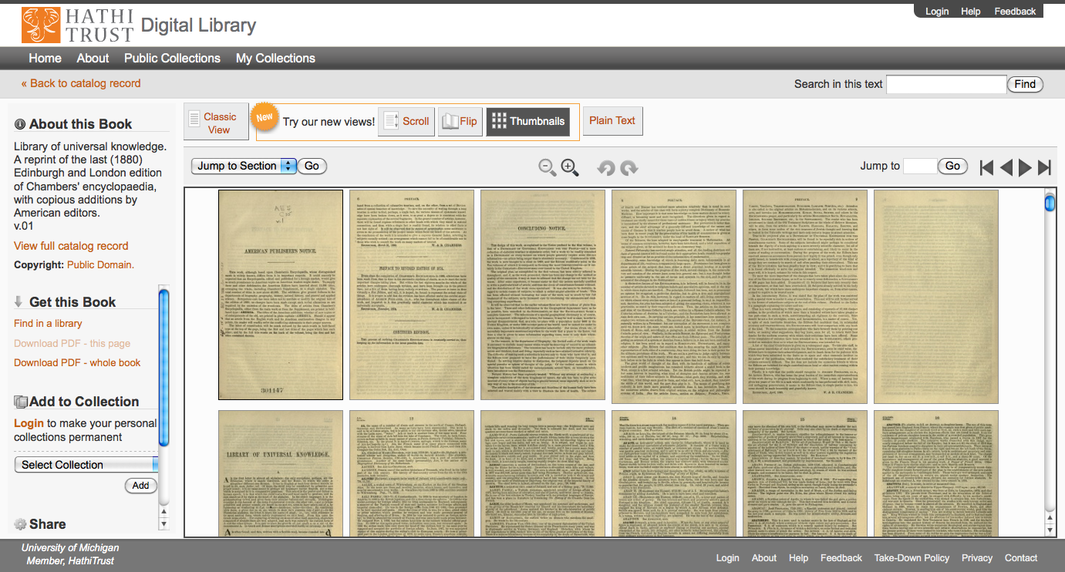

Slide 27
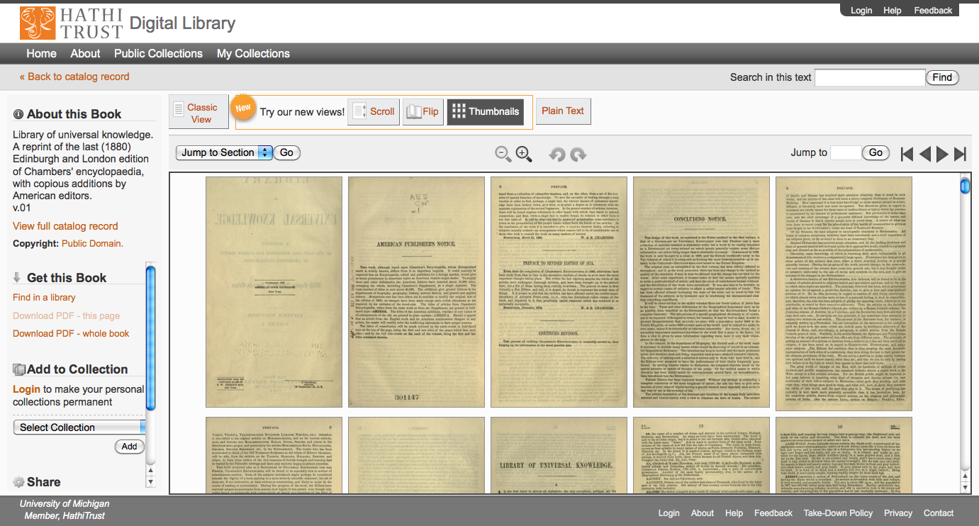

Slide 28
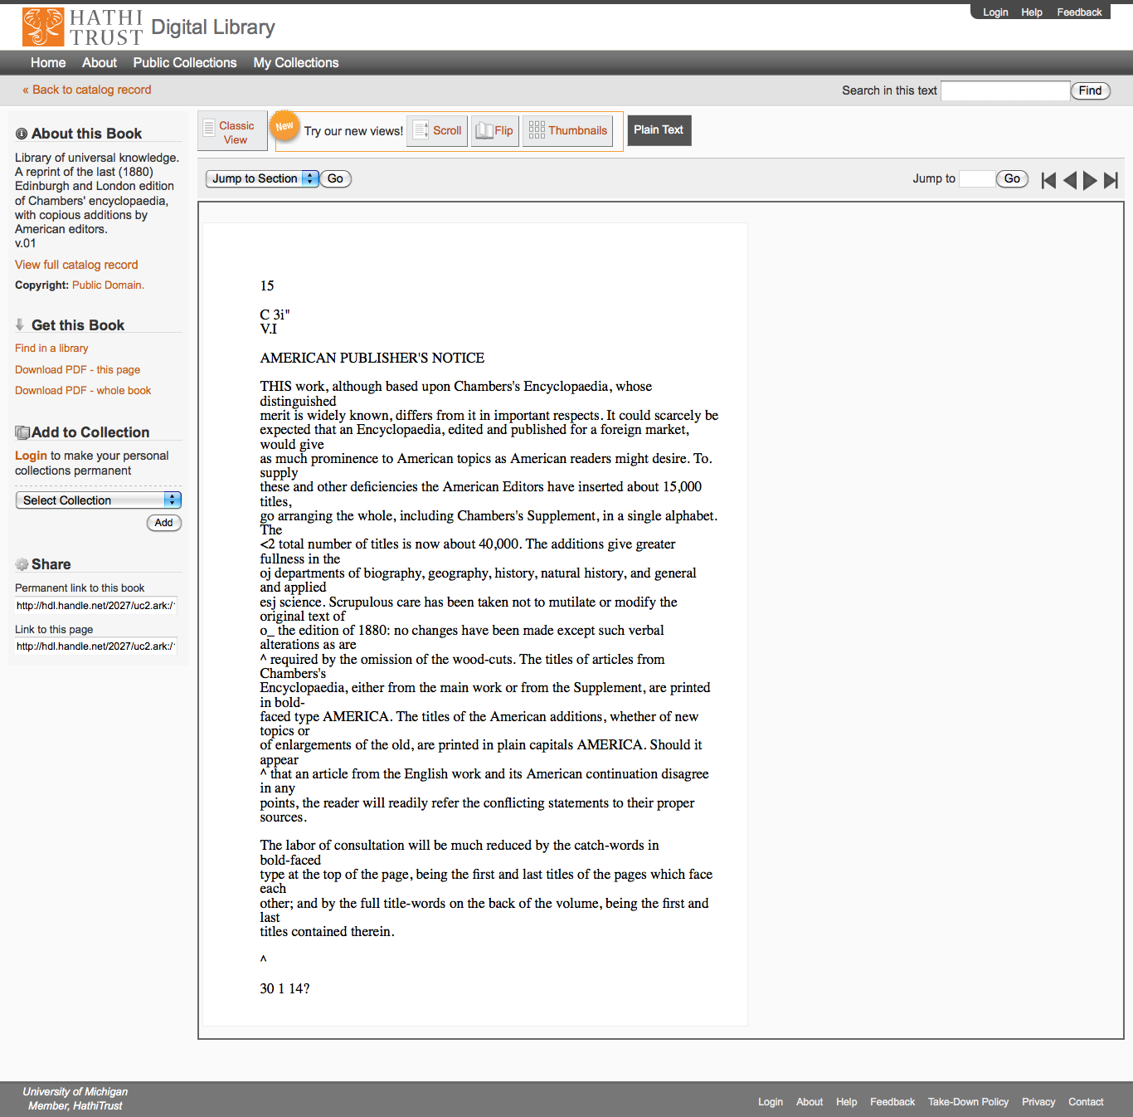

Slide 29
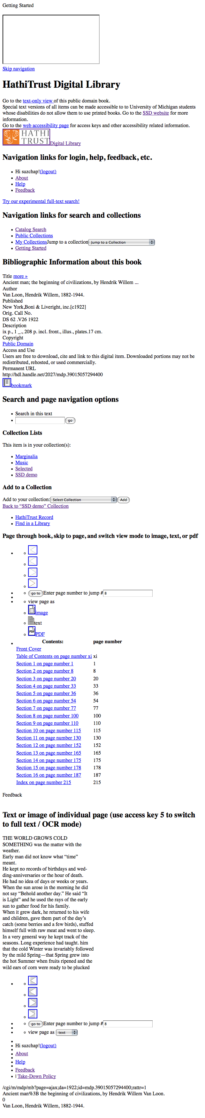
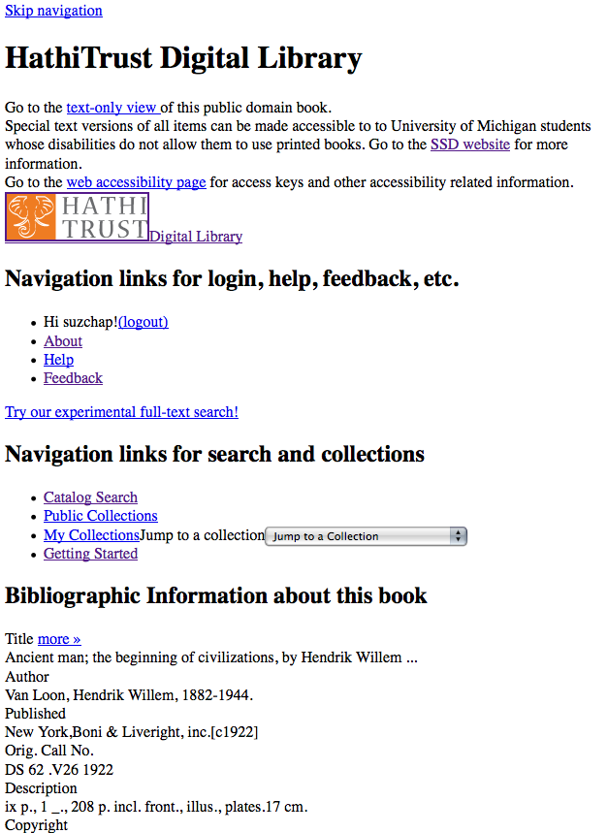
Skip navigation link
Info about SSD service & link to accessibility page
Descriptive headings added (hidden from GUI with CSS)
Added labels & descriptive titles to forms & ToC table
Access keys for navigating pages with keyboard
Images used for style are in css so no need to use alt tags

Slide 30
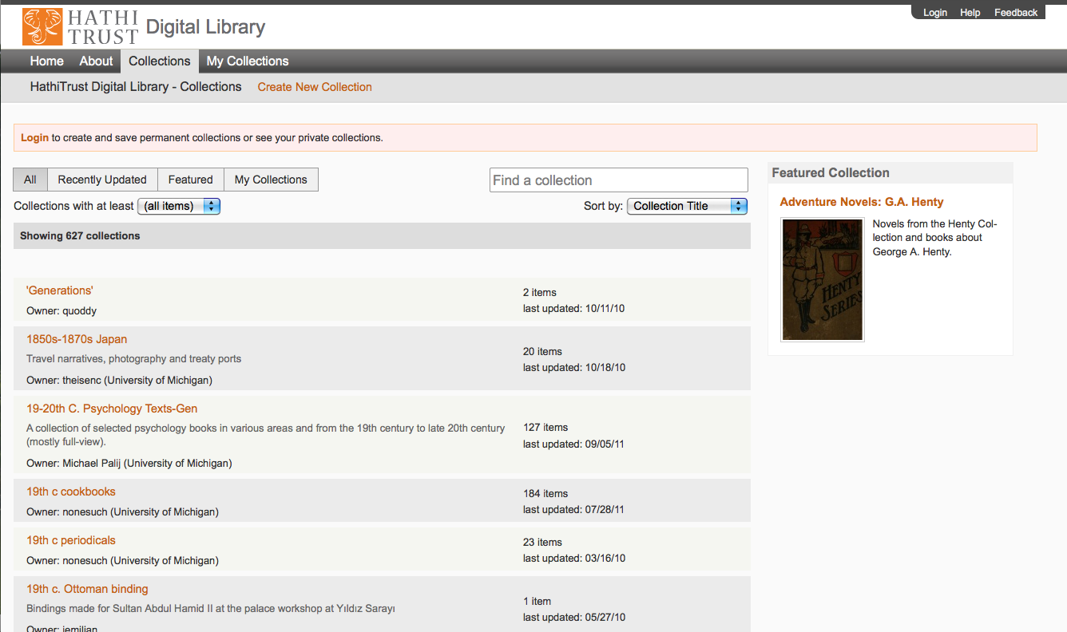

Slide 31
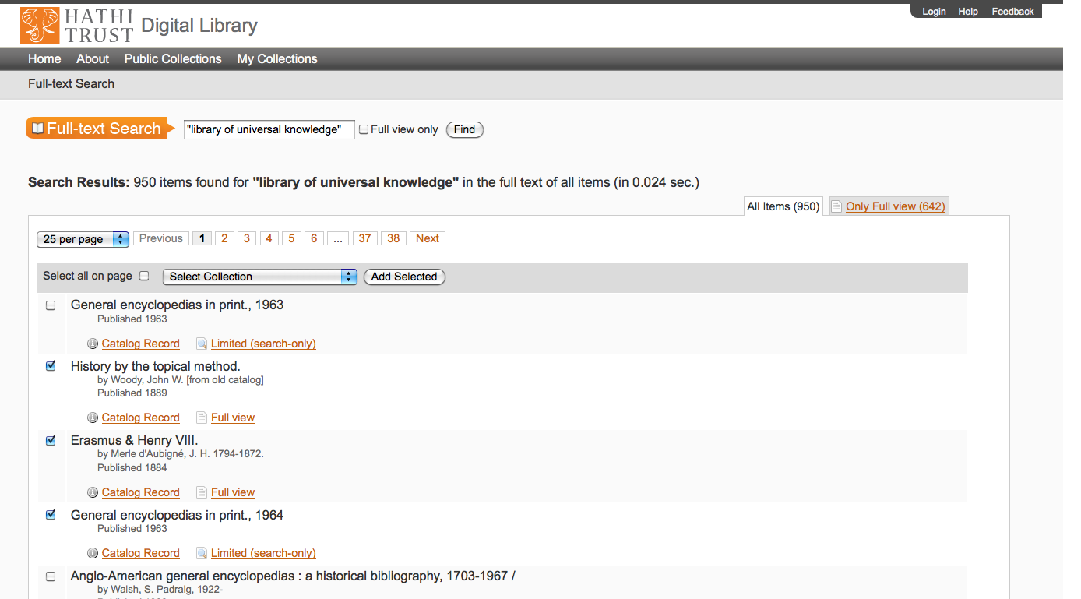

Slide 32
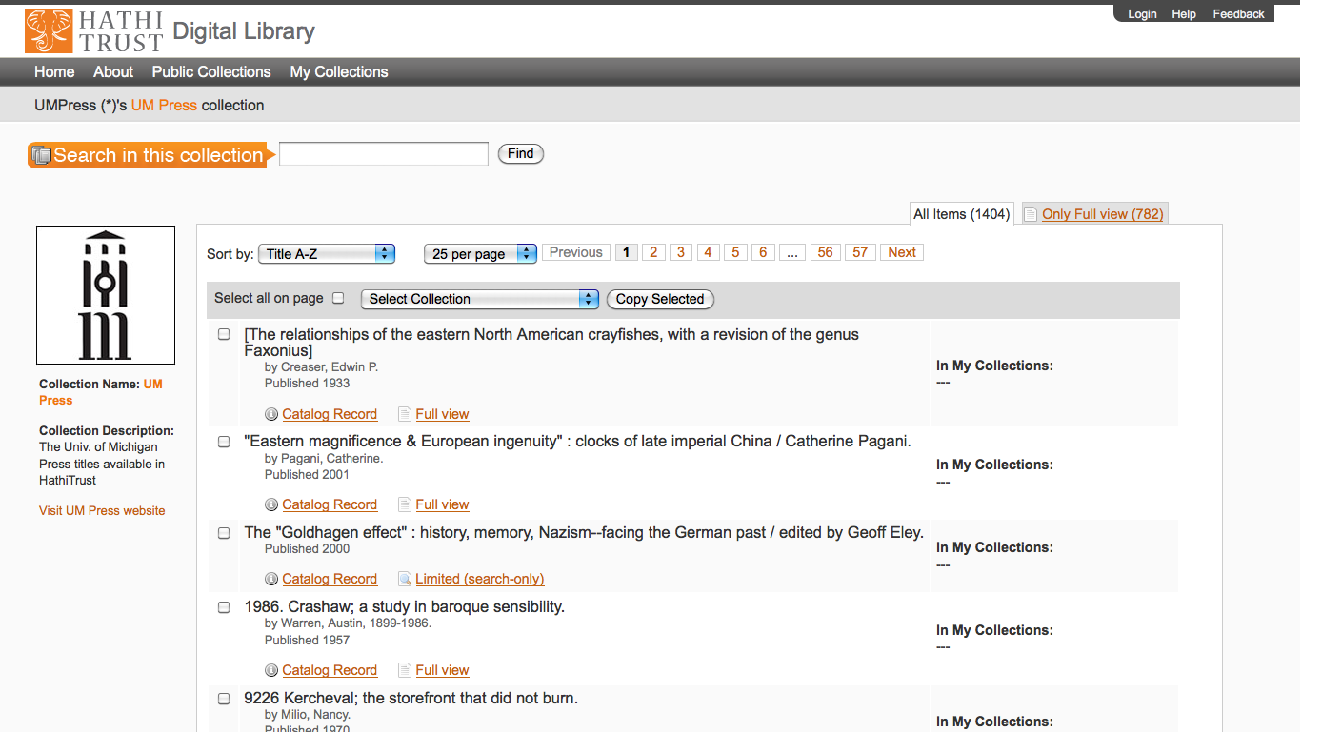

Slide 33
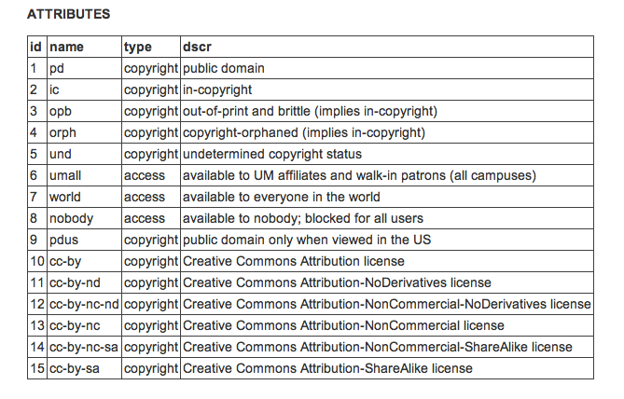
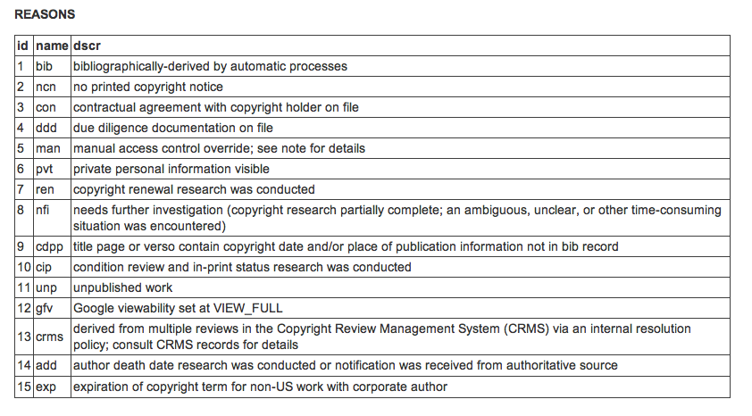
Rights
Manual
Conformance with formalities
Contractual agreements
Access control overrides
Bibliographic (automatic)

Slide 34
Access Matrix
Type of work | Search – Bib and Full text | View | Full-PDF download | Print on Demand | Print disabilities | Section 108 (preservation uses)
Public domain worldwide | World | World | World if no restrictions, Partners if restrictions | World | Partners worldwide | N/A
Public domain in the US | World | US | US if no restrictions, US partners if restrictions | US | US Partners | N/A
Open Access (+Creative Commons) | World | World | World if no restrictions | World with permission | Partners worldwide if no restrictions | N/A
In copyright (and undetermined) | World | Not available | Not available | Not available | Partners US and worldwide, where applicable | Partners US and worldwide, where applicable

Slide 35
Content Distribution
* As of September 24, 2011
Notes:
35

Slide 36
Print Collections
Discovery
SERIALS SOLUTIONS
OCLC
EBSCO
APIs
HathiTrust
Bibliographic
Full-text
Access and Use
Research Center
Rights
Page-Turner
Collections
Repository
Partnership

Slide 37
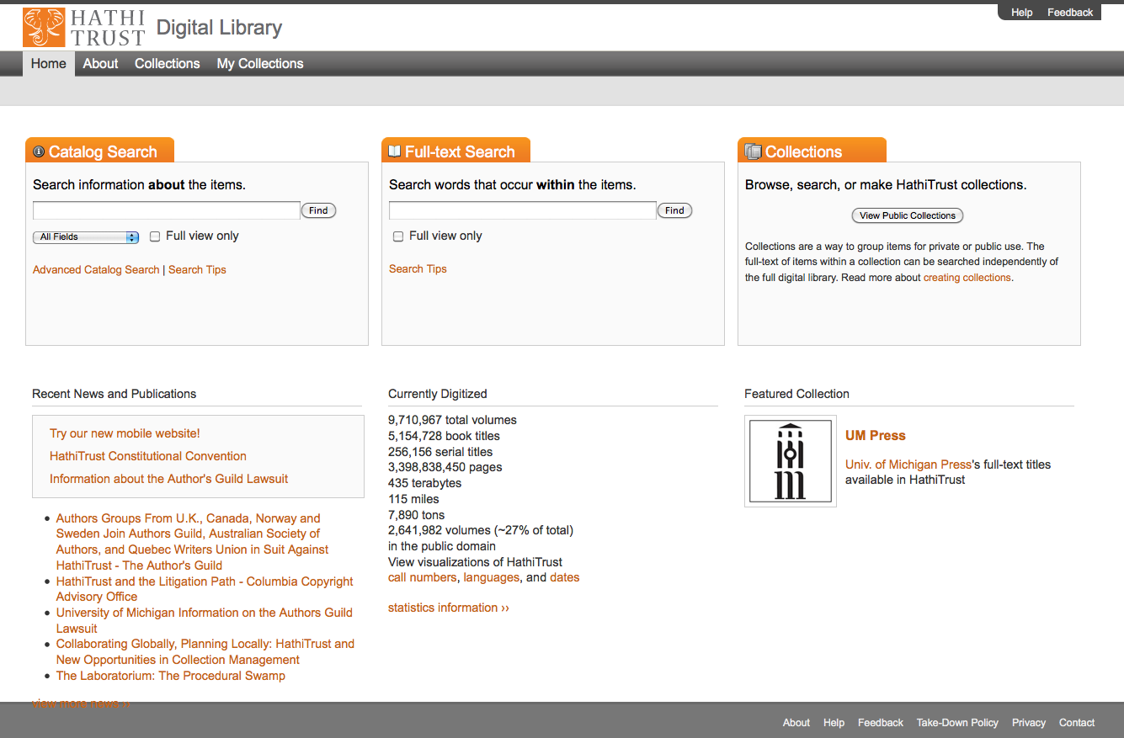

Slide 38
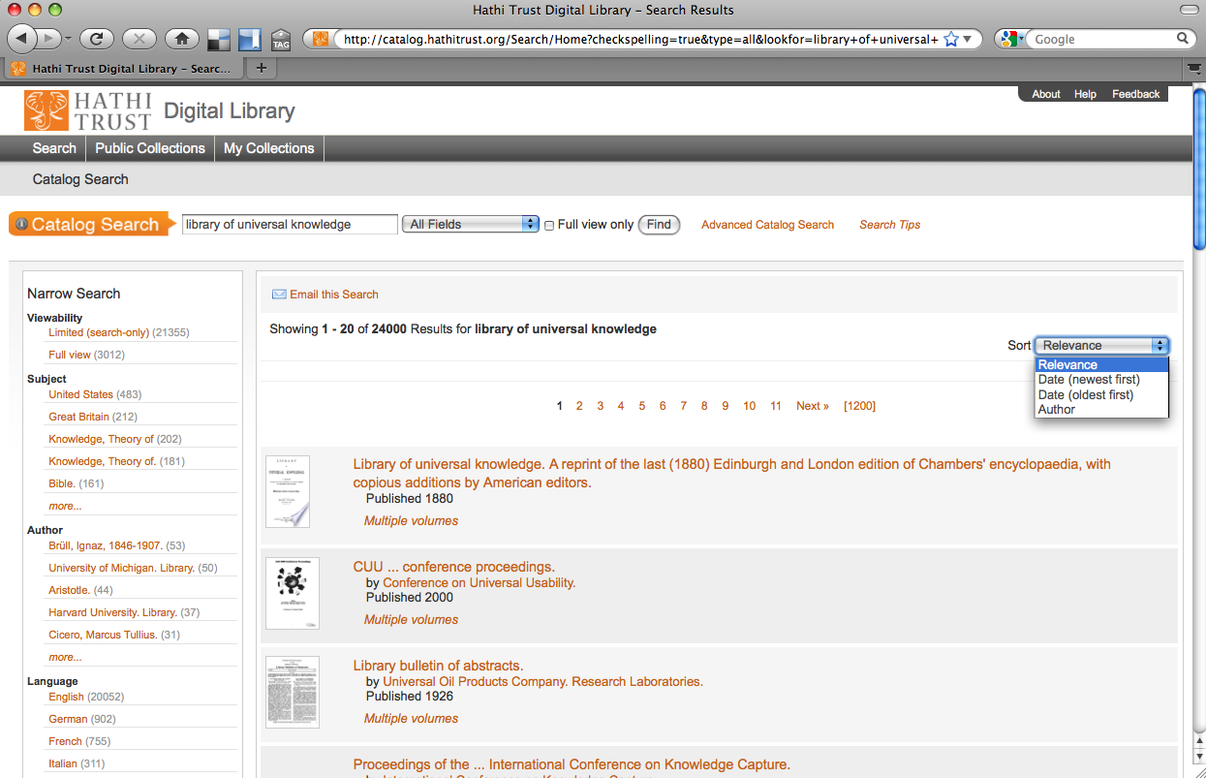

Slide 39
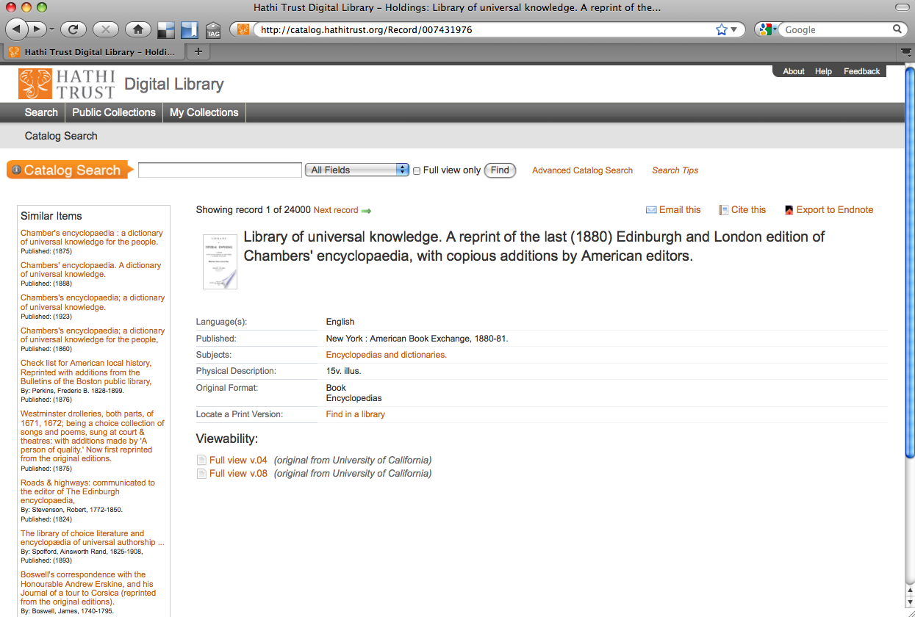

Slide 40
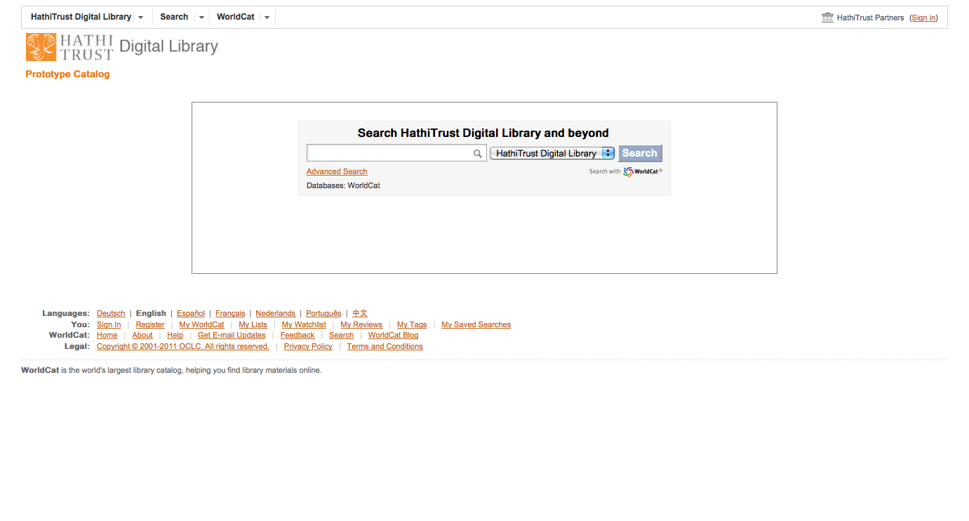

Slide 41
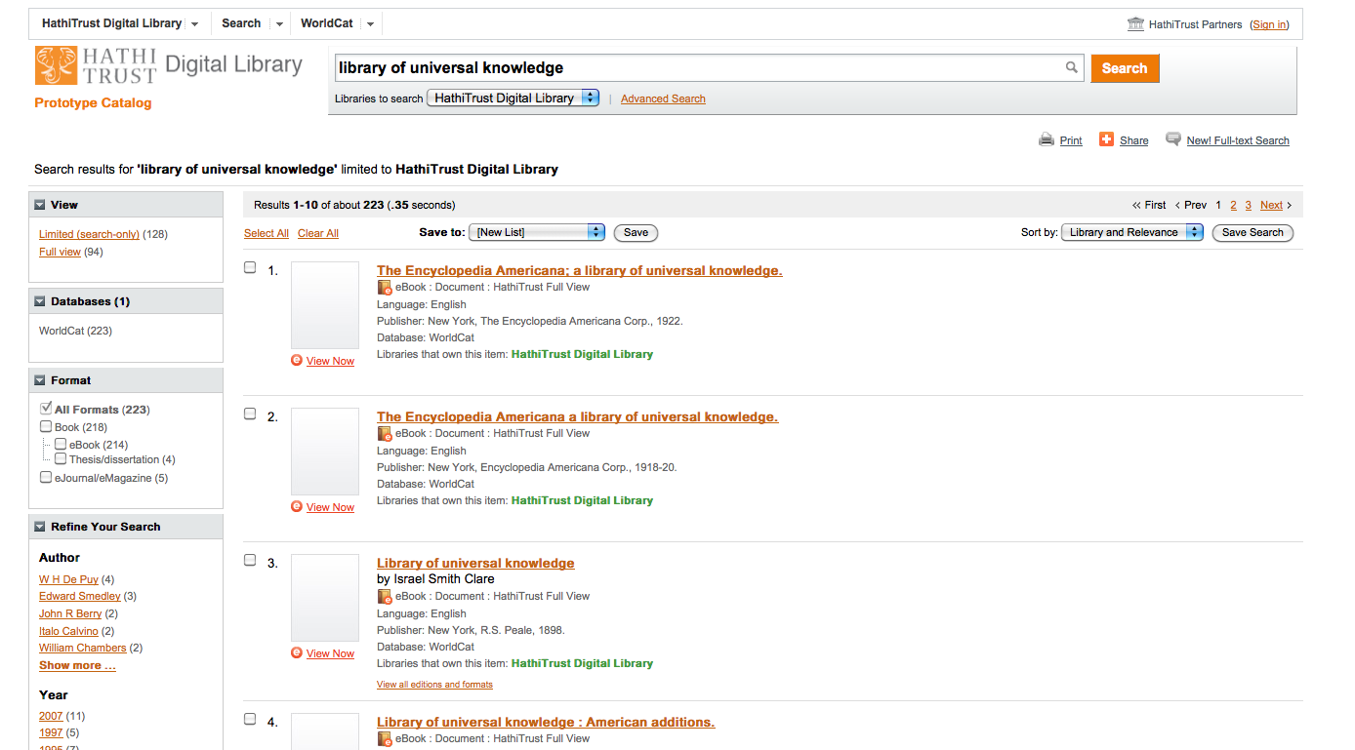

Slide 42
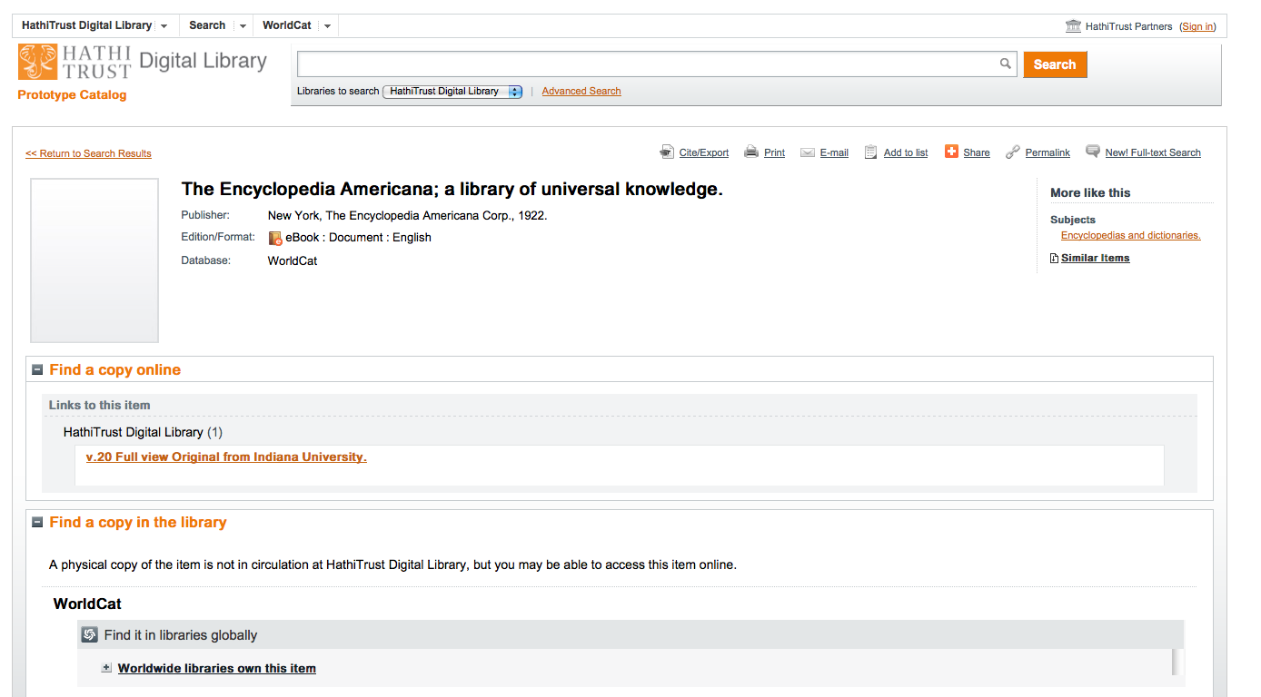

Slide 43
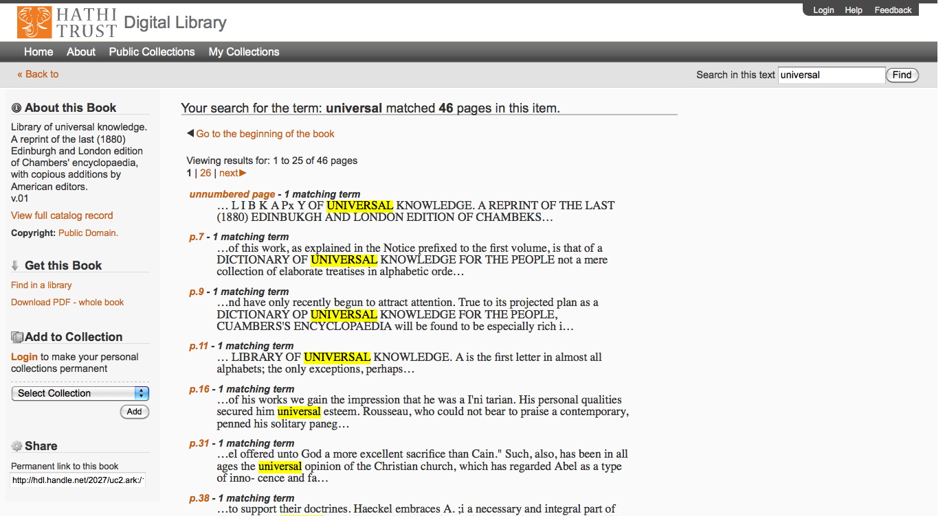

Slide 44
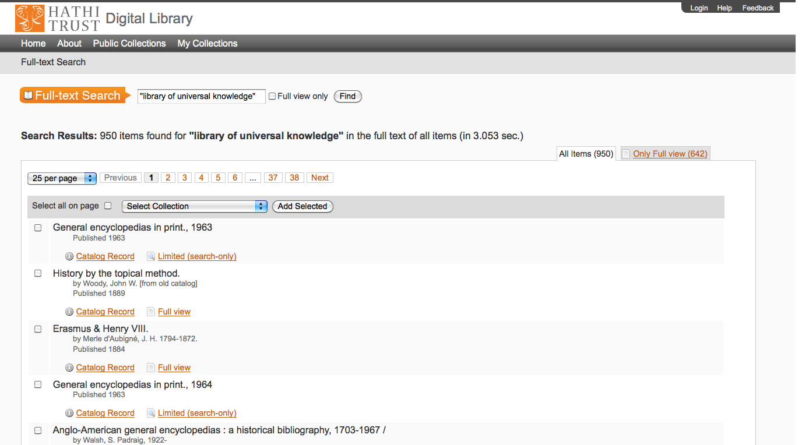

Slide 45
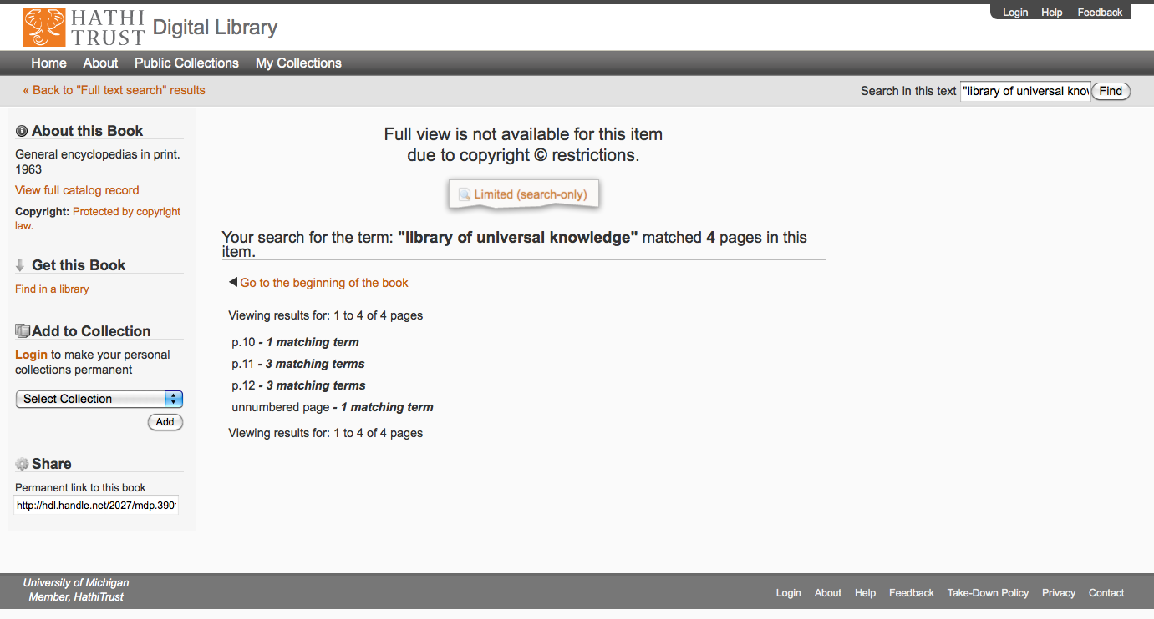

Slide 46
Print Collections
Discovery
SERIALS SOLUTIONS
OCLC
EBSCO
APIs
HathiTrust
Bibliographic
Full-text
Access and Use
Research Center
Rights
Page-Turner
Collections
Repository
Partnership

Slide 47
Research Center
Started May, 2010
Indiana University, University of Illinois
Computational access
18-month development cycle
  Demonstration deliverable June 30, 2012
Digital humanities
“Non-consumptive” research
InCommon

Slide 48
Print Collections
Discovery
SERIALS SOLUTIONS
OCLC
EBSCO
APIs
HathiTrust
Bibliographic
Full-text
Access and Use
Research Center
Rights
Page-Turner
Collections
Repository
Partnership

Slide 49
The Cloud Library
Toward a Cloud Library
  CLIR, Mellon Foundation
  OCLC Research, NYU, HathiTrust, Recap Libraries
    Objective: Characterize the near-term opportunity for externalizing management of academic research collections leveraging capacity of large-scale shared print and digital repositories* (Malpas, RLG Partner Update, January 2010)
    Outcomes: opportunity and risk assessment based on aggregate collection analysis; draft service agreement enabling generic consumer library to selectively outsource preservation and access of low-use research collections to large-scale print and digital repositories

Slide 50
A global change in the library environment
Academic print book collection already substantially duplicated in mass digitized book corpus
June 2010
Median duplication: 31%
June 2009
Median duplication: 19%
Notes:
50

Slide 51
Continuing growth of overlap …
ARL overlap
  31% in June 2010
  33% in Dec (adjustment: adding little-held works)
  ~ 1% per 225,000 vols
  45% in June, 2011
Oberlin Group overlap
  Close to 9% points higher
  41% in December, 2010
  Close to 50% in May, 2011
  Higher rate of overlap per added volume?

Slide 52
Digitized Books in Shared Repositories
~3.5M titles
~75% of mass digitized corpus is ‘backed up’ in one or more shared print repositories
~2.5M
Notes:
52

Slide 53
New Cost Model
Original model based on GB contributed
New model based on overlap of print collections with HathiTrust digital collections
Supported by print holdings database
For public domain volumes:
(PD*X*C)/N
For a given in­copyright volume:
IC=(X*C)/H

Slide 54
Holdings Database
Database will
  Support expansion of legal uses of materials: preservation uses, access for users who have print disabilities, access to orphan works
  Facilitate individual and collaborative collection development and management operations
  Will also benefit efforts in de-duplication

Slide 55
Print Collections
Discovery
SERIALS SOLUTIONS
OCLC
EBSCO
APIs
HathiTrust
Bibliographic
Full-text
Access and Use
Research Center
Rights
Page-Turner
Collections
Repository
Partnership

Slide 56
Governance
Strategic Advisory Board
Guidance on Policy, Planning
Budget/Finances
Decision-making
Executive Committee
HathiTrust

Slide 57
How does work get done?
Collective work
  e.g., working groups
  Perform the work of the partnership
  Now 40+ people across partner institutions
Distributed work
  Driven by needs of institutions – able to leverage across the partnership
  Projects, e.g. grant work, ingest specifications, page-turner, bibliographic data management
Leverage expertise across institutions

Slide 58
Constitutional Convention (1)
3-year review
7 ballot initiatives
5 passed
  Print monograph storage
    To establish a print monograph archiving program
  Approval Process for development initiatives
    To invite, evaluate, rank, launch development initiatives
  Governance
    Establishes a 12-member Board of Governors

Slide 59
Constitutional Convention (2)
  U.S. Government Documents
    To expand and enhance access to U.S. federal publications
  Fee for service content deposit

Slide 60
Themes going forward
Importance of our partnership and our work
Representative
Light-weight, nimble
Trust
Core values, core mission

Slide 61
Work going forward
Print Holdings
Print archiving, management
Government documents
Lawful uses
Quality
Research Center
Beyond books and journals
Publishing
Transitioning to next phase of partnership

Slide 62
Thank you!

