Slide 1
Why Digitize? or The Limits of Preservation
Books from Different <angles>
2014 TEI/DHCS Plenary Session
Evanston, IL
Mike Furlough
Executive Director, HathiTrust
Unless otherwise noted, these slides and their contents are licensed under a Creative Commons Attribution Unported License.

Slide 2
Caveat auditor

Slide 3
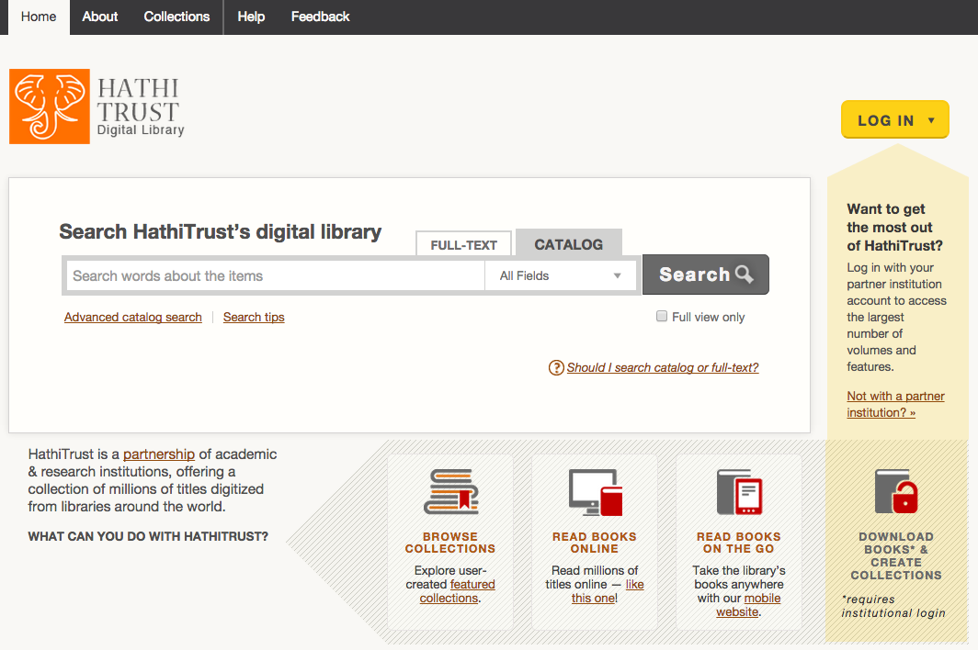
HATHITRUST.ORG

Slide 4
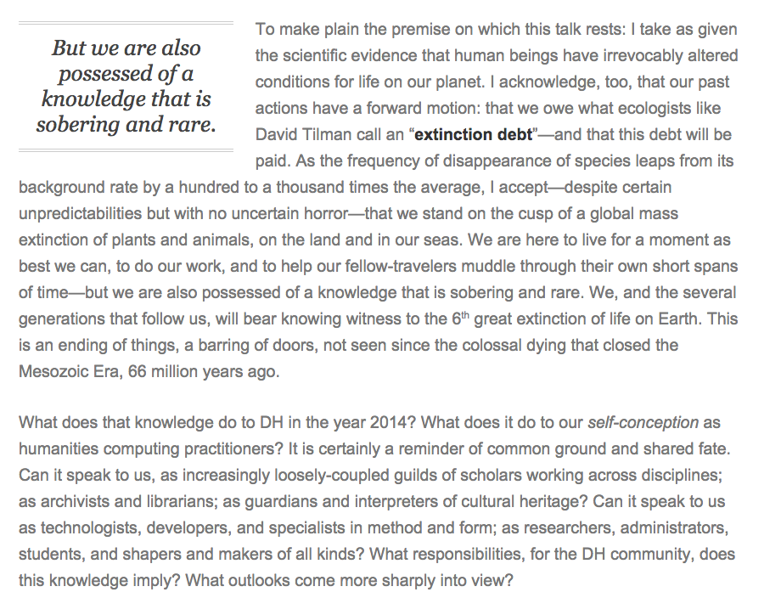
Bethany Nowviskie, “Digital Humanities in the Anthropocene” http://nowviskie.org/2014/anthropocene/

Slide 6
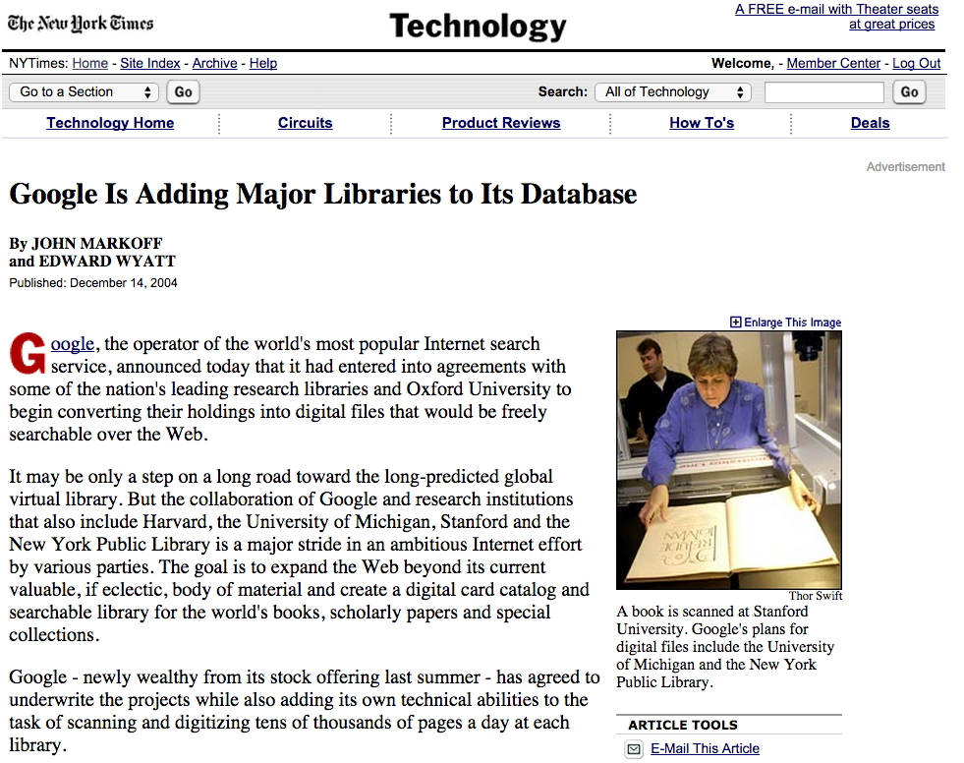

Slide 8
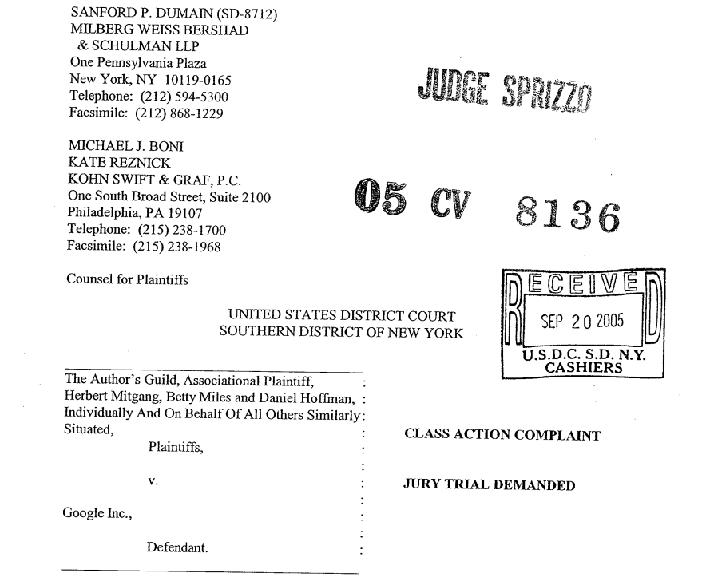

Slide 9
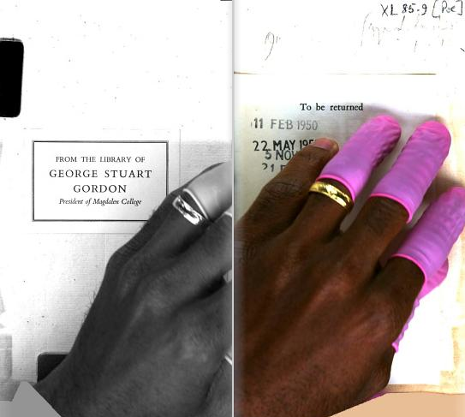
From The Art of Google Books: http://theartofgooglebooks.tumblr.com/post/74936156541/married-employees-hand-over-bookplate-and

Slide 10
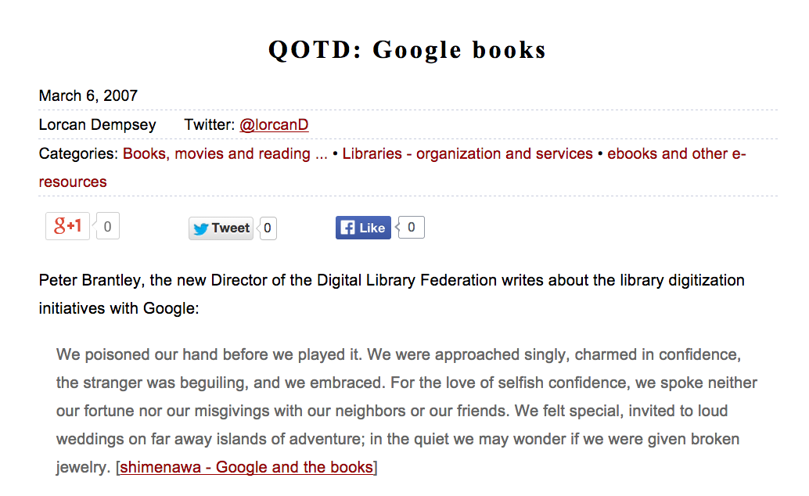
From Lorcan Dempsey’s Weblog: http://orweblog.oclc.org/archives/001284.html

Slide 11
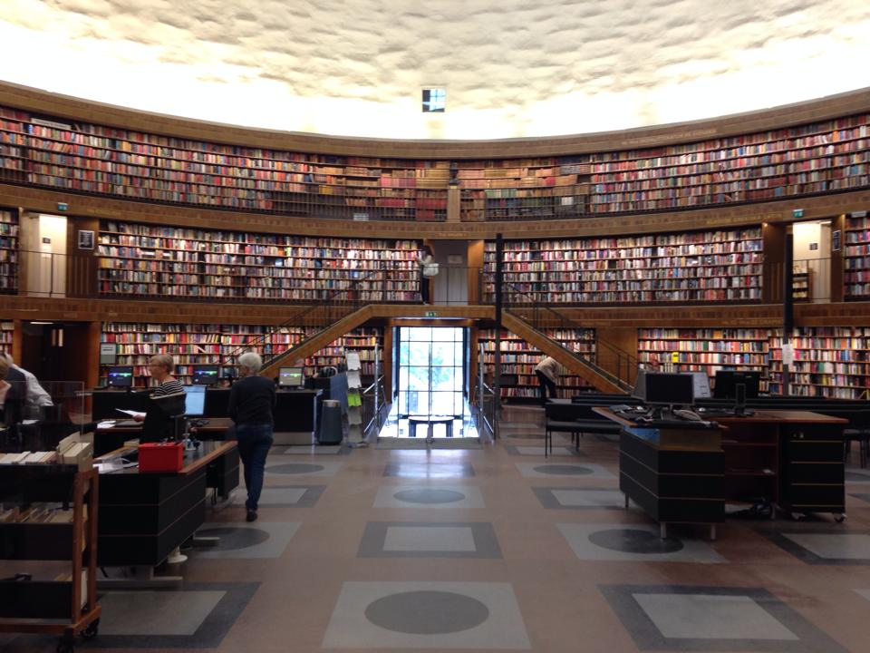
≠

Slide 12
HathiTrust Mission
To contribute to the common good by collecting, organizing, preserving, communicating, and sharing the record of human knowledge.
Efforts include, but are not limited to
…building comprehensive collections co-owned and managed by partners.
…enabling access by users with print disabilities.
…supporting computational research with the collections.
…stimulating shared collection storage strategies among libraries.

Slide 13
HathiTrust Members
Allegheny College
Arizona State University
Baylor University
Boston College
Boston University
Brandeis University
Brown University
California Digital Library
Carnegie Mellon University
Colby College
Columbia University
Cornell University
Dartmouth College
Duke University
Emory University
Florida State University
Getty Research Institute
Harvard University Library
Indiana University
Iowa State University
Johns Hopkins University
Kansas State University
Lafayette College
Library of Congress
Massachusetts Institute of Technology
McGill University`
Michigan State University
Montana State University
Mount Holyoke College
New York Public Library
New York University
North Carolina Central
University
North Carolina State
University
Northwestern University
The Ohio State University
The Pennsylvania State
University
Princeton University
Purdue University
Rutgers University
Stanford University
Syracuse University
Temple University
Texas A&M University
Texas Tech
Tufts University
Universidad Complutense
de Madrid
University of Alabama
University of Alberta
University of Arizona
University of British Columbia
University of Calgary
University of California
Berkeley
Davis
Irvine
Los Angeles
Merced
Riverside
San Diego
San Francisco
Santa Barbara
Santa Cruz
The University of Chicago
University of Connecticut
University of Delaware
University of Florida
University of Houston
University of Illinois
University of Illinois at Chicago
The University of Iowa
University of Kansas
University of Maine
University of Maryland
University of Massachusetts, Amherst
University of Miami
University of Michigan
University of Minnesota
University of Missouri
University of Nebraska-Lincoln
University of New Mexico
The University of North
Carolina at Chapel Hill
University of Notre Dame
University of Oklahoma
University of Pennsylvania
University of Pittsburgh
University of Queensland
University of Tennessee, Knoxville
University of Texas
University of Utah
University of Vermont
University of Virginia
University of Washington
University of Wisconsin- Madison
Utah State University
Vanderbilt University
Virginia Tech
Wake Forest University
Washington University
Yale University Library

Slide 14
Shared Responsibilities
Leverage expertise across institutions
Collective work
Distributed Infrastructure
Preservation repository and access services
University of Michigan
Mirror site: Indiana University
Metadata management services (Zephir)
California Digital Library
HathiTrust Research Center
Indiana University and University of Illinois

Slide 15
Growth of Collection

Slide 16
Language Distribution (1)
The top 10 languages make up ~87% of all content
* As of February 17, 2014
Notes:
16

Slide 17
Language Distribution (2)
The next 40 languages make up ~12% of total
* As of February 17, 2014

Slide 18
Dates
* As of February 17, 2014
Notes:
18

Slide 19
Preservation with Access
Preservation
TRAC-certified
Long-term commitments on digital content facilitate planning, decision-making
Discovery
Bibliographic and full-text search of all materials
Mechanisms for local loading of records
Access and Use
Full text search (all users)
Public domain and open access works (all users)
Collections and APIs (all users)
Lawful uses of in-copyright works (members)

Slide 21
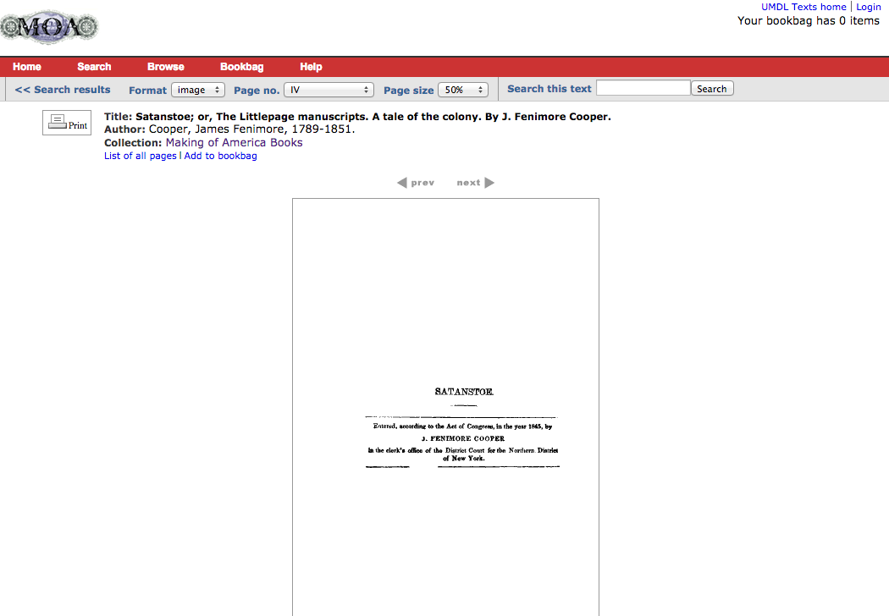
Title page of edition of JF Cooper’s Satanstoe presented in the Making of America database. (Accessed October 18, 2014)

Slide 22
Spine of edition of JF Cooper’s Satanstoe presented in the Early American Fiction database. (Accessed October 18, 2014)

Slide 23
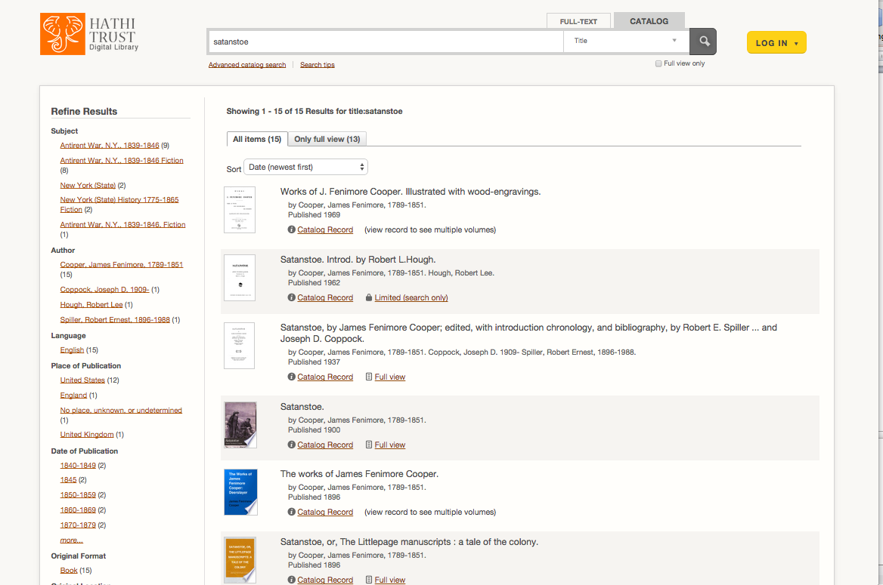
6 of 15 records for different copies of JF Cooper’s Satanstoe presented HathiTrust. (Accessed October 18, 2014)

Slide 24
Some Issues
Collection strategies
What else?
Associated access and preservation questions
The “Evolving Scholarly Record”
The book and the network
Fragmentation and loss

Slide 26
How to find out more
About: http://www.hathitrust.org/about
Resources: http://www.hathitrust.org/resources
Twitter: http://twitter.com/hathitrust
Facebook: http://www.facebook.com/hathitrust
Monthly newsletter:
http:www.hathitrust.org/updates
RSS http://www.hathitrust.org/updates_rss
Contact us: feedback@issues.hathitrust.org
Blogs: http://www.hathitrust.org/blogs
Large-scale Search
Perspectives from HathiTrust

Slide 27
Thank you! furlough@hathitrust.org @MikeFurlough

