Slide 1
Institution Uses of HathiTrust
Jeremy York
University of Maine
May 24, 2013

Slide 2
Partnership
Arizona State University
Baylor University
Boston College
Boston University
Brandeis University
Brown University
California Digital Library
Carnegie Mellon University
Columbia University
Cornell University
Dartmouth College
Duke University
Emory University
Florida State University
Getty Research Institute
Harvard University Library
Indiana University
Iowa State University
Johns Hopkins University
Kansas State University
Lafayette College
Library of Congress
Massachusetts Institute of Technology
McGill University`
Michigan State University
New York Public Library
New York University
North Carolina Central
University
North Carolina State
University
Northwestern University
The Ohio State University
The Pennsylvania State
University
Princeton University
Purdue University
Stanford University
Syracuse University
Texas A&M University
Tufts University
Universidad Complutense
de Madrid
University of Alberta
University of Arizona
University of Calgary
University of California
Berkeley
Davis
Irvine
Los Angeles
Merced
Riverside
San Diego
San Francisco
Santa Barbara
Santa Cruz
The University of Chicago
University of Connecticut
University of Delaware
University of Florida
University of Houston
University of Illinois
University of Illinois at Chicago
The University of Iowa
University of Kansas
University of Maryland
University of Miami
University of Michigan
University of Minnesota
University of Missouri
University of Nebraska-Lincoln
The University of North
Carolina at Chapel Hill
University of Notre Dame
University of Pennsylvania
University of Pittsburgh
University of Utah
University of Vermont
University of Virginia
University of Washington
University of Wisconsin- Madison
Utah State University
Vanderbilt University
Virginia Tech
Wake Forest University
Washington University
Yale University Library

Slide 3
Digital Repository
Launched 2008
Initial focus on digitized book and journal content
10.7 million total volumes
5.6 million book titles
278,000 serial titles
3.3 million volumes in the public domain (~31%)

Slide 4
Mission
To contribute to the common good by collecting, organizing, preserving, communicating, and sharing the record of human knowledge

Slide 5
HathiTrust
Universal Library
Common Goal
Single Entity, Many Partners

Slide 6
Collections and Collaboration
Comprehensive collection
Preservation…with Access
Repository centralized, yet open
Shared strategies
Copyright
Collection management, development
Preservation
Discovery / Use
Bibliographic Indeterminacy
Efficient user services
Public Good

Slide 7
Preservation...with Access
Long-term preservation
Bit-level and migration
Bibliographic search
Full-text search
Copyright review
Reading and download capabilities
Access for users who have print disabilities
Access to out of print and brittle books
Subject to terms and conditions at http://www.hathitrust.org/access_use#ic-access
Support beyond books and journals (pilots)

Slide 8
Content Sources

Slide 9
Language Distribution (1)
The top 10 languages make up ~86% of all content
Notes:
9

Slide 10
Copyright Distribution
Notes:
10

Slide 11
Copyright Review
CRMS US (since 2008)
Published in US, 1923-1963
245,305 reviewed
131,880 opened (~54%)
CRMS-World (since 2012)
Published non-US (UK, Canada, Australia, Spain)
44,746 reviewed
24,154 opened (~54%)
Permissions
Open access – 6,656
Additional Creative Commons – 5,542

Slide 12
Centralized...yet open
Print on demand
Linking from local catalogs
Collections

Slide 13
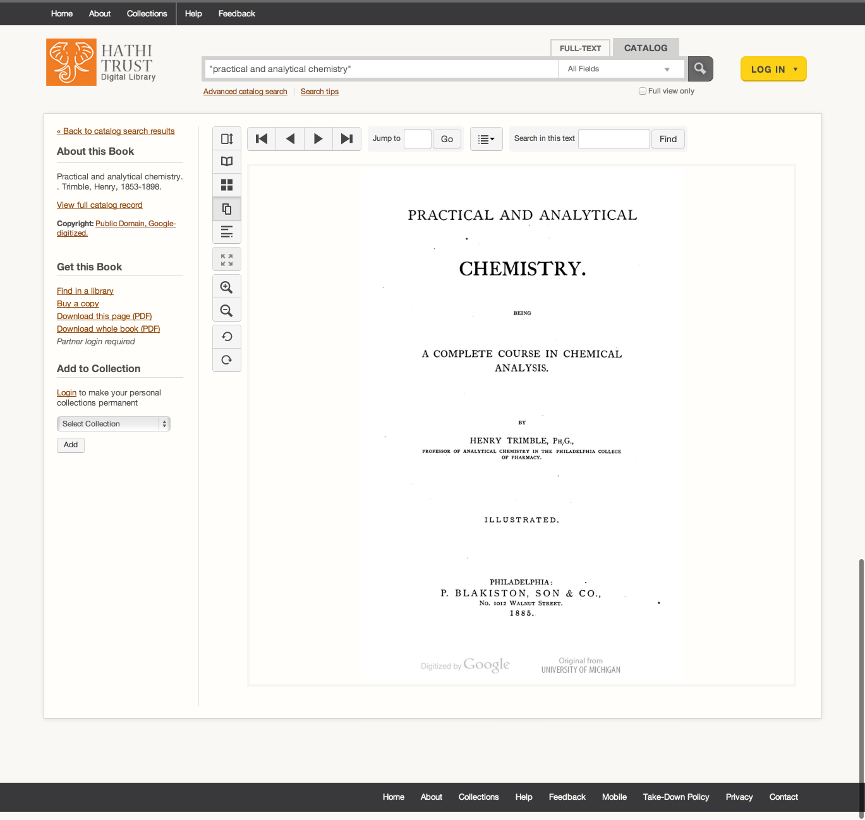

Slide 14
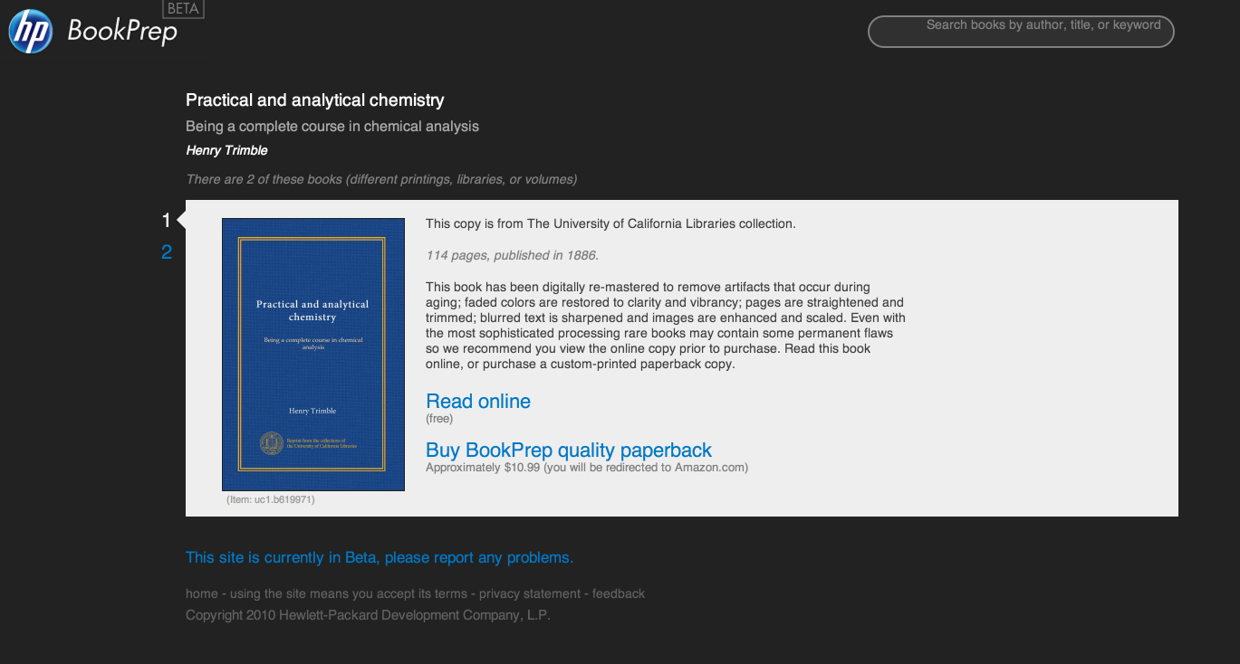

Slide 17
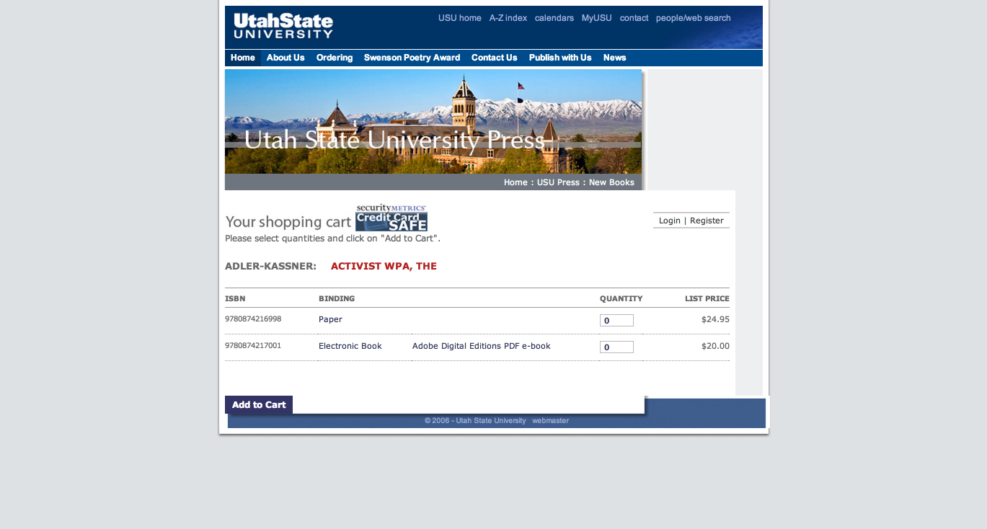

Slide 18
Linking in Local Catalogs
Bibliographic API
Volume and rights information
MARC records
http://www.hathitrust.org/bib_api
OAI
http://www.hathitrust.org/data
“Hathifiles”
http://www.hathitrust.org/hathifiles
Data API
Volume and rights information
Page images
OCR
http://www.hathitrust.org/data_api

Slide 19
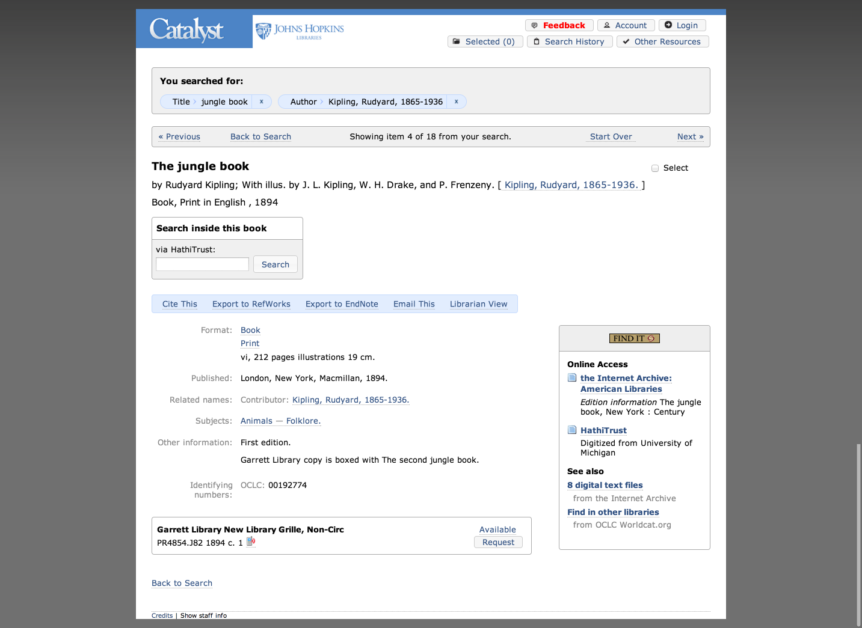

Slide 20
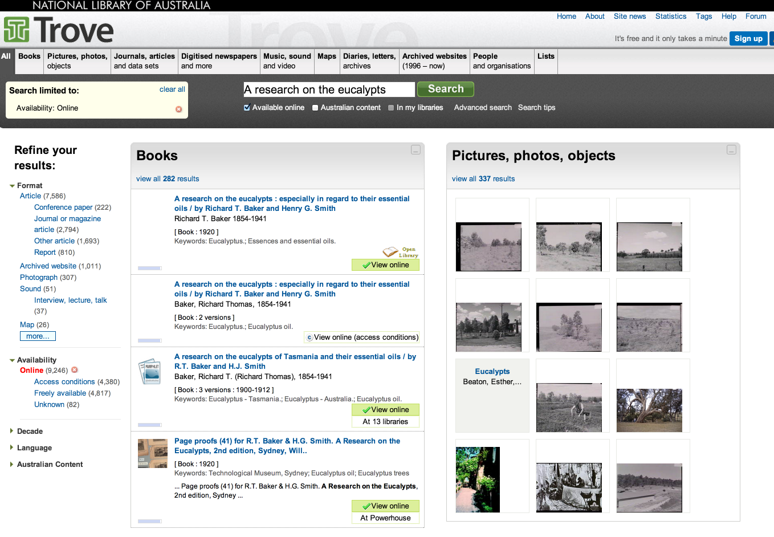

Slide 21
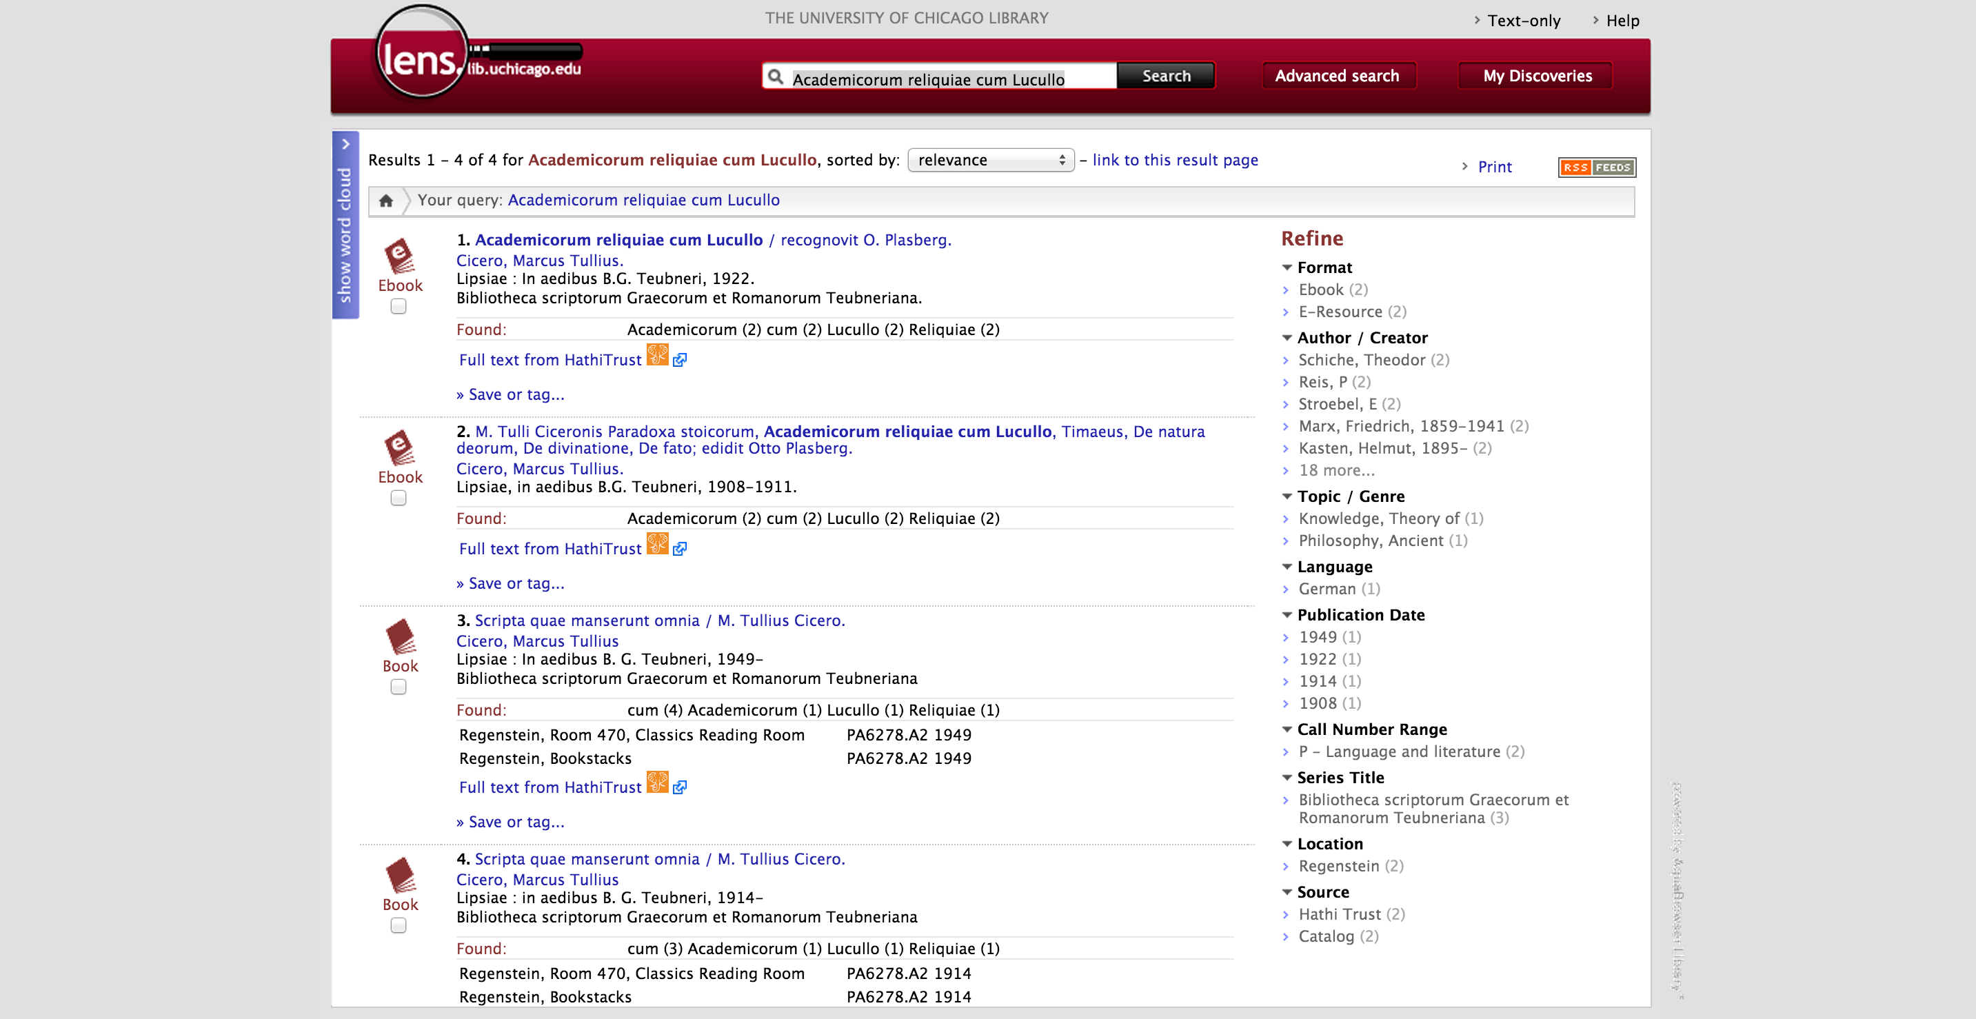

Slide 23
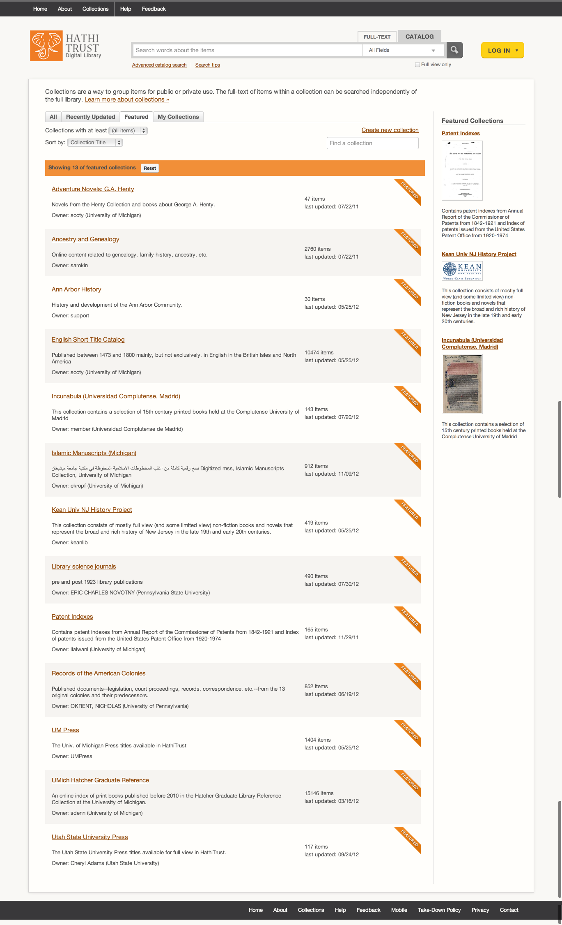
Collections

Slide 24
Collection Examples
Physical spaces
Collections within HathiTrust
English Short Title Catalog
USU Press, UM Press
Islamic Manuscripts
Incunabula (Universidad Complutense de Madrid)
Collections drawn from the collection
Patent Indexes
19th cen cookbooks
Dictionaries
Anarchism pamphlets
Historical and topical collections
Datasets

Slide 25
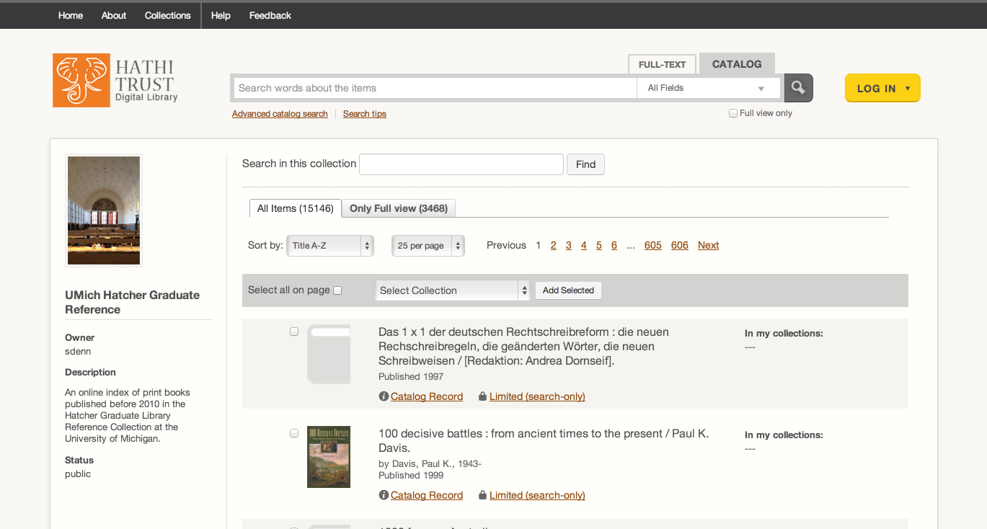

Slide 26
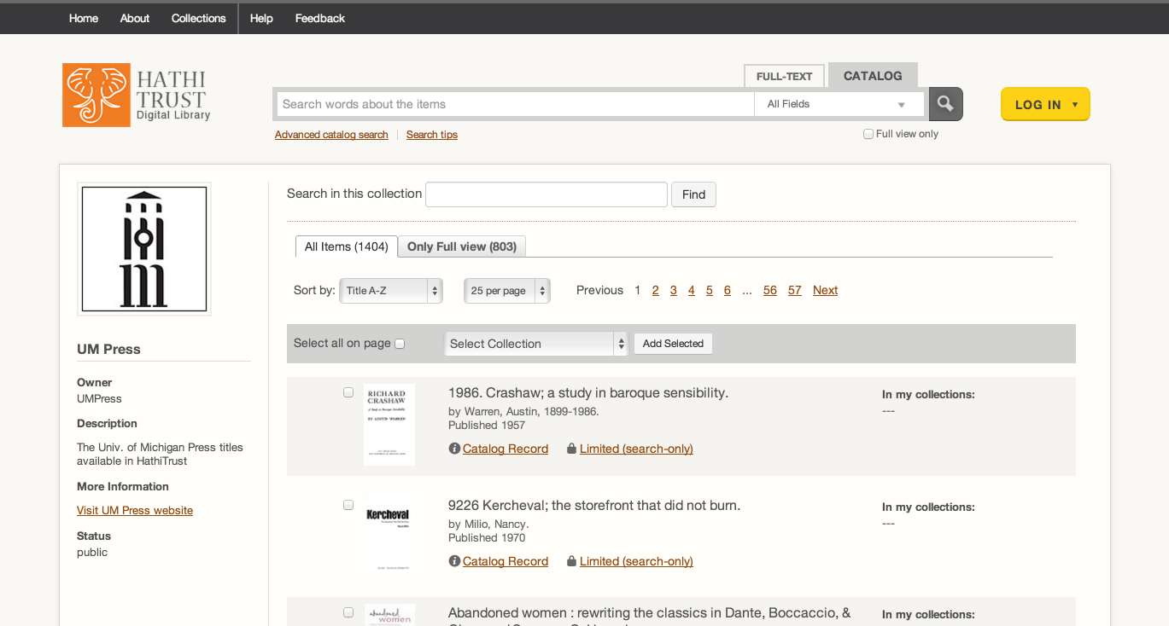

Slide 27
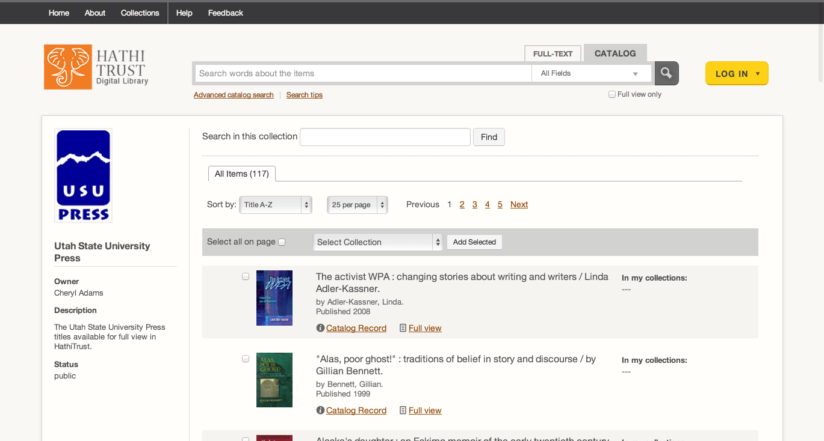

Slide 28
Library Collections
Use in digitization planning
Use in collection management, development, analysis
Collection analysis
Holdings data
Print monographs archive

Slide 37
How to find out more
About: http://www.hathitrust.org/about
Twitter: http://twitter.com/hathitrust
Facebook: http://www.facebook.com/hathitrust
Monthly newsletter:
http:www.hathitrust.org/updates
RSS http://www.hathitrust.org/updates_rss
Contact us: feedback@issues.hathitrust.org
Blogs: http://www.hathitrust.org/blogs
Large-scale Search
Perspectives from HathiTrust

