Slide 1
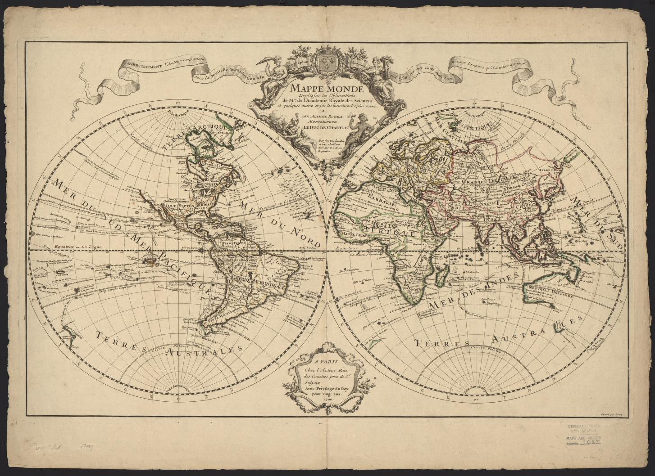
Your Roadmap to Digital Collections
U-M Library
November 2013
Source: UM-Clark Library Maps
Notes:
Image: http://quod.lib.umich.edu/c/clark1ic/x-005144027/39015091197023

Slide 2
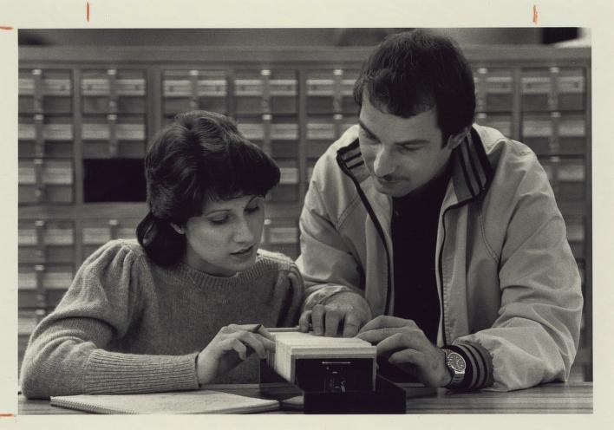
Introductions
Source: UM-Dearborn Newsletter Photos
Notes:
Image: http://quod.lib.umich.edu/u/umdphotos1ic/x-31.433/umdph31_0433
Introductions:
Who are we?
Ask Questions!
We recognize there are librarians and others who are here on behalf of their constituency

Slide 3
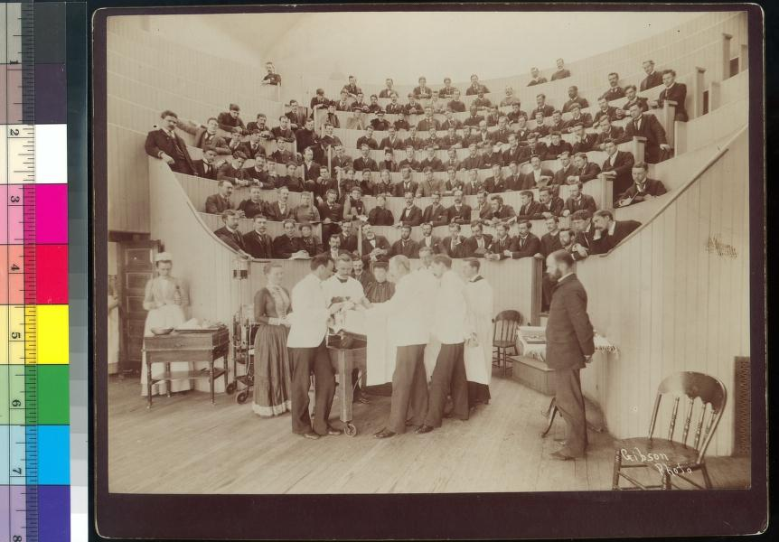
Discussion Topic:
What is a digital collection?
Can you name a digital collection?
Source: Bentley Image Bank
Notes:
Image: http://quod.lib.umich.edu/b/bhl/x-bl002078/bl002078
Time: 5 minutes
Image: http://quod.lib.umich.edu/b/bhl/x-bl002078/bl002078
In other words, what have you used in the past that you consider a digital collection?

Slide 4
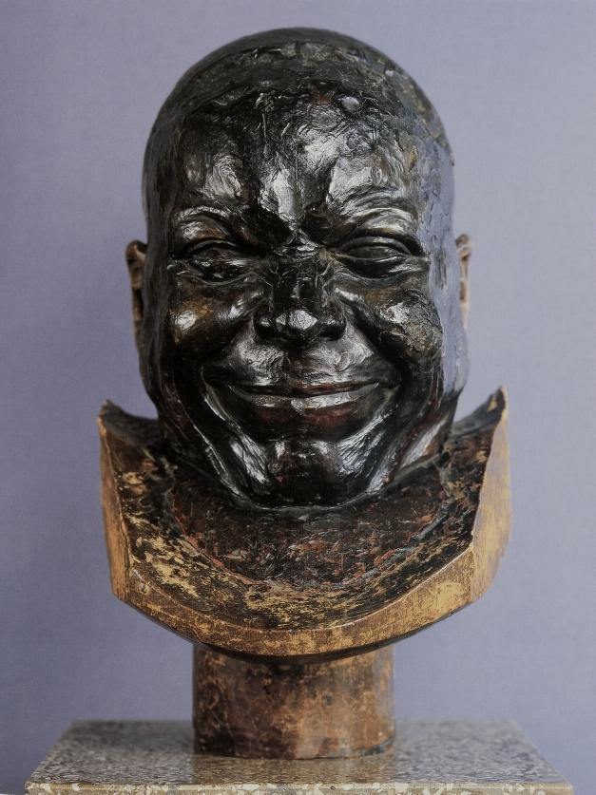
What we’re going to cover (Yes!)
* Breadth of our collections
* How to access our collections
* How to use our collections
* Collections & Research/Teaching
Source: UM History of Art, VRC
Notes:
Image: http://quod.lib.umich.edu/h/hart/x-363074/07d119797
Here’s what we’re going to discuss today:
Understand the breadth of our collections
Understand how to access our collections
Understand how to use our collections
Understand who has access to materials?
What can you find and what can’t you find?
Understand how it’s relevant to your work

Slide 5
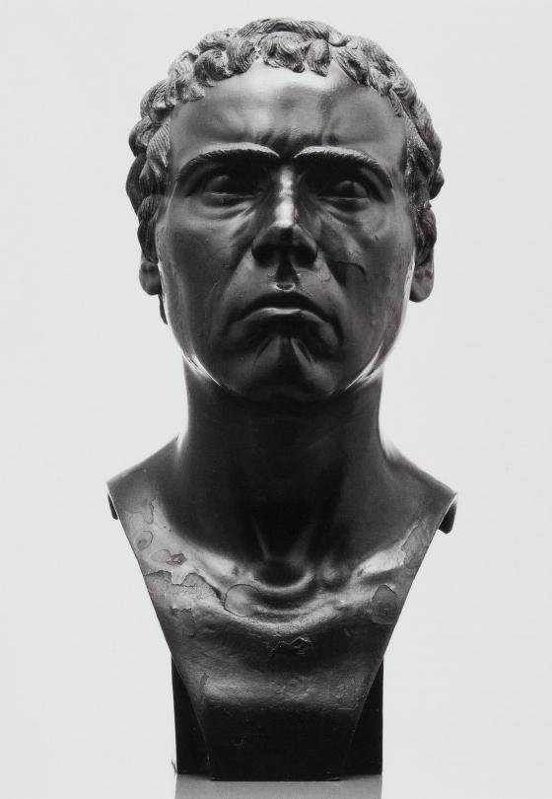
What we’re NOT going to cover (Boo!)
* Licensed/subscription
(ProQuest, Web of Science, PsycINFO)
* Datasets
* MPub Collections
* Online Exhibits
Source: UM History of Art, VRC
Notes:
Image: http://quod.lib.umich.edu/h/hart/x-363069/07d119792
no licensed or subscribed-to databases and collections
Proquest
Web of Science
PsycInfo
HTRC & HathiTrust data sets
Clark, data sets
MPub colls
Omeka exhibits

Slide 6

Digital Collections (our definition):
A collection of digital objects, curated by an expert,
includes metadata and images, and a mechanism of access
Source: University of California
Notes:
Source: http://hdl.handle.net/2027/uc2.ark:/13960/t5m90cf07
A collection of digital objects, curated by an expert
Digital object =
Metadata =
By curated we mean = selected
The Library cares about curation in general
Providing access to digital things

Slide 7
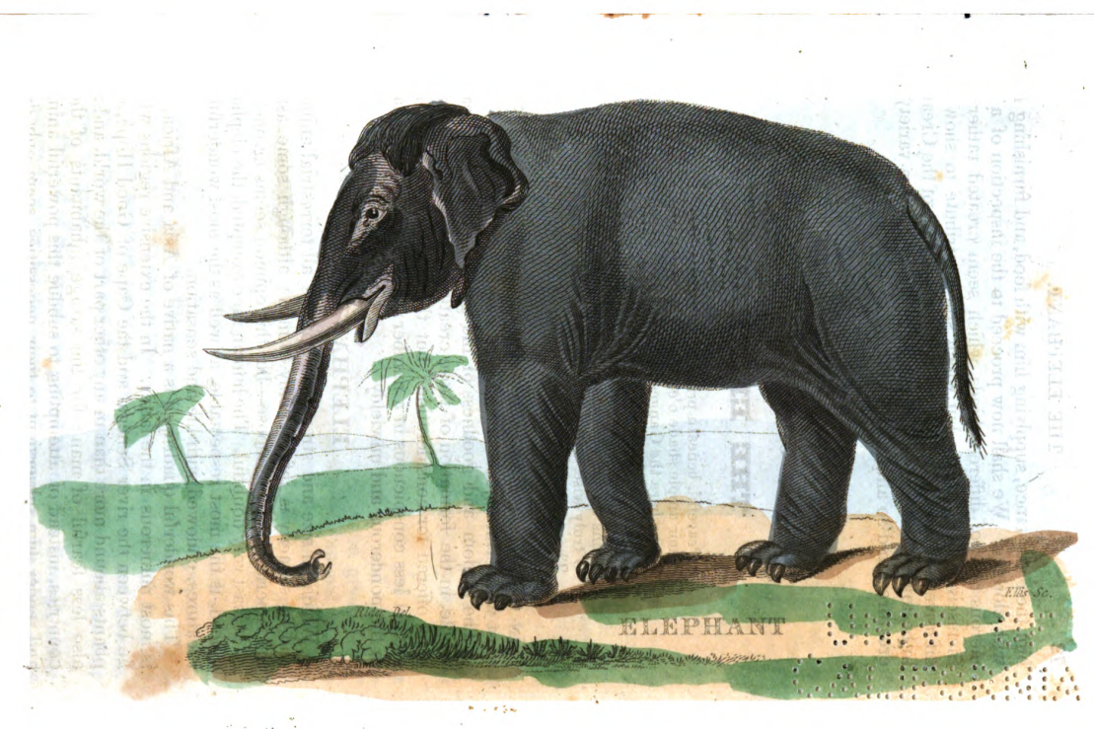
HathiTrust Digital Library
Source: University of California
Notes:
Image: http://hdl.handle.net/2027/uc1.b3272008?urlappend=%3Bseq=93

Slide 8
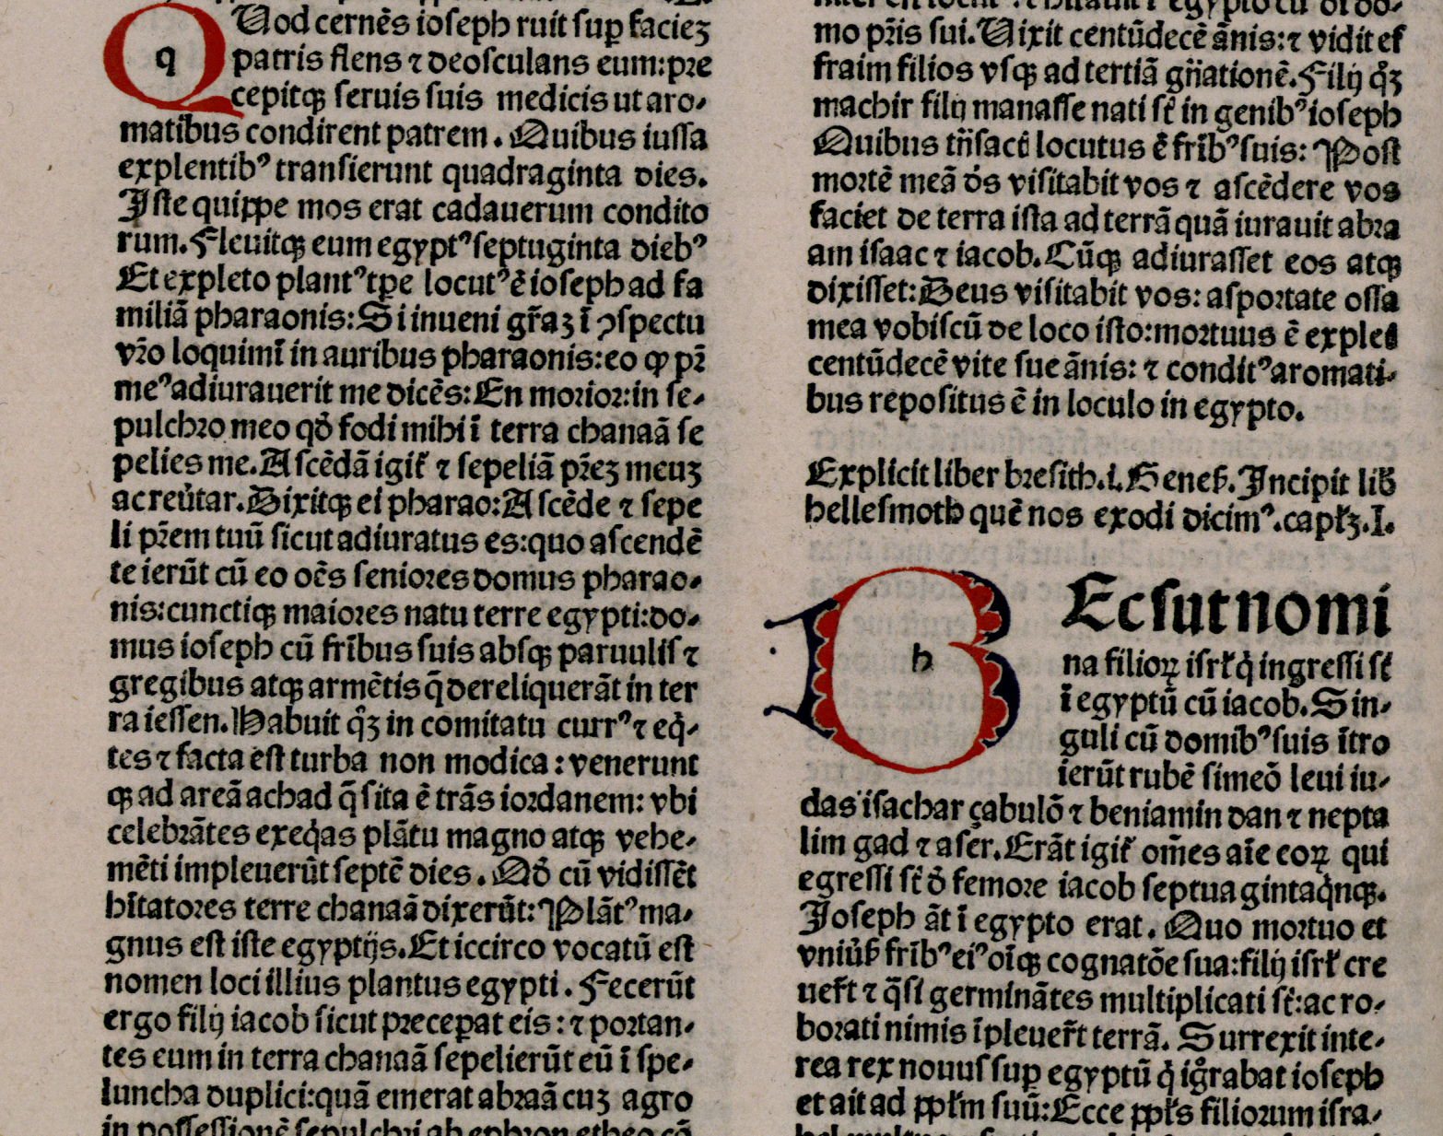
HathiTrust Digital Library
www.hathitrust.org
Initial focus on digitized book and journal content
  10.8 million total volumes
  5.6 million book titles
  282,000 serial titles
  3.4 million public domain (~32%)
Source: University of California
Notes:
Image: http://hdl.handle.net/2027/ucm.531685396x?urlappend=%3Bseq=44
www.hathitrust.org
Launched 2008
A partnership of 92 institutions
Initial focus on digitized book and journal content
10.8 million total volumes
5.6 million book titles
282,000 serial titles
3.4 million public domain (~32%)
Content comes mostly from academic libraries
University of California system of libraries, Yale, Harvard, the CIC institutions, others
Non-academic libraries: NYPL
Non-US content: Universidad Complutense de Madrid, Keio University
Google Books vs. HathiTrust

Slide 9
HathiTrust Digital Library
Content comes from academic and research libraries
Content from non-US partners: Universidad Complutense de Madrid
Google Books vs. HathiTrust
Source: University of California
Notes:
Content comes mostly from academic libraries
Non-academic libraries: NYPL
Non-US content: Universidad Complutense de Madrid (and soon, Keio) - UCM content is mostly Latin, Spanish, French; largest part of the collection was pub’ed in the 1700s
Google Books vs. HathiTrust

Slide 10
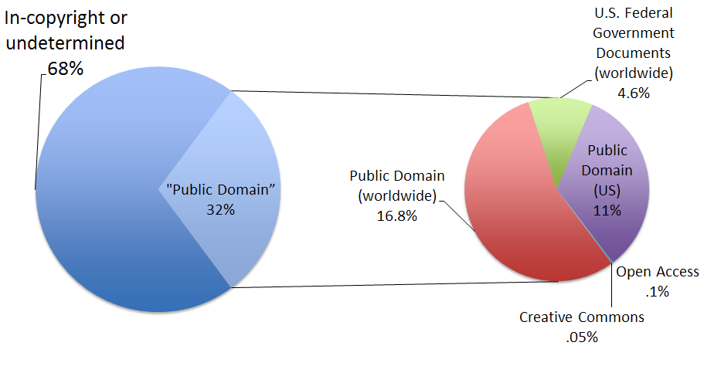
Copyright Distribution
Notes:
In copyright or undetermined - “limited-view”
“Public domain” - “full-view”

Slide 11
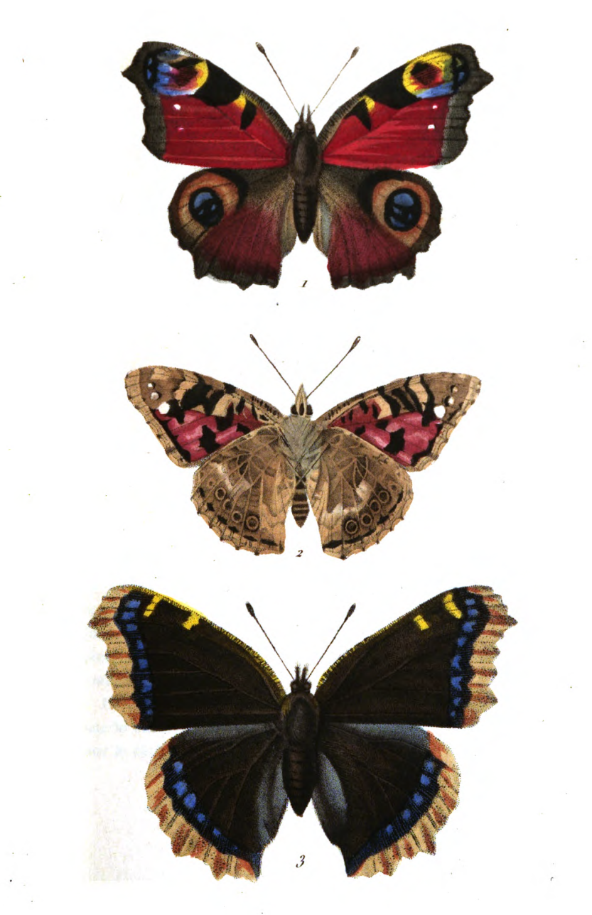
Content Distribution
By subject...
By language...
By date...
Source: University of California
Notes:
Image: http://hdl.handle.net/2027/uc1.b3104093?urlappend=%3Bseq=51
DEMO http://www.hathitrust.org/statistics_visualizations
Call numbers to indicate primary subjects of volumes - not all vols have LOC call numbers
50% of the collection is English, other top languages are European, and then Chinese, onwards
The top 10 languages make up ~86% of all content

Slide 12
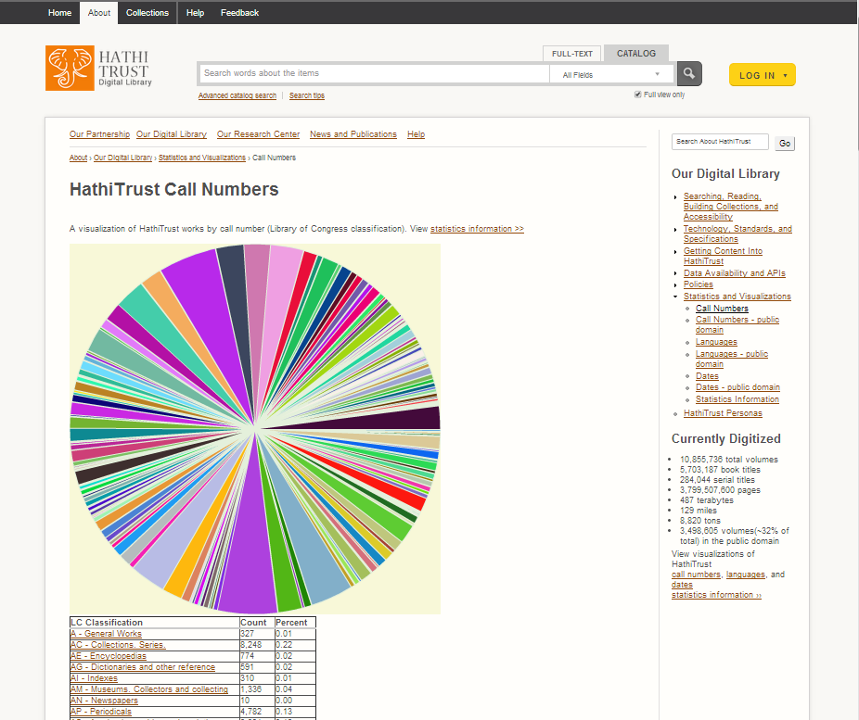
Notes:
http://www.hathitrust.org/visualizations_callnumbers

Slide 13
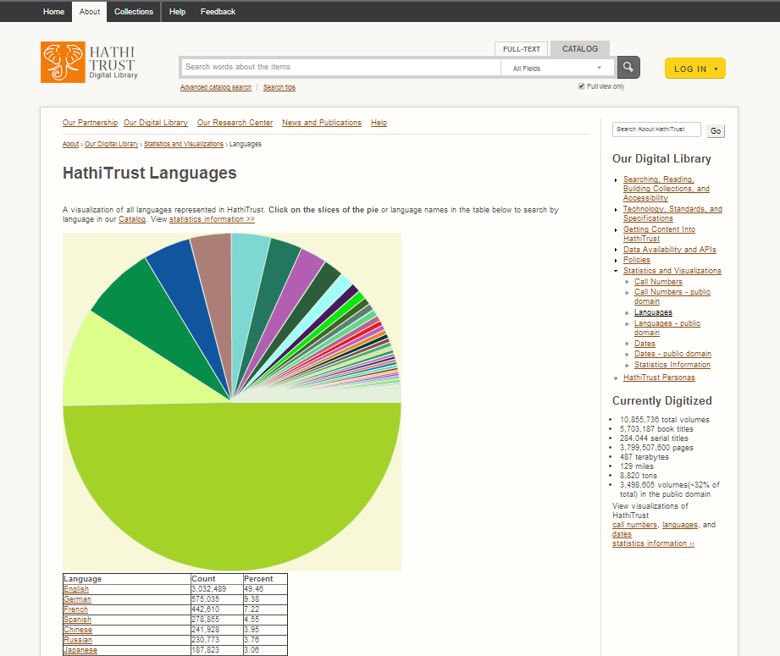
Notes:
http://www.hathitrust.org/visualizations_languages

Slide 14
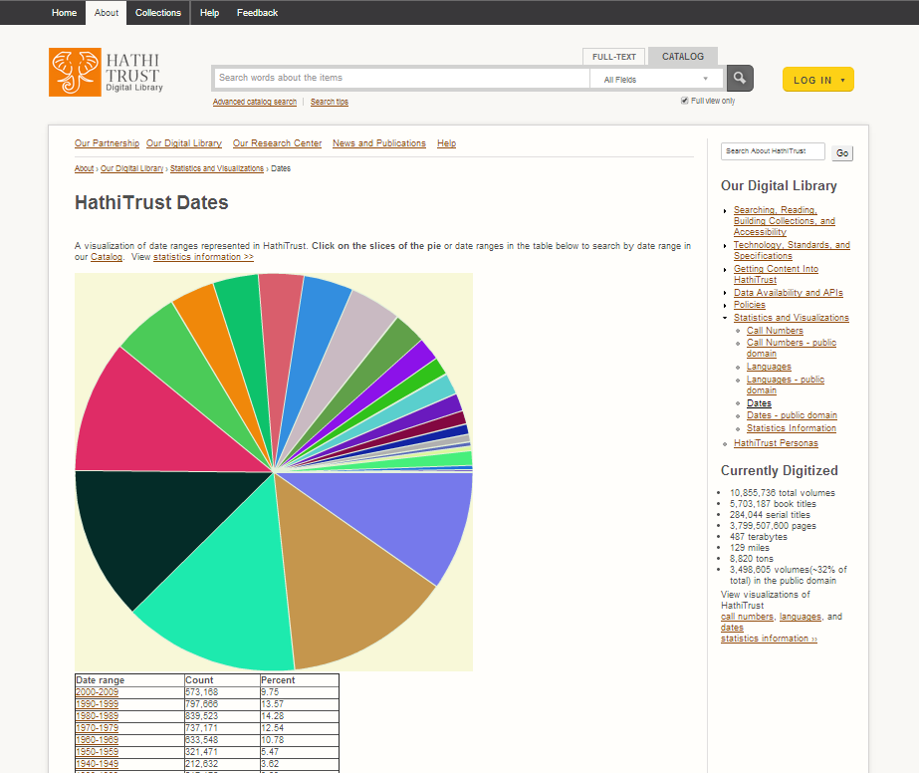
Notes:
http://www.hathitrust.org/visualizations_dates

Slide 15
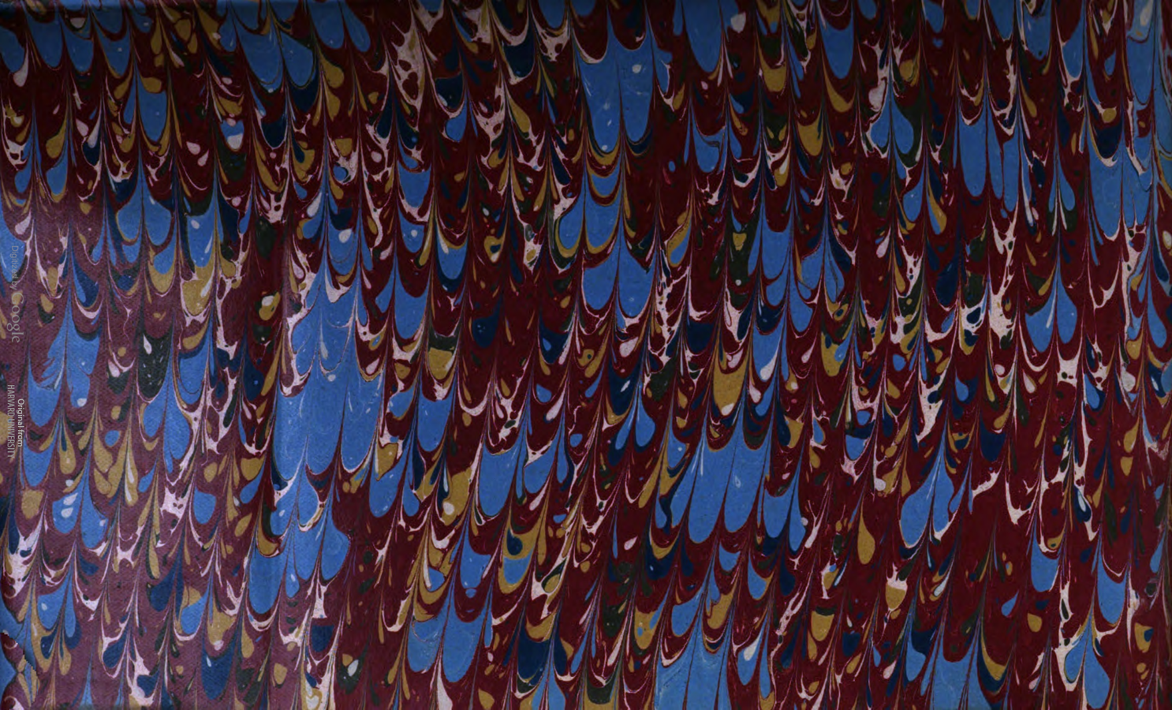
HathiTrust contains materials in all disciplines…
...and includes a wide range of primary source materials, such as:
Diaries
Correspondence
Reports
Newspapers
Memoirs
Source: Harvard University
Notes:
Image: http://hdl.handle.net/2027/hvd.32044107230294?urlappend=%3Bseq=3
Search for:
Letters
Diary

Slide 16
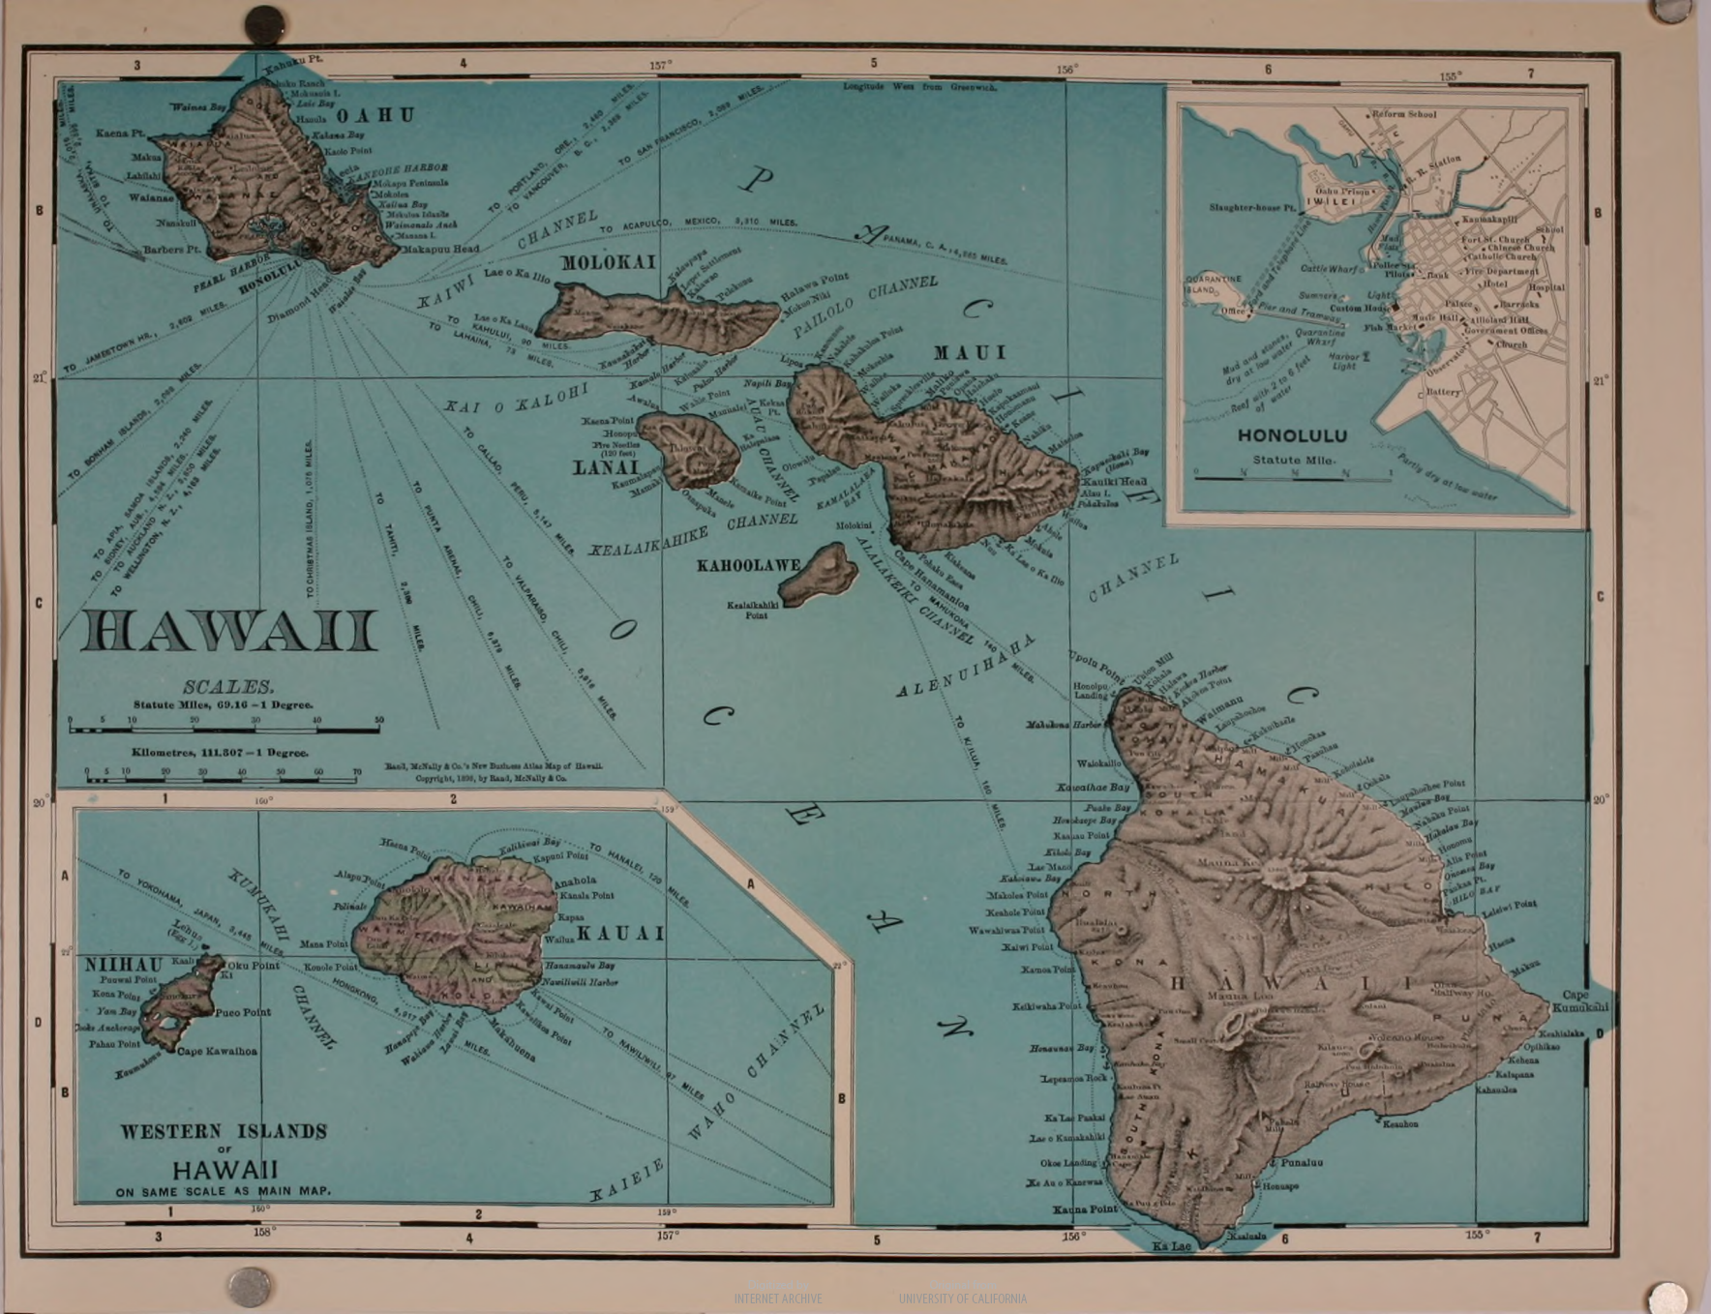
HathiTrust covers a wide range of formats, such as
Books
Encyclopedias
Archival materials
Directories
Periodicals
Maps
Illuminated manuscripts
Musical scores
Statistics
Visual Materials
Source: University of California
Notes:
Image: http://hdl.handle.net/2027/uc2.ark:/13960/t6g168q23?urlappend=%3Bseq=48
DEMO: null search and expand the format facet

Slide 17
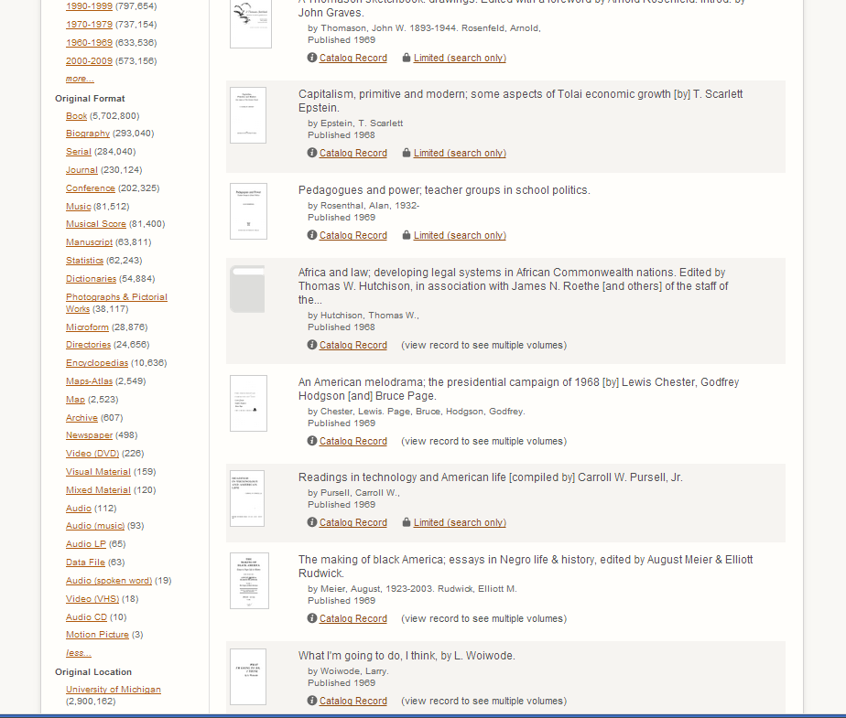
Notes:
To perform a null search, type an asterisk (*) into the search bar under catalog search. Null search cannot be performed in full-text search.

Slide 18
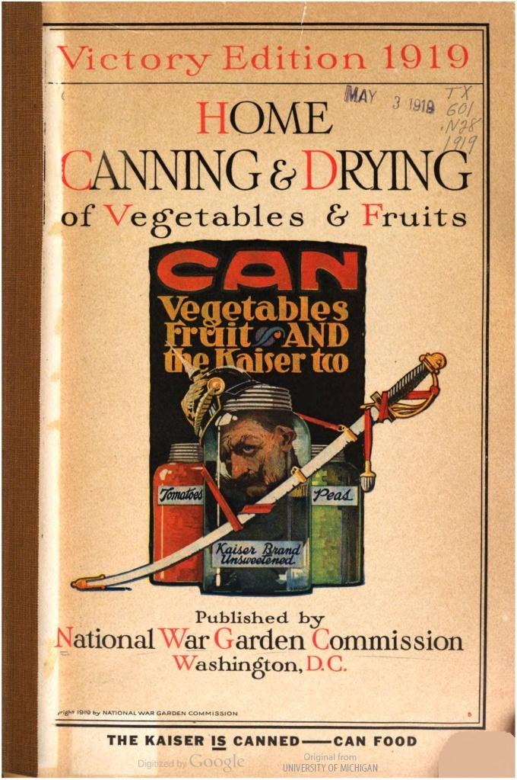
U.S. Federal Government Documents
Approx. 512,000+ U.S. federal government documents
Most are in the public domain
Source: University of Michigan
Notes:
Image in http://hdl.handle.net/2027/mdp.39015026288392
Reports by agencies
Congressional hearings
Laws and bills
Congressional hearings and reports
Federal Register
When are they not in the public domain? When we don’t know that they are us federal gov docs (based on cataloging)
When there are complications wrt non-federal authors; publishers; location of publication
Gov docs initiatives: HT is devoted to becoming THE source for US Federal gov docs
Ballot proposal at Constitutional Convention: create a comprehensive digital corpus of docs
Working on building a registry of gov docs to help identify all gov docs
Catherine Morse:
- research papers where students are required to use primary resources. Some end up using gov docs in HT
-a course where the professor assigns older public domain political theory books in HT.
-I've been contacted by a few different Indian tribes. They want digital copies of documents (often hearings about their tribe).

Slide 19
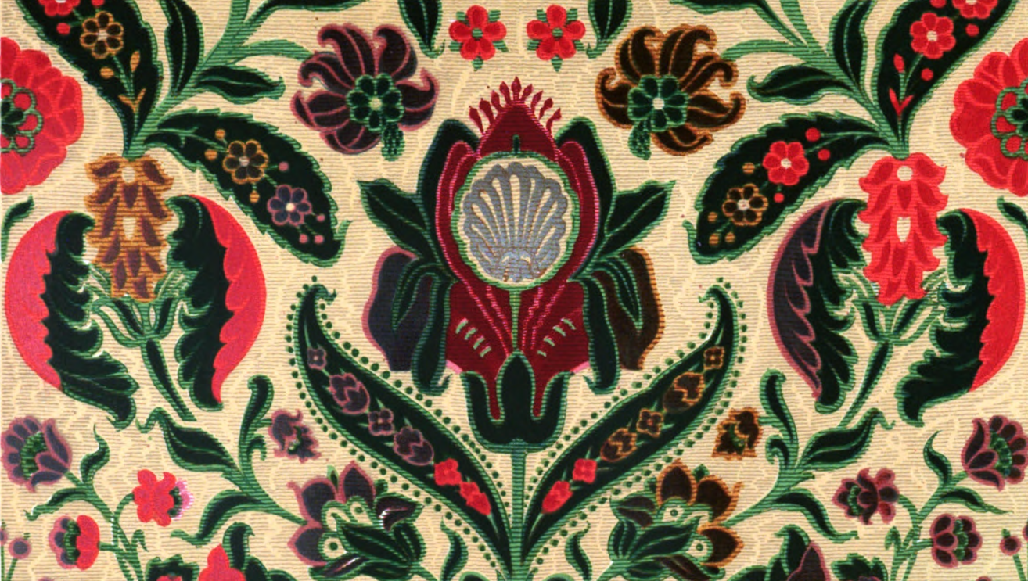
Services
Long-term preservation
Catalog search
Full-text search
Reading and download capabilities
Print-on-demand
APIs and Data feeds
  Data API
  Bibliographic API
  “Hathifiles” inventory files
  OAI
Collections
Datasets, Research Center
Source: University of California
Notes:
Image: http://hdl.handle.net/2027/uc1.b3258765?urlappend=%3Bseq=285

Slide 20
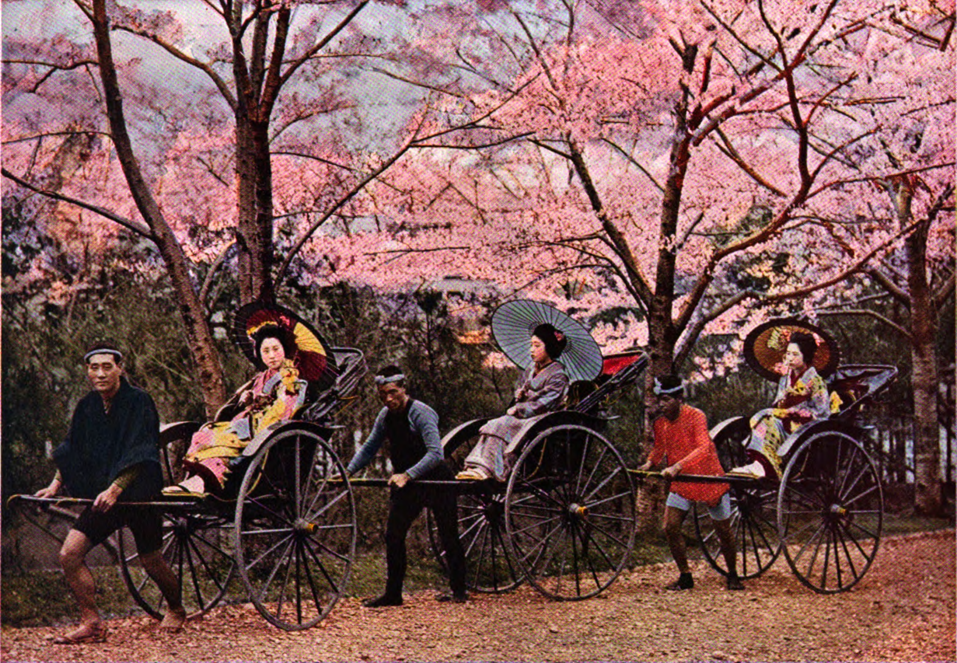
Searching
A source for texts
Two kinds of searches:
Full-text search
Catalog search
Source: New York Public Library
Notes:
Image: http://hdl.handle.net/2027/nyp.33433072155330?urlappend=%3Bseq=189
Demo:
Full-text search
Catalog search

Slide 21
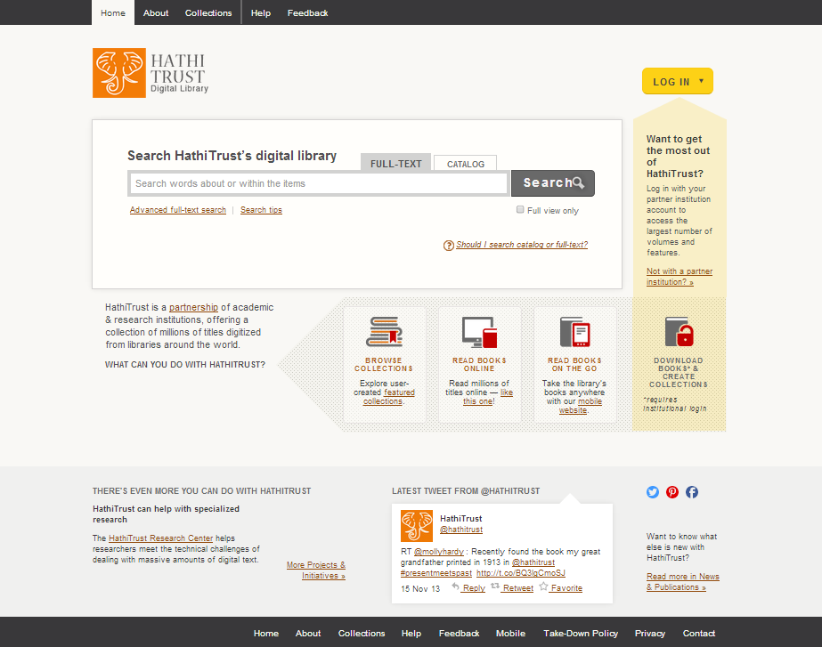
1
2
3
4
5
Notes:
When do you use full-text search? descriptive information plus full-text that occurs in a work, such as a name, place, citation, or favorite quote.
1. Make sure you’re in the right tab for full-text search
2. Advanced full-text search
3. Search tips if you ever need additional help
4. Check this box to limit to items that are available to you immediately
5. Additional tip on when to use catalog or full-text search

Slide 22
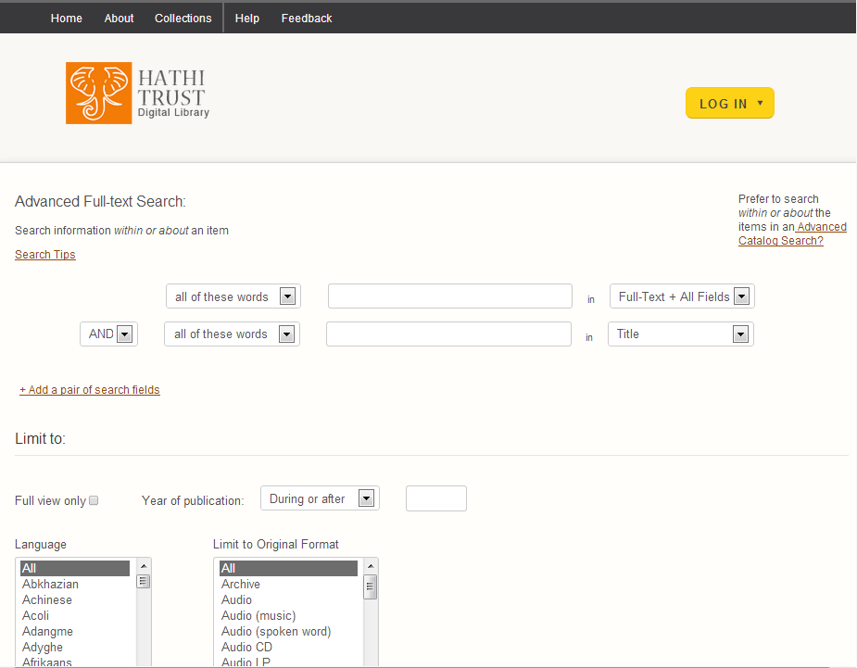


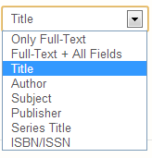
Notes:
Dropdown menus allow you to customize your advanced search

Slide 23
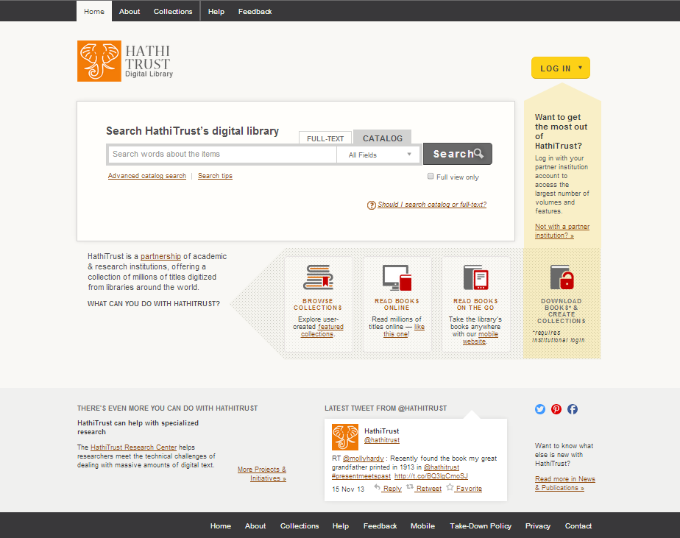
1
2
3
Notes:
When do you use catalog search? - descriptive information only, such as author or title
1. Make sure you’re in the right tab
2. Advanced catalog search
3. Check this box to limit to items that are available to you immediately

Slide 24
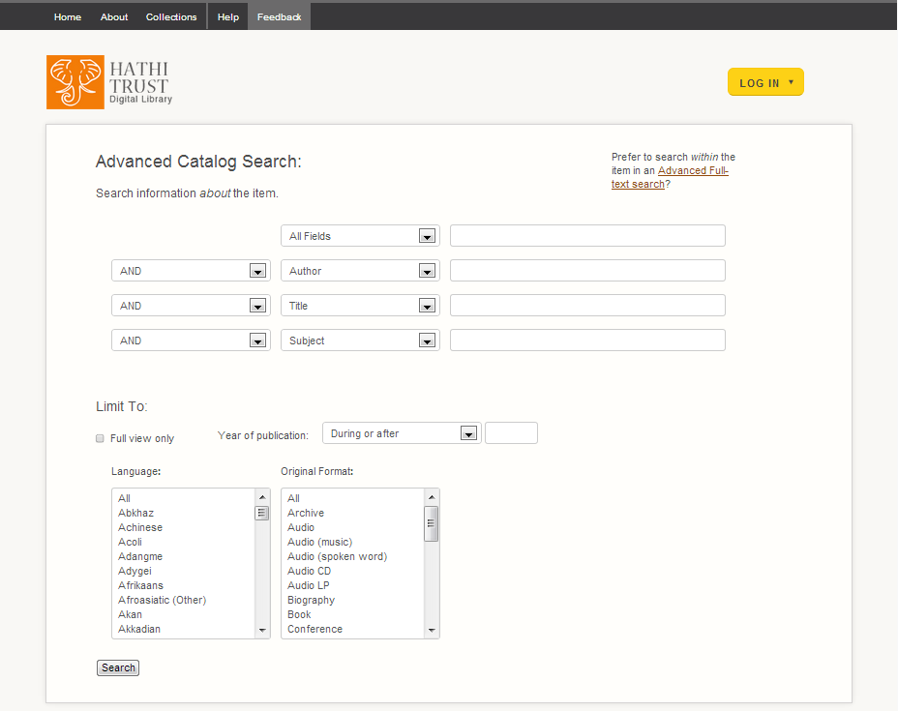
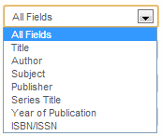

Slide 25
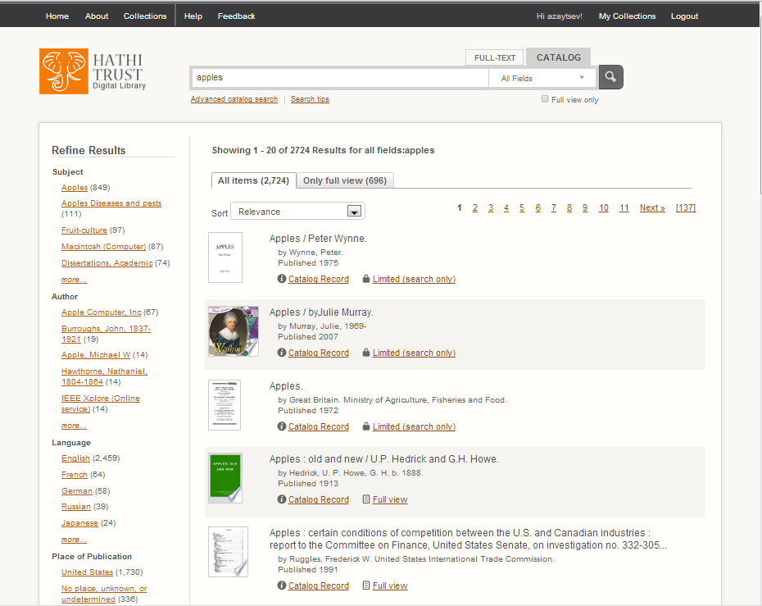
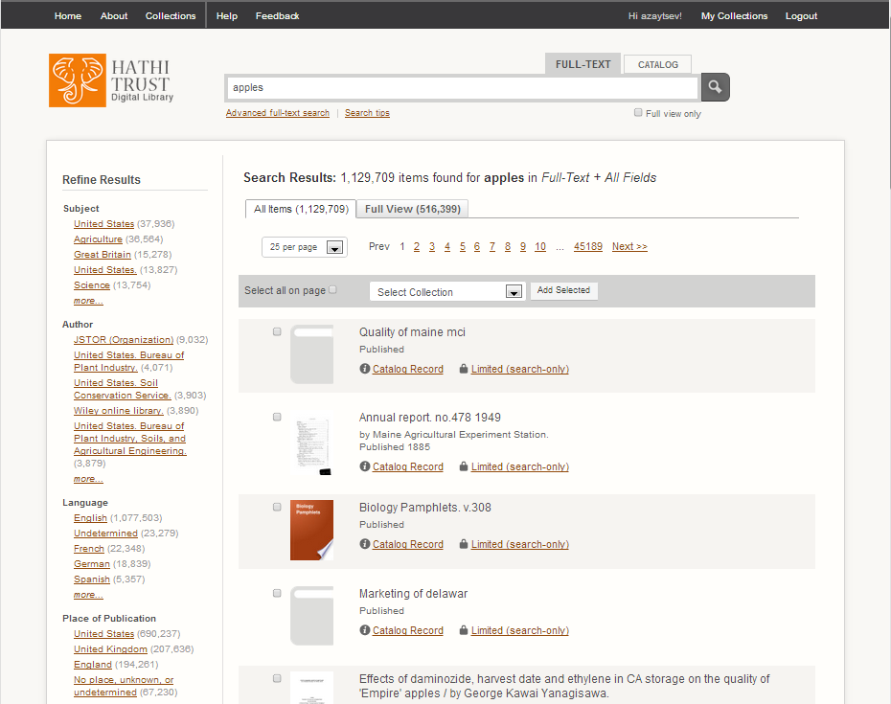
Notes:
Search results - Catalog v. Fulltext
Catalog: 2,724 records
Full-text: 1,129,709 items
Catalog search allows you to sort your results by relevance, date, title
Full-text search allows you to modify the number of results that appear on a page
Full-text allows you to add items to a collection directly from the search results list. This is the best way to bulk add items to a collection.

Slide 26
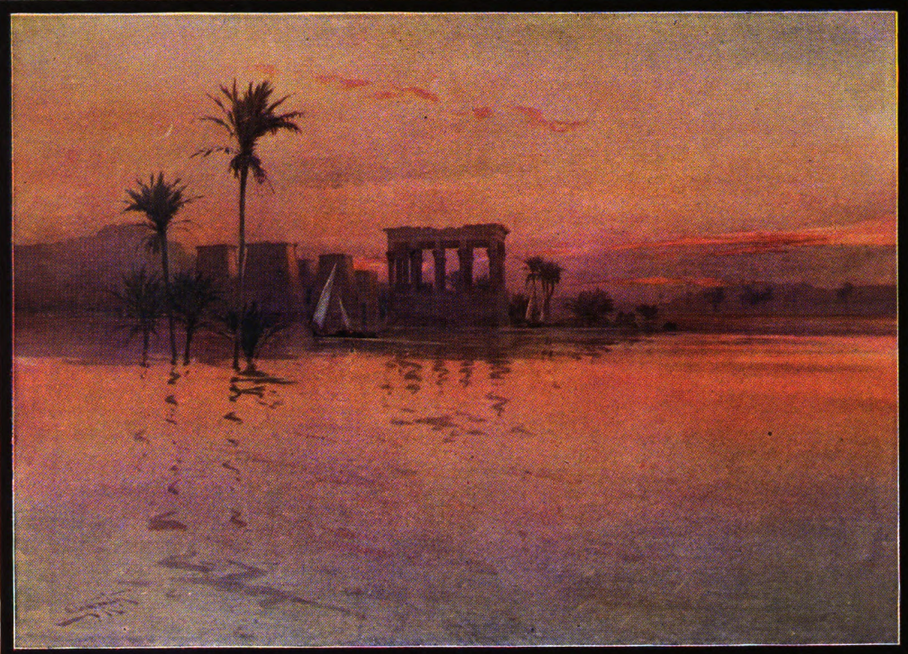
Explaining Access & Restrictions
Full-view v. limited-view
Downloads
Lawful uses
Users with print disabilities
Preservation uses of materials
Source: University of Wisconsin
Notes:
Image: http://hdl.handle.net/2027/wu.89104419106?urlappend=%3Bseq=8

Slide 27
Notes:
Search results display both “limited-view” and “full-view” volumes

Slide 28
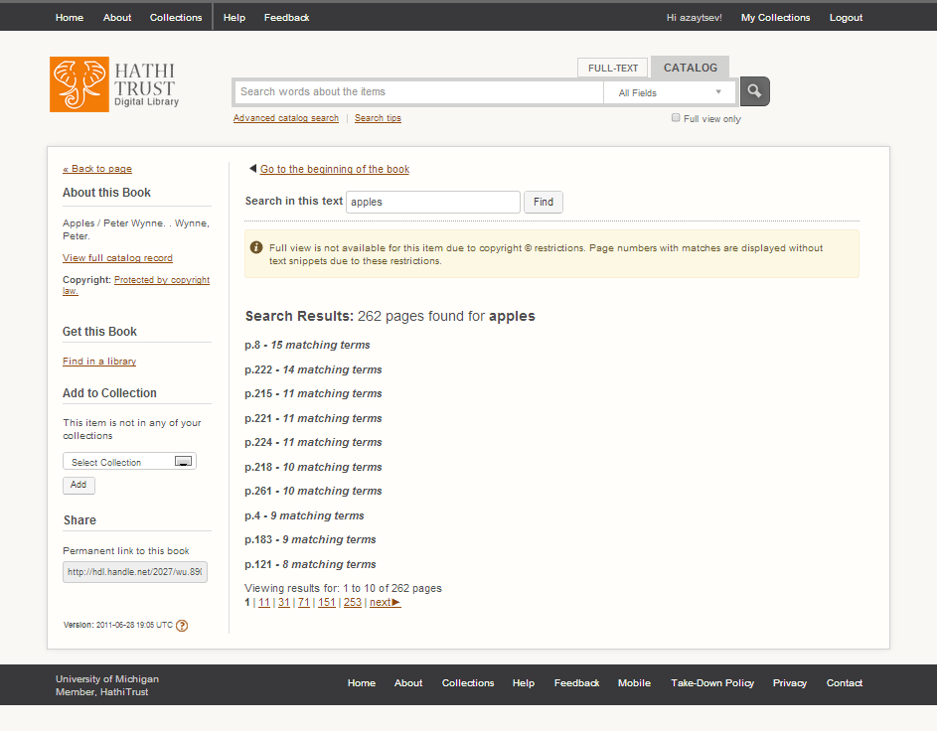
Notes:
Items labeled “limited-view” are generally unavailable for viewing. However, there are some volumes where we can provide access based on Section 108 of the Copyright law to UM users, so make sure you log in to ensure those show up in your results.
- Search within limited-view volumes (use it like an index in the case where you have a print copy of the volume; use search to identify volumes of interest to you (ex: volumes that have numerous instances of your search term))

Slide 29
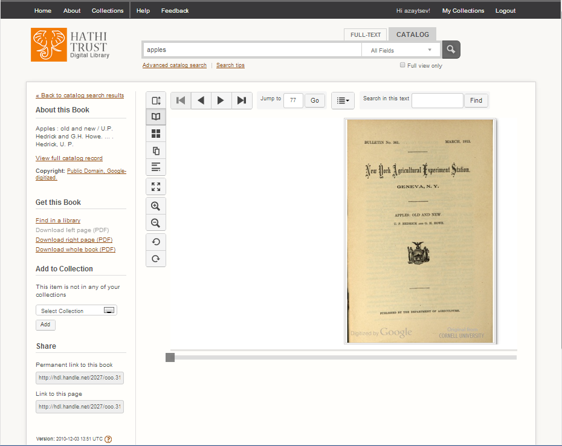
5
4
2
1
3
Notes:
Items labeled “full-view” are available for viewing and sometimes for download.
1. Under “get this book” you will see options for viewing and downloading and finding a print copy. If you are unable to download the whole book, check the copyright statement
2. Copyright: Books that included “Google-digitized” are only available to logged in members of partner institutions. So LOG IN!!
3. You can add an item to a collection while you are viewing that book.
4. Different views for books: scroll view, flip view, thumbnail view, single page view, text view (based on OCR), make the view full-screen, zoom in and out, rotate pages
5. Search within a book

Slide 30
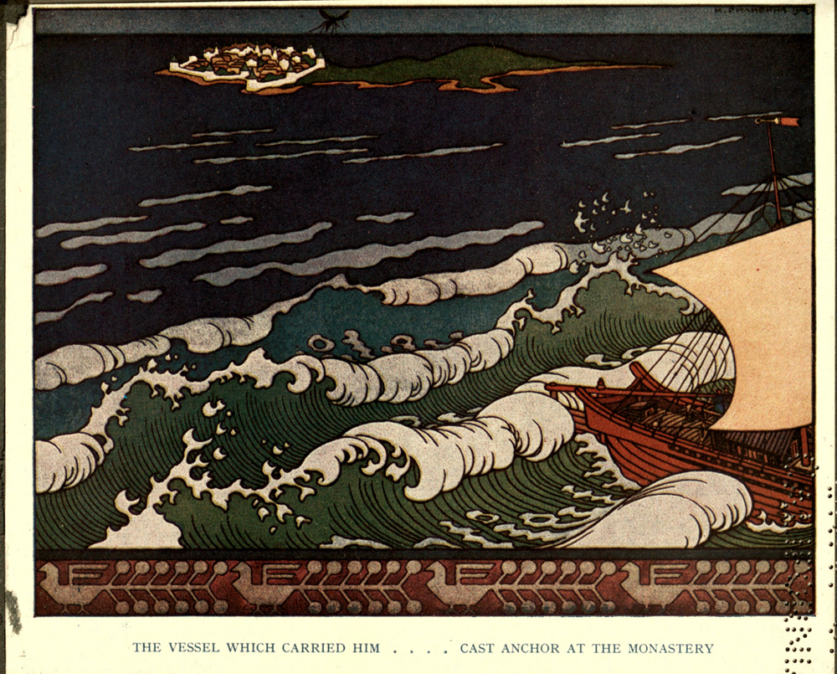
Building collections
Build collections
Share collections
Search within a collection
Source: University of California
Notes:
Image: http://hdl.handle.net/2027/uc2.ark:/13960/t9p26rk7j?urlappend=%3Bseq=339
DEMO Collection Builder
Build collections as you search
Share collections or keep them private
Search within a collection that you created
E.g., search within all the volumes of a specific journal; search within all the volumes by a specific author

Slide 31
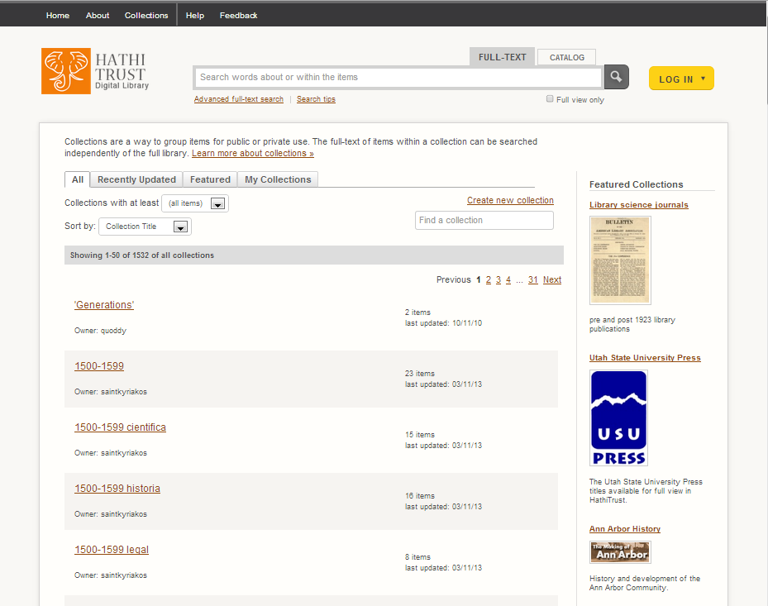
3
1
2
Notes:
1. Select the tab for the collections you are interested in viewing. If you are not logged in, you will not see any collections under “My Collections”
2. There are two ways to create a collection. One way is from this page, to click the link “create new collection” and then create an empty collection
3. Make sure you are LOGGED IN when creating a collection. Otherwise, you will just create a temporary collection that will disappear when your session expires.
The collections featured on this page are public collections, which can be searched and viewed by anyone.

Slide 32
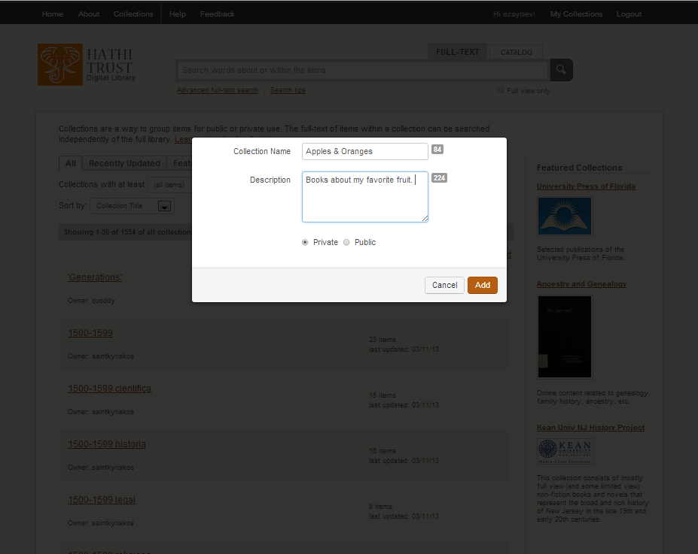
Notes:
Creating a collection
Enter name and description. The numbers to the right of the text boxes indicate character limits.
Select whether a collection will be private or public.

Slide 33
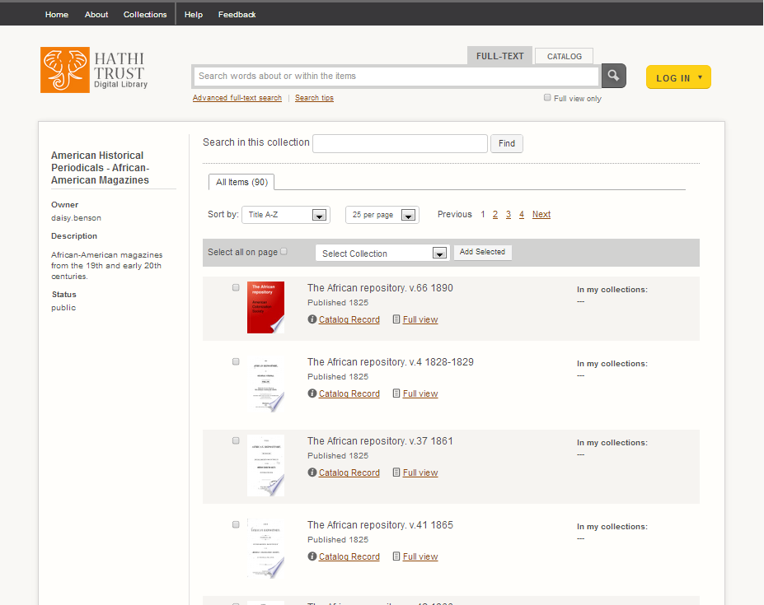
1
2
3
Notes:
1. Choose how you want the collection sorted
2. If you are copying a large amount of items over into a personal collection, it is useful to modify how many items show on a page to minimize effort
3. Add items in a collection to your own colletion

Slide 34


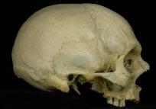

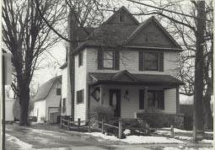
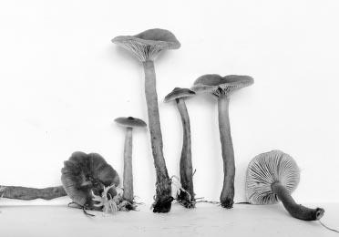
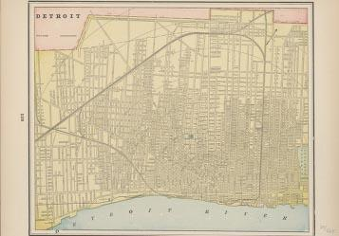
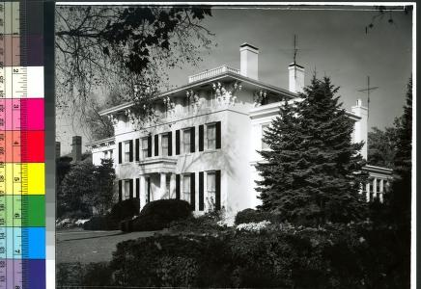
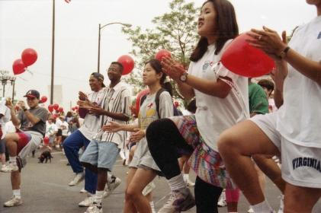
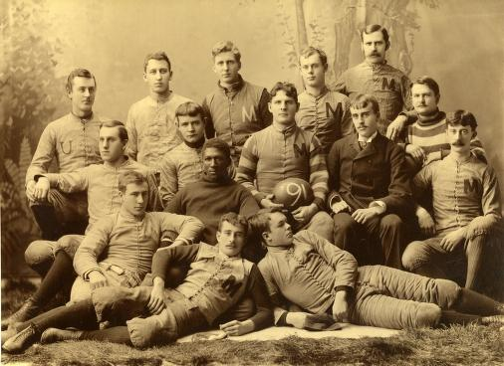
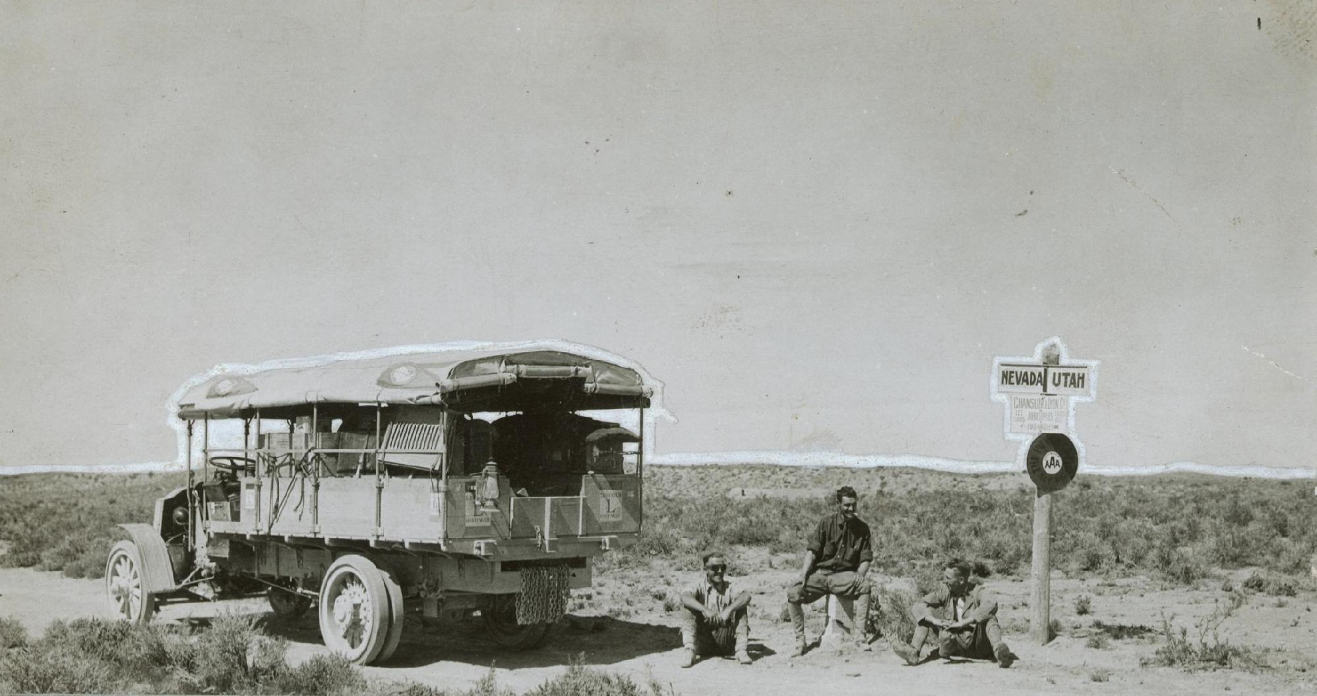
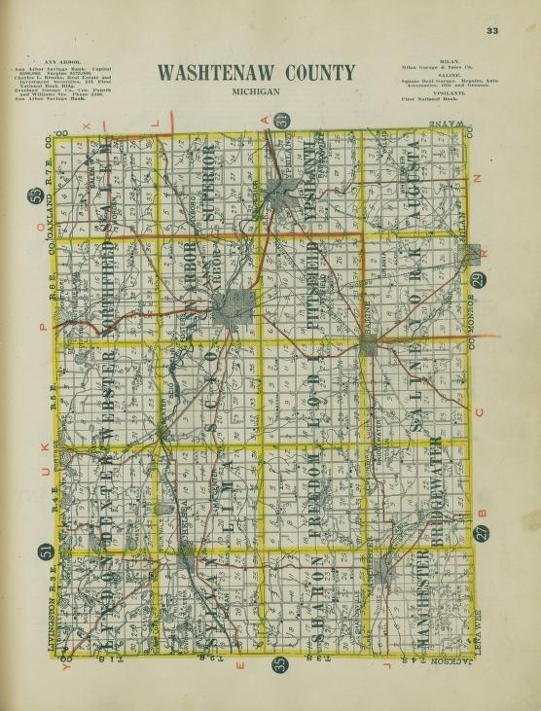
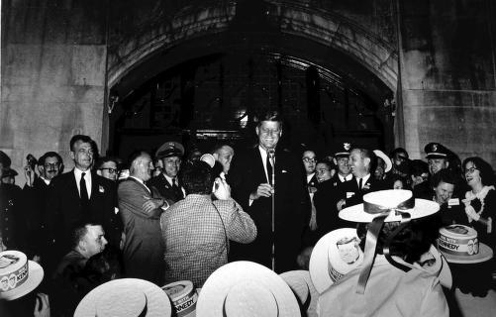
UM Digital Collections
aka UM Digital Library

Slide 35
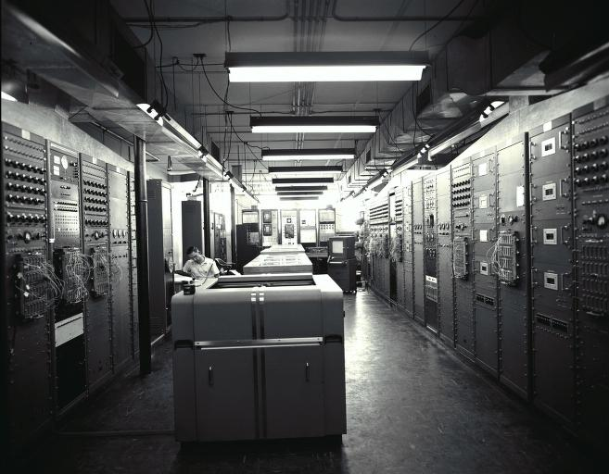
UM Digital Collections
Famous for digitization efforts
One of the first digital libraries with a production focus
Source: Bentley Image Bank

Slide 36
What do we have?
Currently -- 259 separate collections of
images = photographs, drawings, etc.
texts = books, journals, etc.
finding aids = digital tools to find archives
quod.lib.umich.edu

Slide 37
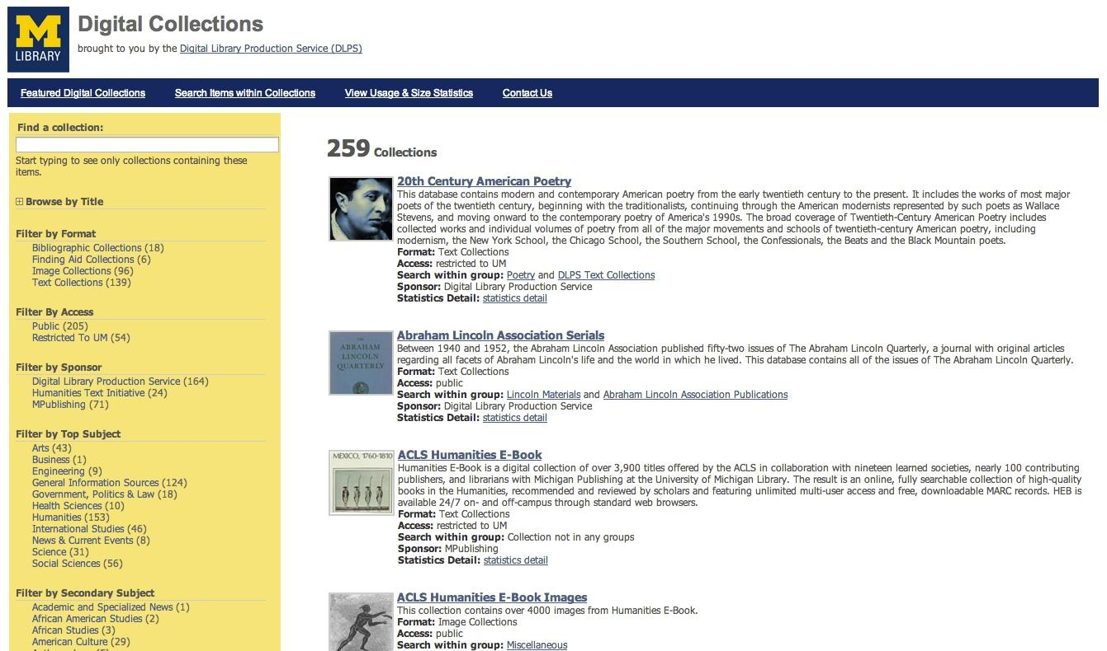

Slide 38
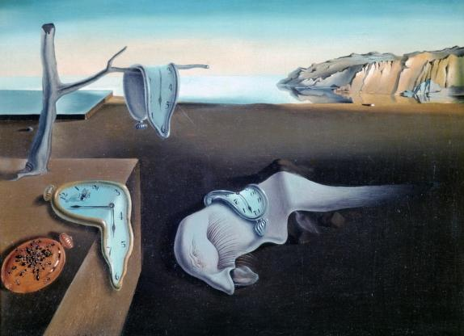
What if I forget that URL?
Multiple ways to get to the UM Digital Collections
Several ways from the main Library gateway
Source: History of Art Department, Visual Resources Collections

Slide 39
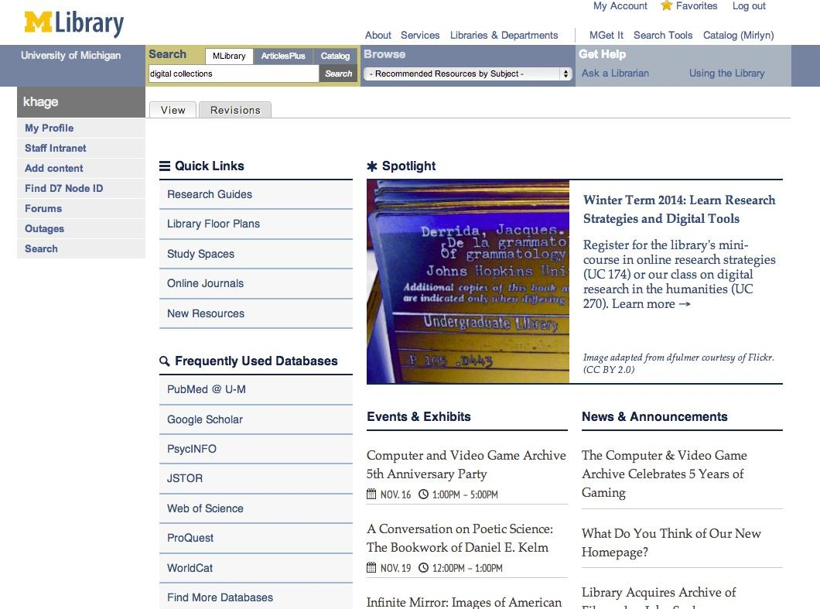

Slide 40
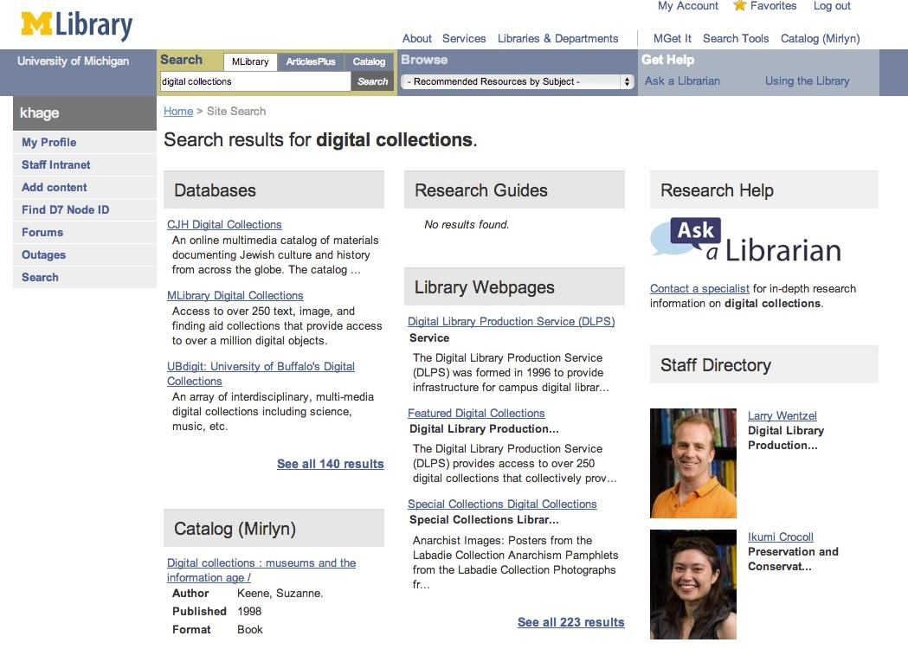

Slide 41
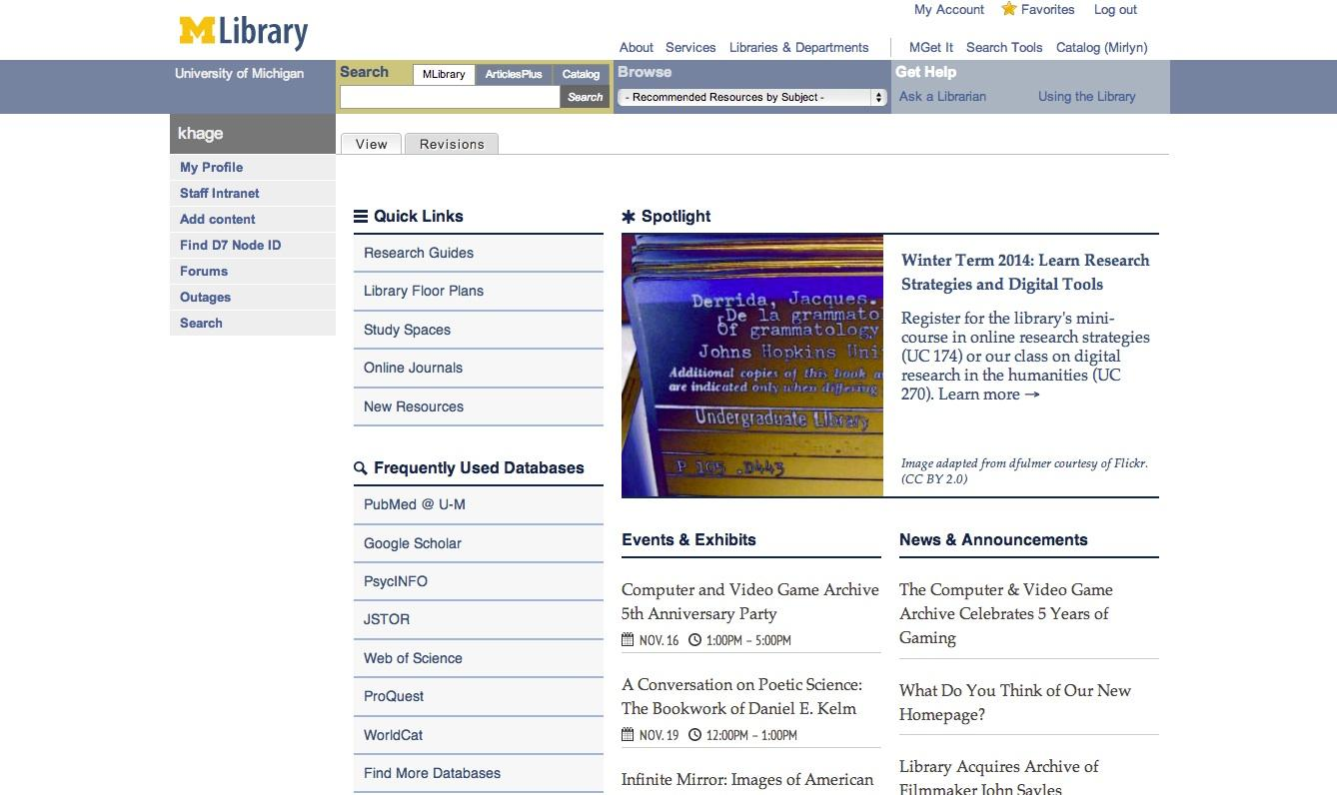
Notes:
Promotional Road Tour!

Slide 42
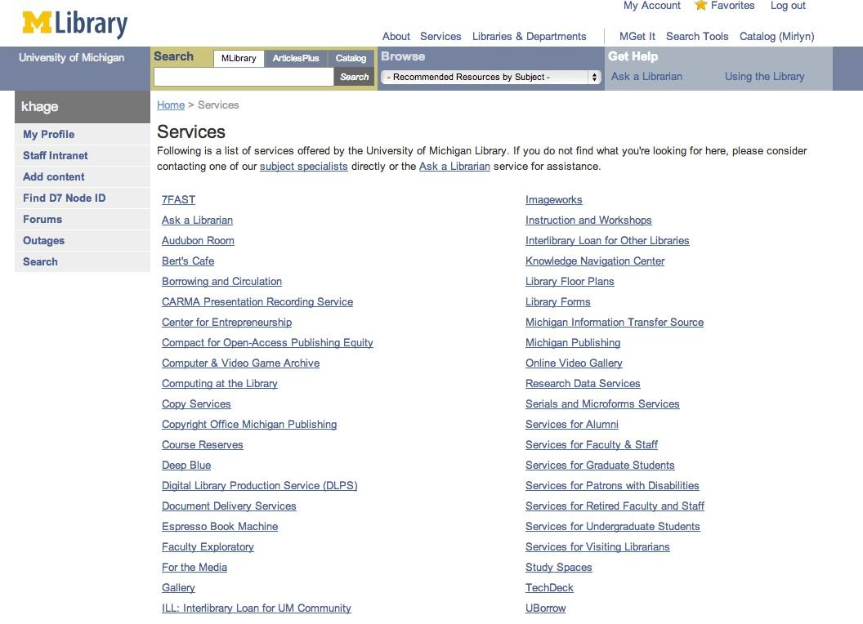

Slide 43


Slide 44
How do I find things?
Right, now that you know where the list of all digital collections is, you want to search for books and images and everything.
images = images.umdl.umich.edu
texts = quod.lib.umich.edu/t/text
finding aids = quod.lib.umich.edu/cgi/f/findaid/findaid-idx
Which are all linked from...
quod.lib.umich.edu

Slide 46


Slide 47

TEXT
Searching texts is by group or individual collection.
We don’t have the functionality to search across all of them... yet.

Slide 48
So before I move on...
We need to talk about migration.
Many, many of these text collections are migrating to HathiTrust.
We will slowly be closing off access to these - as separate UM Digital Collections - over time.
This is NOT happening with the image or finding aids collections.

Slide 49

IMAGE
Searching images is easier. We’ve built functionality so you can “Search items within collections.”

Slide 50
And one more thing...
We need to talk about metadata.
Metadata = technically, data about data
Think of the records you see in Mirlyn - that’s metadata
Image collections, unfortunately, tend to have sparser metadata
So your search may not be as accurate as searching text collections.

Slide 51

Finding aid = document containing detailed information about a specific collection of papers or records within an archive.

Slide 52
How do I use your interfaces?
Text collections and image collections have a different look-n-feel. They also have slightly different functionality.
But what both have is the ability to search and browse through the items.

Slide 53

TEXT
When you select “Browse” from quod.lib.umich.edu/t/text, you can choose a group of collections to search within.
Click on the name of the group to search all those collections.

Slide 54

TEXT
Basic Search gives you some advanced search capabilities, like limiting by a certain field. BUT this is limited when searching in a group.
You can select a group of text collections to search within.

Slide 55

TEXT
Boolean Search provides complex Boolean operators so you can “AND” or “OR” or “NOT” your search.

Slide 56

TEXT
Go to the text itself, the list of pages that contain the word(s) you were searching, or the TOC.
Search results show hits in all collections and in each collection you’re searching.
Save the record to your “bookbag” (sort of like RefWorks or Zotero)

Slide 57

TEXT
Selecting “results details” (the list of pages containing your search word) gives you the option to select a particular page.

Slide 58

TEXT
Selecting the page (“Page 6”) shows you the scanned page.

Slide 59

TEXT
Selecting a different format gets you the plain text (or the page as a PDF)

Slide 60

TEXT
The search history tab shows all the searches you’ve done, and with one click you can repeat the search.

Slide 61

TEXT
Selecting the Bookbag tab will allow you to see all your saved records, search them, and download or email them.

Slide 62
IMAGE
One way to limit what you search is by clicking on a group or groups first.

Slide 63

IMAGE
Tip #1: You can browse by a variety of different aspects of the photos here.
Tell us what you like or don't like or what could be more useful or, really, anything.

Slide 64
IMAGE
Note that I am not logged in.
But I am an authorized user of the collection. That's because you're sitting in a UM building or you're proxied in.

Slide 65

Tip #2: You can resize the photo on this page.
IMAGE
Tip #4: You can download different sizes of the photo. The range of resolutions will differ depending on the collection.
Tip #3: You can zoom in and out on the photo.

Slide 66

IMAGE
Tip #5: If you click on the Description tab you can see all the "metadata" about the image.
Tip #6: Note the copyright or permissions statement when you're in a particular collection. They could differ!

Slide 67
IMAGE
Tip #7: Lots of subject headings. They are links that allow you to browse by subject. Click on them to see all the images tagged with a subject.

Slide 68

IMAGE
Portfolios allow you to collect images of interest from any collection into one browseable, downloadable collection. You can do that with any public portfolio.

Slide 69

IMAGE
You can add it to a new or existing portfolio of your own.
You can see which public portfolios this image is in.
Notes:
Mention not going to over finding aids for time reasons...

Slide 70

One word about the image interface
Better functionality will be coming in the new semester.
Can view record and image side by side.
Can zoom and move the image around within the screen more smoothly.

Slide 71






We are eager to hear how you use our collections.
Notes:
Collections from Kelsey, UM Anthropology, UMMA, and Library Special Collections, like Labadie, where the Anarchism Pamphlets reside

Slide 72

We know you use
Two things you should know…
We’ve made improvements in the UM Digital Collections so they are findable in Google
Just be sure to add “michigan” or “umich”
eg, “Lincoln Highway michigan”
You can find HathiTrust book titles directly via Google
Just be sure to add “hathitrust”
eg, “Home Needlework Magazine hathitrust”

Slide 73

Time for an exercise!
Source: Early Detroit Images from the Burton Historical Collection of the Detroit Public Library
Notes:
→ URLs: HT and dig colls list
→ toddler being thrown in a pool
→ attendees will try to find something in either DLXS or HT
→ report out
have them use a research query of their own or ask us for one
[AZ will come up with some queries]
5 minutes: search your search
5 minutes: use the functionality of the system
5 minutes: do it in the other (HT or DLXS)
for DLXS, those would be:
download
resizing
paging
portfolios
saving results
we can do this either individually or in teams
if we do as a team, then a group could report out on a specific activity, like downloading
Don Quixote translations
Versions of the Bible
Robert Louis Stevenson - Treasure Island
Earliest use of the word
Content related to nuclear power, plants, history, armament, etc
Uses of the phrase “nuclear family”
“Black Action Movement” - group formed in the 60s to advocate for minority groups

Slide 74
Exercise #1: HathiTrust
Pick a topic (something that interests you) or we have some topics for you.
Search for your topic in HathiTrust.
  http://www.hathitrust.org
Search, download, cite, redo searches, add items to a collection, anything you’d like.
Have fun!

Slide 75
Practice makes perfect! (a 2nd exercise)
Source: Early Detroit Images from the Burton Historical Collection of the Detroit Public Library
Notes:
→ URLs: HT and dig colls list
→ toddler being thrown in a pool
→ attendees will try to find something in either DLXS or HT
→ report out
have them use a research query of their own or ask us for one
[AZ will come up with some queries]
5 minutes: search your search
5 minutes: use the functionality of the system
5 minutes: do it in the other (HT or DLXS)
for DLXS, those would be:
download
resizing
paging
portfolios
saving results
we can do this either individually or in teams
if we do as a team, then a group could report out on a specific activity, like downloading
Don Quixote translations
Versions of the Bible
Robert Louis Stevenson - Treasure Island
Earliest use of the word
Content related to nuclear power, plants, history, armament, etc
Uses of the phrase “nuclear family”
“Black Action Movement” - group formed in the 60s to advocate for minority groups

Slide 76
Exercise #2: Digital Collections
Use the same topic.
Search for your topic in Digital Collections.
  quod.lib.umich.edu/t/text - text collections
  images.umdl.umich.edu - image collections
  quod.lib.umich.edu - all the digital collections
Search, download, cite, redo searches, add items to portfolios, anything you’d like.
Have fun!

Slide 77
Discussion Topic:
What did you discover?
What questions do you have?
Source: Bentley Image Bank
Notes:
Image: http://quod.lib.umich.edu/b/bhl/x-bl002078/bl002078
Time: 5 minutes
Now that you’ve heard this all, how has your definition of a digital collection changed?

Slide 78
Discussion Topic:
What is a digital collection?
Has your definition changed?
Source: Bentley Image Bank
Notes:
Image: http://quod.lib.umich.edu/b/bhl/x-bl002078/bl002078
Time: 5 minutes
Now that you’ve heard this all, how has your definition of a digital collection changed?

Slide 79

Digital Collections: Research & Teaching
Source: Pictorial History of Ann Arbor
Notes:
Image: http://quod.lib.umich.edu/m/moaa/x-bl000298/bl000298

Slide 80

Our digital collections can help you with your RESEARCH.
Source: UMMA
Notes:
Image: http://quod.lib.umich.edu/m/musart/x-1968-sl-1.76/1968_1.76.jpg

Slide 81

Our digital collections can help you with your TEACHING.
Source: UMMA
Notes:
Image: http://quod.lib.umich.edu/m/musart/x-1962-sl-2.1/1962_2.1.jpg

Slide 82
Our Digital Collections are:
Full of primary resources
Allow you to collect and curate
You can reuse and repurpose
Conduct textual analysis
Use stuff in papers & presentations

Slide 83

(http://hathitrust.org/htrc)

Slide 84

Questions?
Source: U-M AAEL Library

Slide 85
Contact Us!
Kat Hagedorn (khage@umich.edu)
Project Manager for Digital Projects, Digital Library Production Service
Meghan Musolff (musolffm@umich.edu)
Special Projects Librarian for LIT and Publishing, Online Exhibits Coordinator
Angelina Zaytsev (azaytsev@umich.edu)
Special Projects Librarian, HathiTrust
Notes:
Questions for you:
Should we run this session again?
We’ll be sending out a survey--confirm this!

