Slide 1
CRMS Problems That Aren’t
May 15, 2012
Notes:
Sometimes, the way that information is extracted from a catalog record can produce a deceptive display in HathiTrust, even though the cataloging itself is correct. Corrections can’t make changes to records that aren’t incorrect. Reporting these situations as errors takes up time and prevents decisions from being made on items with valid records.
We would like to show you a few of these situations so the number of these reports can be reduced.

Slide 2
Volume/index title "wrong record" report
“appears to be scan of Index to selected Japanese medical literature of pre-Meiji times -- didn't see Galaxy of old Japanese medical books”
Notes:
This is the report made by the CRMS evaluator.

Slide 3
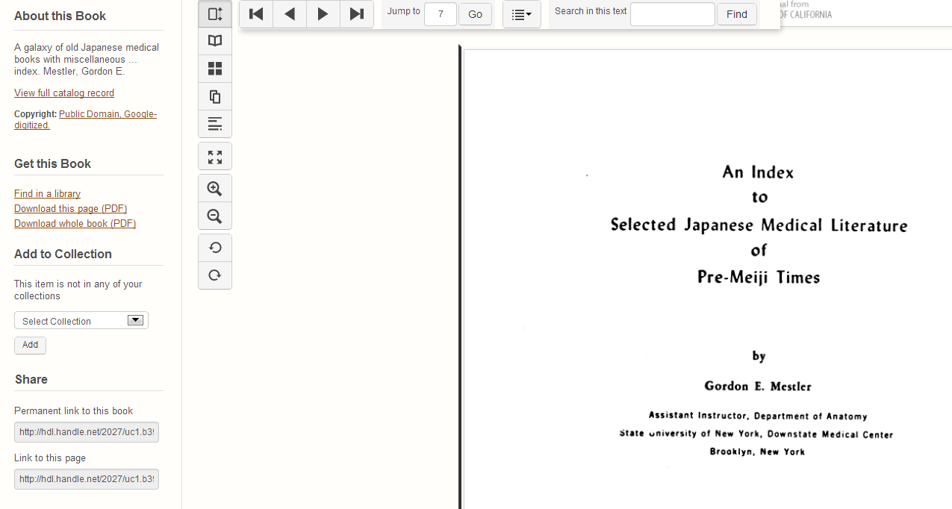
Notes:
When you look at the display you see what appears to be a straightforward mismatch between the title from the record and the scanned work. But if you look at the full record…

Slide 4
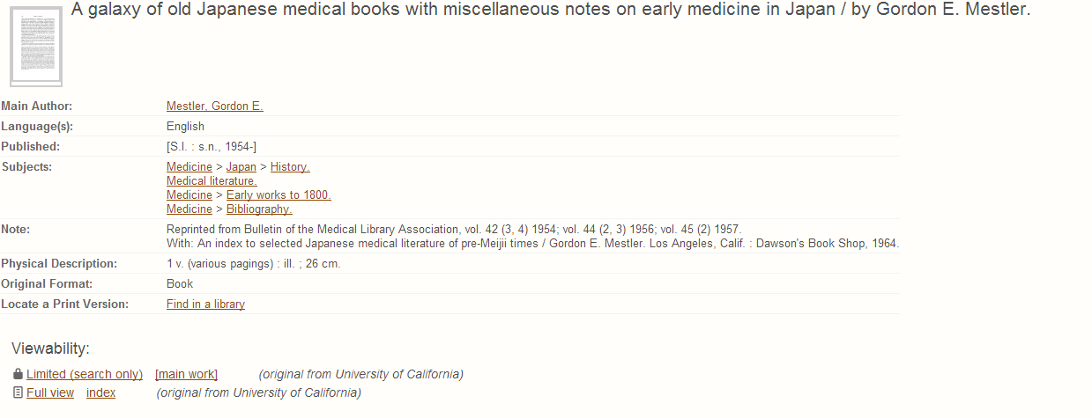
Notes:
…you see that the item being evaluated is an index to a larger body of work with a different name. It is that larger body that was represented in the bibliographic data displayed in the left frame.

Slide 5
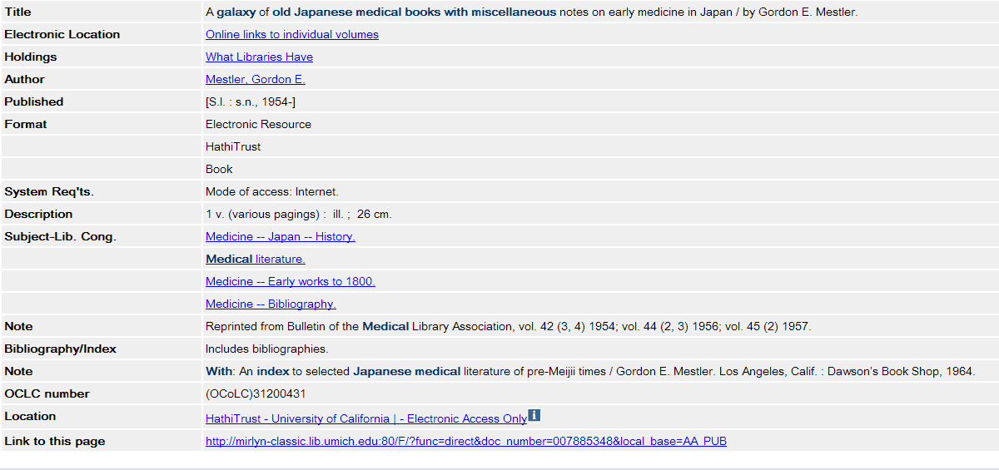
Notes:
Here is what the full bibliographic record looks like. As you can see, the title from the HathiTrust scan is described in the note field, but the title of the main work is what was extracted for the HathiTrust display. No correction was needed.

Slide 6
Changes in Cataloging Approach
“I think this book (and the other volumes) might be better off being cataloged as a monographic series. Seems to have individual titles and authors.”
Notes:
It is not currently HathiTrust policy to change series records to analyzed monographs or vice versa.

Slide 7
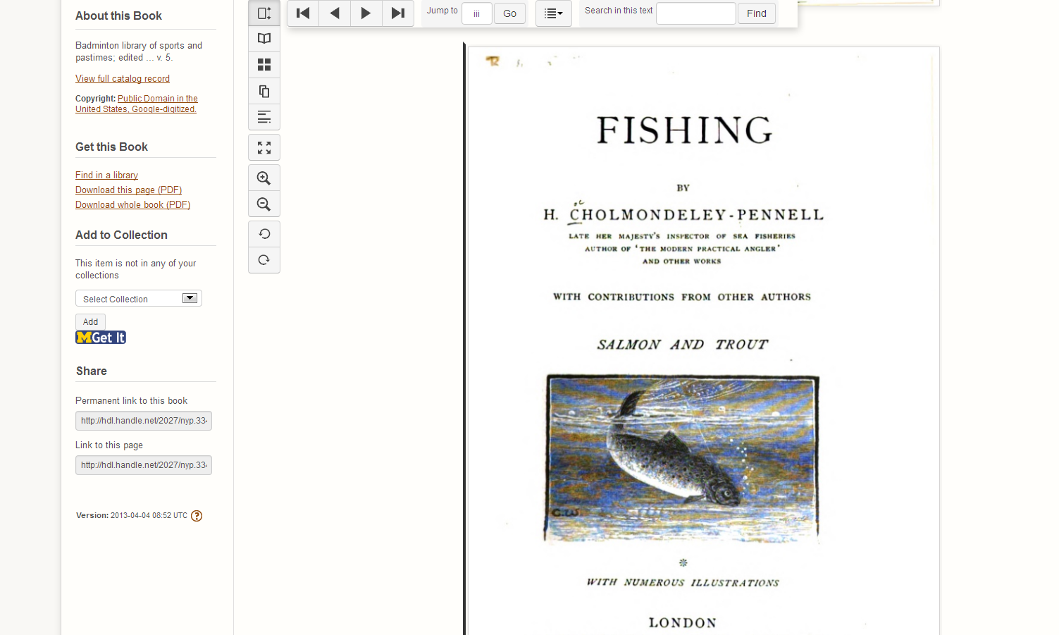
Notes:
In this instance Fishing is v. 5 of the Badminton Library of sports and pastimes. You can tell this is so from this half-title page…

Slide 8
Notes:
…here. The New York Public Library has chosen to keep all the volumes in the set together under the Badminton Library title. We do not second guess their decision. If the confusion is egregious, you can make a suggestion via HathiTrust Feedback that can be relayed to the originating library. The decision is then theirs as to whether or not to make any changes.

Slide 9
Last Thoughts
Please remember to check for series information before reporting errors:
Look at abbreviated record
Check the full MARC view

